Slide 1
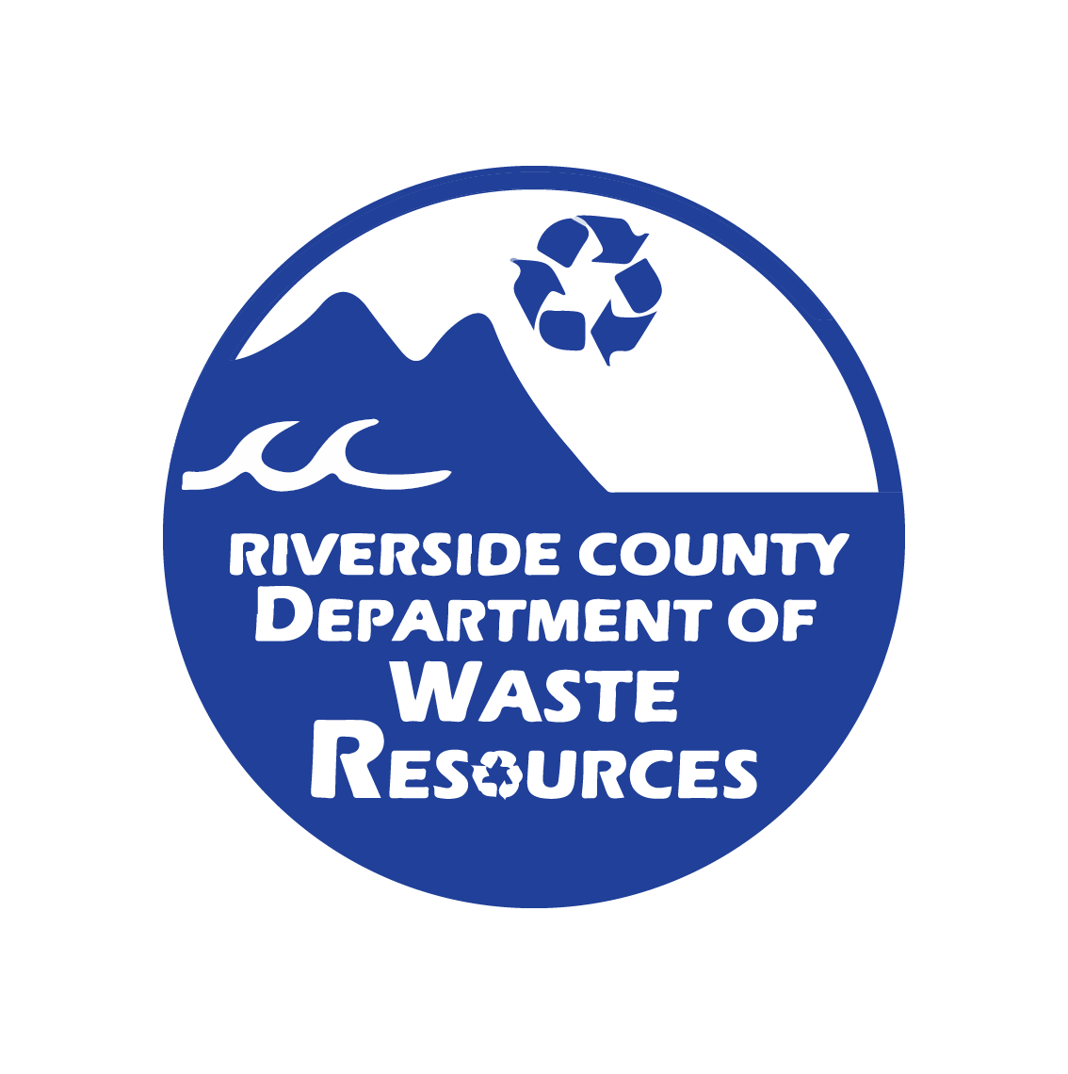
Sustainability 101
Riverside County, Department of Waste Resources Rivco Recycles Community Summit 2021 Day Three
Notes:
Good morning everyone! My name is Julian Brambila and I am a Recycling Specialist I with the Dept. Of Waste Resources. Welcome to my section of todays programming revolving around sustainability and how you can personally make an impact in your everyday life. Lets jump right into it!

Slide 2
Agenda
What is Sustainability?
Why is sustainability important?
How to be sustainable.
Notes:
Here is our main focus for this presentation.

Slide 3
Sustainability
"Meeting our own needs without compromising the ability of future generations to meet their own needs."
-Brundtland Commission, Our Common Future
Notes:
So what is sustainability:
Regardless of who we are, where we live, and what we do, we all have a moral obligation to each other, our future generations, and other species to sustain the planet and try and live sustainable lives. Our present choices and actions have huge long-term impacts on future generations and our planet. Practicing sustainability ensures that we make ethical choices that bring a safe and livable future to everyone. If we deplete the resources of the Earth, future generations will have to live with more scarricity of natural resources. For example, if we over-fish our oceans, we risk not only depleting the supply of fish, but also depleting the supply of every living organism in the food chain.

Slide 4
Notes:
Sustainability improves the quality of our lives, protects our ecosystems, and preserves natural resources for future generations. One way to make sure you're meeting the rate of sustainnablly that's essential for future generations is adopting and understanding zero waste practices and principles.
These three pillars also encompass the general mission of sustainability: people, planet, profit.
People: “people” refers to all possible stakeholders. This includes the company’s employees and shareholders, as well as its customers, affected communities and people at every stage of the supply line. It even includes future generations that may feel the impact of the company’s doings. We must ensure that all people affected by it will benefit in some way.
Planet: The various activities of a corporations and indivduals—from building new facilities to utilizing its supply chain—have monumental effects on the environment and our planet.
Profit: This is intended to encompass the overall positive or negative impacts of a company on the local, national and global economies.

Slide 5
Importance of Zero Waste
Less waste in landfills 91% of packaging waste is sent to the landfills and/or in the environment.
Conserves natural resources New products are made by extracting fresh, raw material from the Earth, through mining and forestry.
Less carbon emissions Every stage of packaging production emits greenhouse gases from manufacturing to transporting.
Less pollution of our air, water, and soil A truckload of plastic waste enters the ocean every single minute, endangering marine life and impacting human health.
Toxicity CEPA deems plastic as toxic due to its immediate or long-term harmful effect on the environment and its biological diversity.
Notes:
Why is sustainability and zero waste practices important. There are a few things to point out: #1 Less waste in landfills As we learned yesterday, Landfill space is limited. And as of now, 91 percent of packaging waste is sent to landfills or it ends up in our environment, like the ocean or in our conserved spaces and in our soil. So reducing single-use plastics would lighten the load for waste-management systems around the world and increase efficiency for the necessary waste needed for processing. Landfills are also very expensive to maintain and operate, even after they are closed down. There's lining, piping, constant oversite, upkeep, and engineering involved. So decreasing the amount of trash in landfills enables landfills to have an extended life, ultimately saving a lot of money and resources. #2 Zero waste conserves natural resources by decreasing our need to extract the raw materials that go in to creating and manufacturing packaging in the first place. When products at the store are purchased and taken off the shelves by consumers, new products need to be created and manufactured to continuously replace those purchased items. And with every new item, materials and resources have to be extracted and sourced one way or another again, through oil, coal, mineral mining or logging to replenish those purchased items, as well as all the packaging for those items. Therefore, by reusing what we have, we will minimize our need to buy new products, thus conserving the materials needed to produce and replace purchased products. Let's not forget that landfills were once natural lands and habitat for wildlife. So zero waste preservaces natural lands so these spaces remain places where we can visit and enjoy the great outdoors.
#3 Zero Waste means also Less carbon emissions and that's because a lot of energy is used during the manufacturing process as well as the transportation process of all those goods, and these processes emit tons of Greenhouse Gas Emissions along the way. 1.) extracting the raw materials uses a lot of energy and also produces GHG's (2). Transporting the raw material to the processing plant – that also adds GHGs (trucks, airplanes, trains, etc) (3) then once at the plant, the manufacturing process itself also emits GHG's (4) then there's all the transportation to the stores or to our doorstop. GHG emissions are created every step of the way when it comes to extracting, transporting and processing new products.
#4: Zero Waste means less pollution of our air, water, and soil
We just talked about how less products means less GHG emissions in our air, but it also effects our water and soil. For instance, packaging now accounts for a quarter of the 245 million tons of plastic that are used globally each year, making packaging the single most common use of plastic. And globally, only 14% of this plastic packaging actually get's recycled, while a third of it escapes collection entirely, leaving it to pollute our streets, beaches and oceans. So much so that it is estimated that a truckload of plastic waste enters the ocean every single minute. And plastic can take centuries to break down which is why it's so dangerous. In fact, The National Geographic sites that there are five trillion pieces of plastic in our oceans today – enough to circle the Earth over 400 times. Many of this plastic will remain for tens of thousands of years.
World Wide Fund for Nature: WWF International conducted a study that suggests every human consumes enough plastic a week to make a credit card and that's mainly because of microplastics getting into our soil and into our ocean and ultimately our dinner plates.
Lastly: plastic is toxic. Under the CEPA, a substance can be declared toxic if it has an immediate or long-term harmful effect on the environment or its biological diversity, or if it may constitute a danger to human life or health. The latest science suggests that plastics certainly do fit into this definition. In October 2020, Canada released a scientific assessment of plastic pollution and concluded that plastic pollution poses a significant risk to the environment and its biodiversity (although the risk to human health was found to be low).

Slide 6
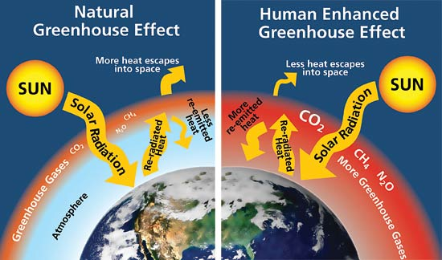
Carbon footprint
A carbon footprint is the total amount of greenhouse gases (including carbon dioxide and methane) that are generated by our actions.
– The Nature Conservancy
Reducing our consumption and using clean energy can lower individual carbon footprint.
Notes:
It is also important to understand that Human related carbon emmisions are largly responsbile for heating the planet. Like a green house keeps plants warm, greenhouse gases keep the planet warm. The greenhouse effect is a natural occurance which is actually vital to sustaining life on the planet, to a certain extent. Life on earth can only exist because of the perfect balance of greenhouse gases. Too mjuch, and we overheat. Too little, and we freeze. It is estimated that comparfed to pre-industrial revolution, Earth has gotten 1.2 to 1.4 F degrees warmer in just the last century. Though this might not seem like a big jump, if this trend continues, this will have massive negative implications for our life on earth as we experience more severe weather, global warming, and rising sea levels.

Slide 7
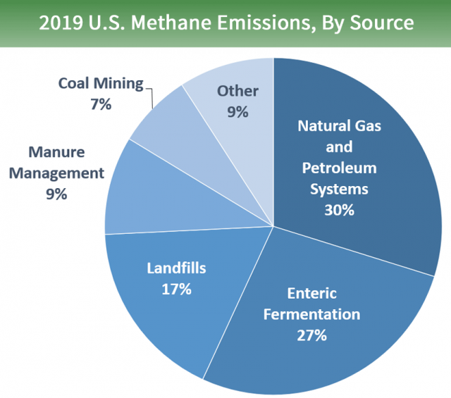
Where is methane coming from?
Methane, a green-house gas, is 20x more potent than Carbon Dioxide.
Notes:
We can be sustainable through our actions by first understanding where emmisions come from and learn how to tackle the main contributors. The largest source of greenhouse gas emissions from human activities in the United States is from burning fossil fuels for electricity, heat, and transportation. This is what "natural gas and petroleum systems" refers to. This encompasses processing facilities, manufacturing and transportation of goods across country.
The next one is Enteric Fermentation (which is a fancy way of saying Cow flactulents and belching). Emissions from cows and agriculture have been on the rise since meat manufacutirng has become a prominent and growing industry in the United States.
Next are landfills. In all settings, when food decomposes, it releases methane. Landfills unfortunately have large concentrations of methane since that's where all our trash ends up going.

Slide 8
Ways to be sustainable as a student.
Recycle / Reuse
Incorporate Zero Waste Tactics:
Food Rescue / Compost
Shopping
Wardrobe
Advocate for Environmental Policy
Notes:
There are some key things you can do to be more sustainable as an individual. We will dive deeper with the next few slides.

Slide 9
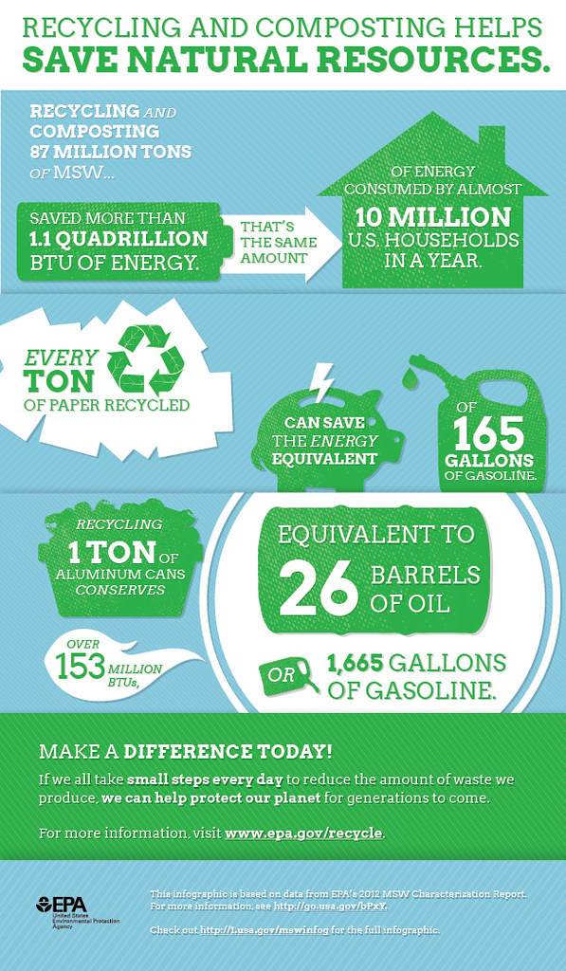
Recycle / Reuse
When we recycle, used materials are converted into new products which reduces the need to consume natural resources. If used materials are not recycled, new products are made by extracting fresh, raw material from the Earth, through mining and forestry.
Notes:
A very easy way to be sustainable as a student or as anyone – is to recycle. When we recycle, not only is less waste going to landfills, but it also puts that matieral back into the production line.
A main component of this is recycling to avoid using virgin materials in the production of goods. Using recycled raw materials (like recycling aluminum or plastic pallets) in a closed loop across the supply and manufactoring chain will help reduce out extraction for virgin materials, avoid more pollution, and decrease out energy output, and thus greenhouse gas emissions. This will also prevent the overfill of landfills since most of these items can be reycled over and over again.

Slide 10
Recycling Prevents
Notes:
Recycling relieves pressure off trees and forests – since recycling uses paper products that have already been produced, we avoid deforrestation and the harmful practives of wiping out entire forrests for materials.
If the current rate of deforestation continues, the world's rain forests will vanish within 100 years - eliminating the majority of plant and animal species on the planet and a large CO2 absorber which is one of the main greenhouse gasses.
It takes a lot of energy to create products. Reusing products and packaging prevents more product from having to be created, thus drawing down the need to mine for natural resources like coal, another large contribution of GHGs.
Another energy component is Oil. It is essential for creating plastic. The continuous use and purchasing of plastic, plastic products, and plastic packaging contributes to ongoing oil drillings efforts which has been a long-time contributor to pollution and oil spills which polllute our oceans and are particially hamrful for marine life.

Slide 11
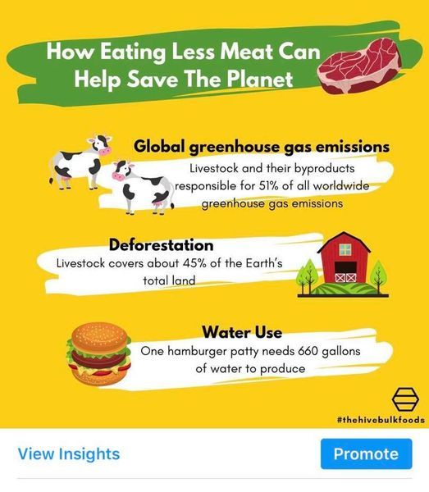
Incorporating a plant-based diet
Beef production is the top driver of deforestation in the world's tropical forests.
Just above landfills, Ruminants/cattle are the 2nd leading cause of human-related methane emmissions.
Notes:
One way to reduce carbon emmisions and conserve land and resources is incorporating a plant-based diet into your lifestyle. This might mean cutting meat out enitrely – or even practing something like meatless mondays. Beef production is the top driver of deforestation in the world's tropical forests. Livestock produce a lot methane and other gases that contribute to out Grenhouse Gasses. They are responsible for 51% of all worldwide greenhouse gas emisisons.
Did you know that one hamburger patty needs 660 gallons of water to produce if you take into consideation the water needed to keep cows hyrdrated as well as the water it takes to grow their food.
just above landfills, livesotck and cattle are the 2nd leading cause of human-related methane emmissions. Think cow poop!!

Slide 12
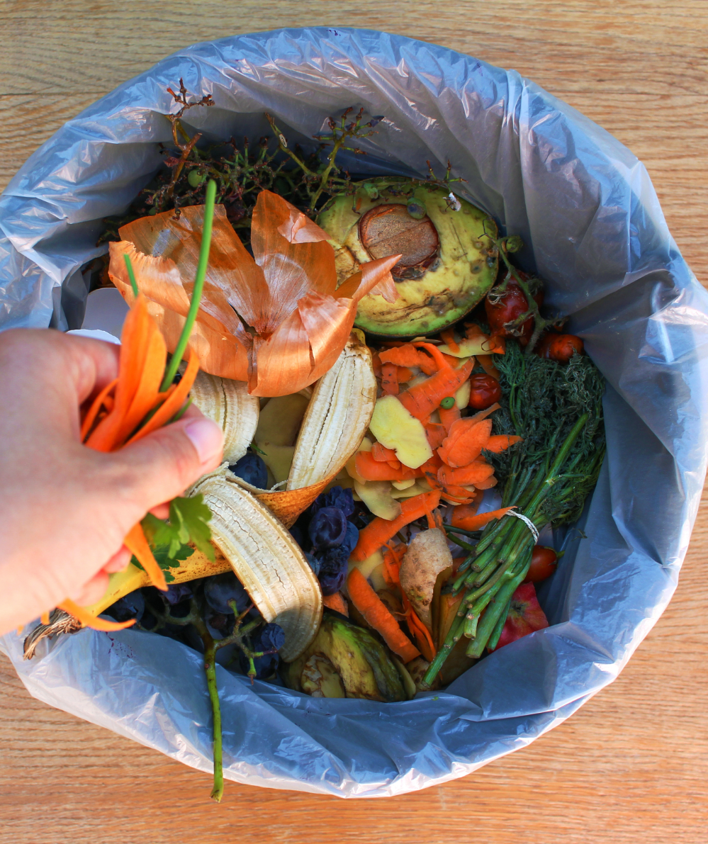
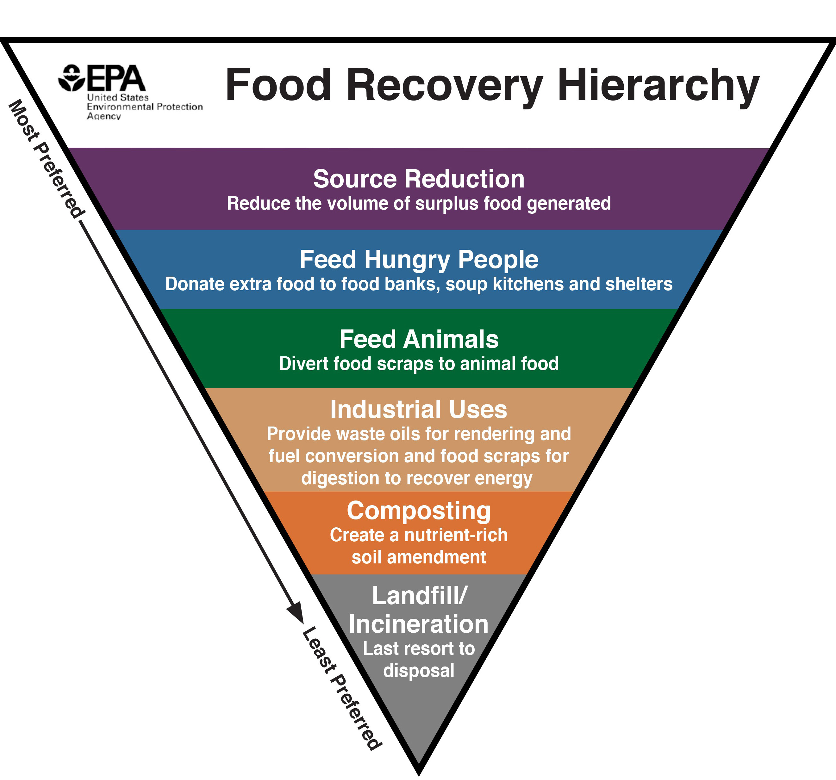
Food Waste
Landfills are the 3rd largest methane emitters in the world.
Prevent food waste by:
Eat your whole meal
Eat your leftovers
Compost / garden
Buy less food
Notes:
Another sustainability tool is combasting food waste. A large part of why Landfills are the 3rd largest methane emitters in the world is because we throw away a lot of food waste that just ends up in the land fills. Wether this be food that was perfectly good to eat or food scraps from when you prepared dinner the other day, food waste and food scraps decompose quickly and emit harmful gasses into the atmosphere.
EPA's Hierarchy Triangle points out a few ways we can reduce food waste. This includes:
Source reduction: buying less food in the first place
Feeding food insecure people: soup kithcens, donations, etc.
Feeding food scraps to animals and livestock.
Composting, the natural breakdown of foodscraps can be turned into compost or mulch.
And finally, the last resort is landfill. This should be the very last option and not the first thing we turn to when we have food waste.
Smaller and simpler steps:
Eating your whole meal
Keeping your leftovers to eat the next day.
Composting foodscraps.
Buying less food and pre-planning your meals out in advance.

Slide 13
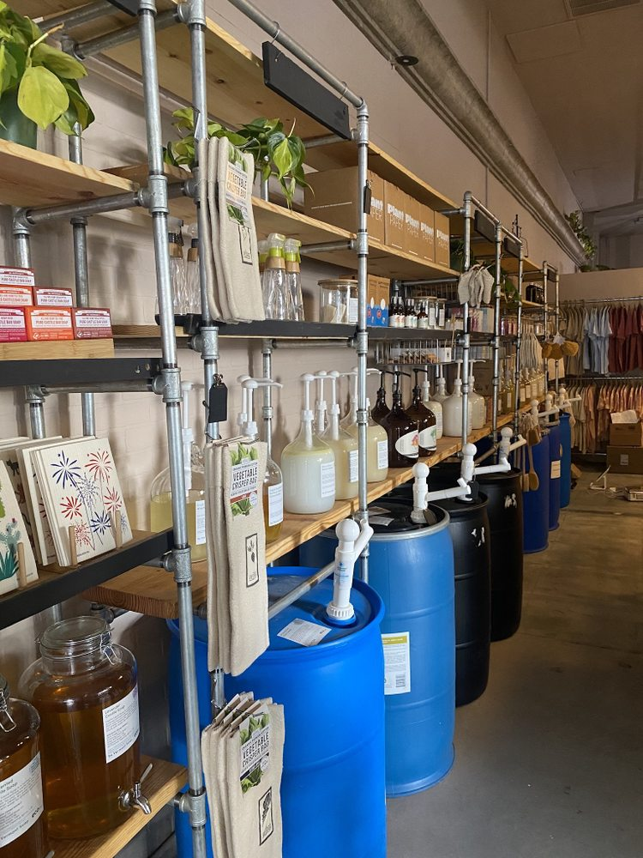
Go Zero Waste Grocery Shopping
Avoid Plastic & Styrofoam
Choose aluminim, glass, or paper
Buy larger containers
Buy imperfect
Buy in Bulk
Eco-Now (3521 Main St, Riverside, CA 92501)
Notes:
Avoid plastic. . Though it is possible to recycle plastic bottles back into plastic bottles, few recycling plants have the capabilities to do so.
When plastic is recycled, their structure becomes weaker, unlike metal, glass, and paper. As a result, most plastic are down-cycled into fiber for clothes, fleece, fluff for insulation, park benches, carpeting or drainage pipes etc.
Even then, the quality of recycled plastic is often not good enough for even textiles. That is why we want to try and avoid plastic use alltogether.
Buy larger containers:
Most bulk purchases have significantly less packaging per use than smaller purchases have. Jumbo packs of toilet paper, for example, are covered in one layer of plastic wrap, whereas individual smaller packs have just a few rolls covered in plastic.
This translates into almost all packing. The more there is inside, the less packaging. Buying in bulk prevents excessive use of plastic and actually saves the constumers time and money.
Buy imperfect:
Imperfect foods that look wonky or are bruised might not look the same but tastes the same. Especially if it’s being cooked, chopped or made into a desert or smoothie. But imperfect foods at the grocery store are always more likely to not be picked up and therefore more likely to get thrown out and the end of the day and wind up as food-waste in a landfill.
Buy in bulk:
Buying in bulk means you're using your own containers to fill up on food or cleaning products. That way, no excess packaging is being created. Stores like Eco Now located in downtown Riverside allow you to bring and weigh your own container, fill up on product then pay at the register for a 100% free plastic transaction. Plus, weighing is necessary so you're only paying for the product and not the weight of your container.

Slide 14
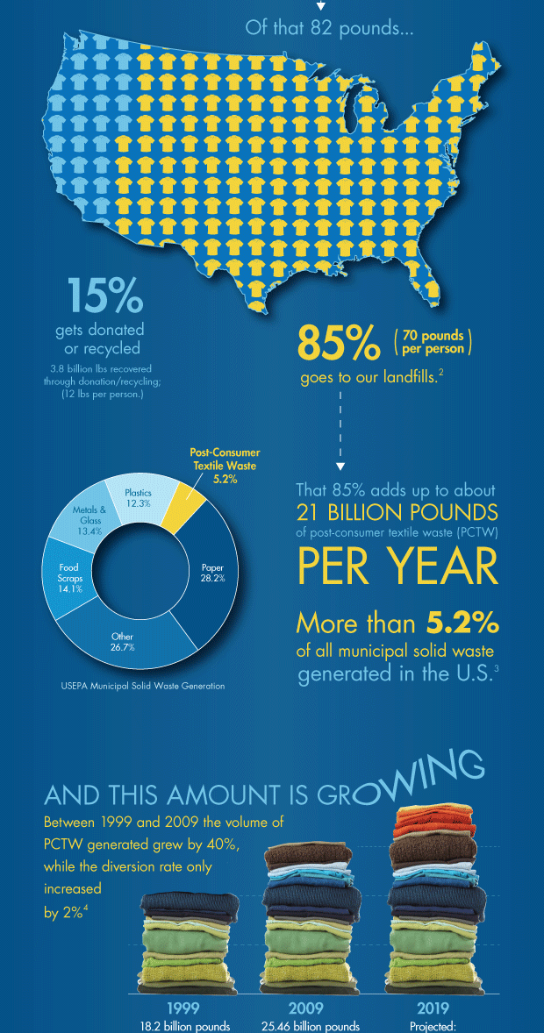
Wardrobe
The U.S. generates an average of 25 billion pounds of textiles per year.
According to the Council for Textile Recycling, the average US citizen throws away 82 pounds of clothing and other textiles annually.
Textiles make up just over 5%
of all municipal waste.
Notes:
Your wardrobe is also a significant part of our waste output. Every year, the US generates over 25 billion pounds of textile waste per year. This averages out to 82 pounds of textile waste per person per year. This waste trendline continues to grow and will become a larger part of our wastestream as more fast fashion is producing cheaper quality goods at a cheaper price, leading people to buy more clothes more often.

Slide 15
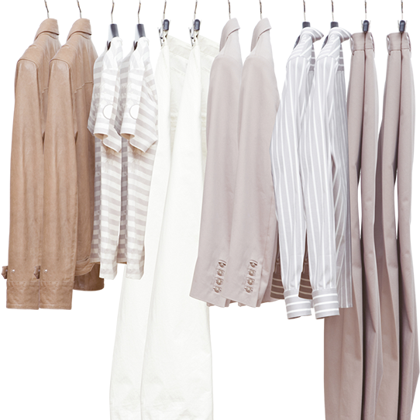
How to avoid textile waste
Buy Second Hand
Clothing swaps
Donate/ sell instead of throwing them away.
Make into rags
Notes:
Some ways to combate textile waste in our wardrobe is quite easy and very cost effective. You can buy second hand at thrift stores, flea markets, or even garage sells. Many of these second hand places offer unique finds for a great value, you would be surprised what you can find. You can also do clothes swaps, this is something we did a few months ago in our department. We had employees bring 5 clothing items, and in return, they could swap that out for another 5 items that other staff members brought.
Even if you think of piece of clothing is ugly, out of style, or does not fit, someone out there would love it. Instead of throwing away clothes you don’t like, donate to your local thrift store or even try to make a few dollars and set up a garage sell or sell on an online used clothing platform like DePOP.
For really torn or used textiles, you can turn those into cleaning rags to mop or clean surfaces, saving you money and a trip to the store. *dad old towel story*

Slide 16
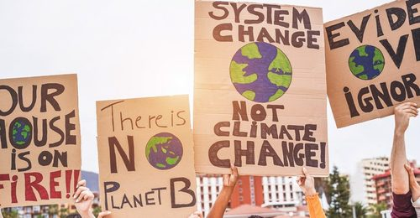
Advocate for Environmental Policy
Policies addressing water and air pollution & wildlife protection EPR – Extender producer responsibility
Clean Renewable Energy Infrastructure
Notes:
Lastly, advocate for Environmental policy! This takes the form of petitions & voting for policies addressing water and air pollution, smog, drinking water quality, land conservation. and wildlife protection, protection of endangered species and other local environemental issues. Don't be afraid to get involved with local organizaions, even if you are just there to learn and support there efforts. Everyone should have an equal say in advocating for environemental policy.

Slide 17
Thank You!
Please visit our website or social media sites for more information.
Notes:
So that about wraps up my presenation, are there any questions? I hope yall learned a thing or two.

