Slide 1
RivCo Recycles Community Summit
Campus Sustainability: Zero Waste November 2021
Francis Mitalo & Richard Zapien UC Riverside

Slide 2
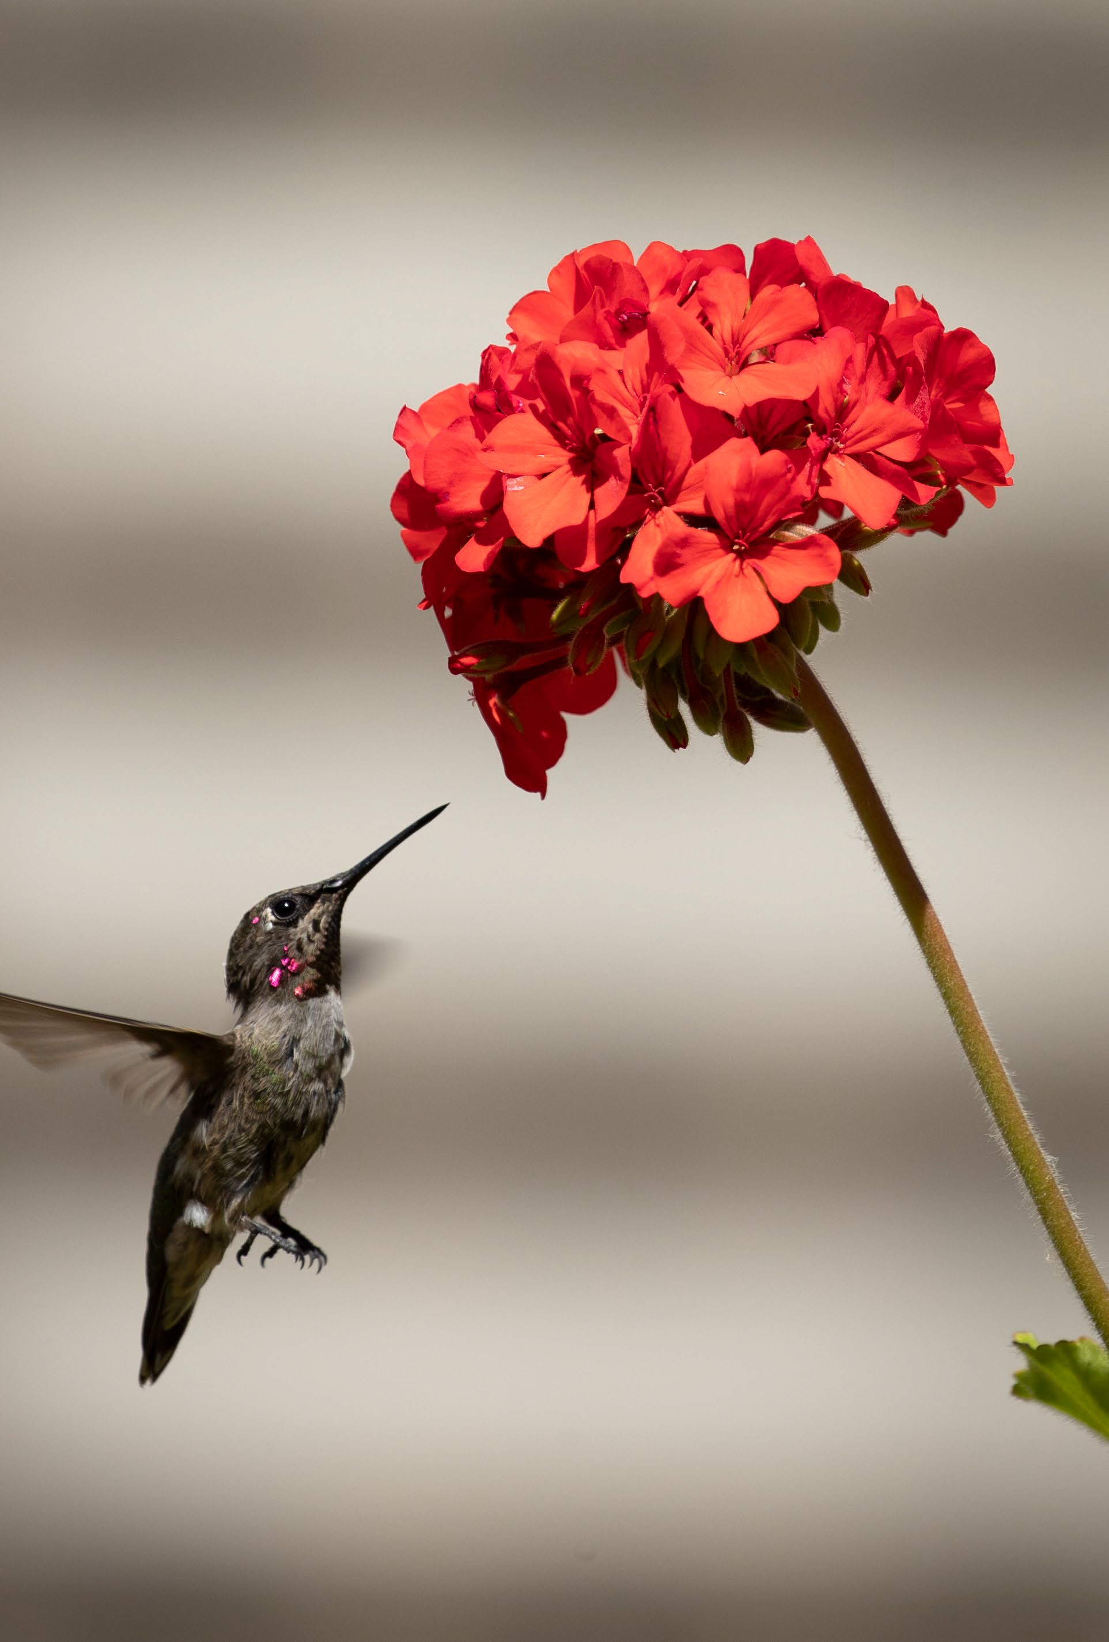
Welcome & Introduction
Academic and policy investments that support ecological health and investigate interconnections among the economy,
social wellbeing, and the environment
Environmental justice, encompassing a commitment to confront environmental racism, promote equity and advance transparency
Economic decisions aimed at secure livelihoods, social justice, and a better world for all generations

Slide 3
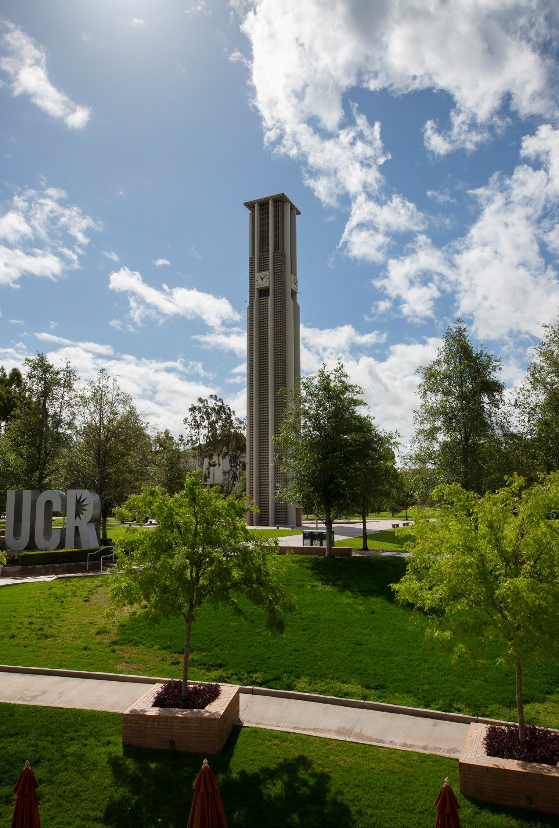
Carbon Neutrality Goal by 2025 UCR Sustainability Policies
Greenhouse Gases
Zero Waste
Campus Engagement
Green Building Design
Clean Energy & Climate Protection
Sustainable Transportation Building & Lab Operations
Sustainable Procurement Sustainable Foodservice Water Systems
Zero Waste
General Sustainability Performance Assessment
Academic Sustainability Environmental Justice
https://ucop.edu/carbon-neutrality-initiative/index.html

Slide 4
But what is Zero Waste?

Slide 5
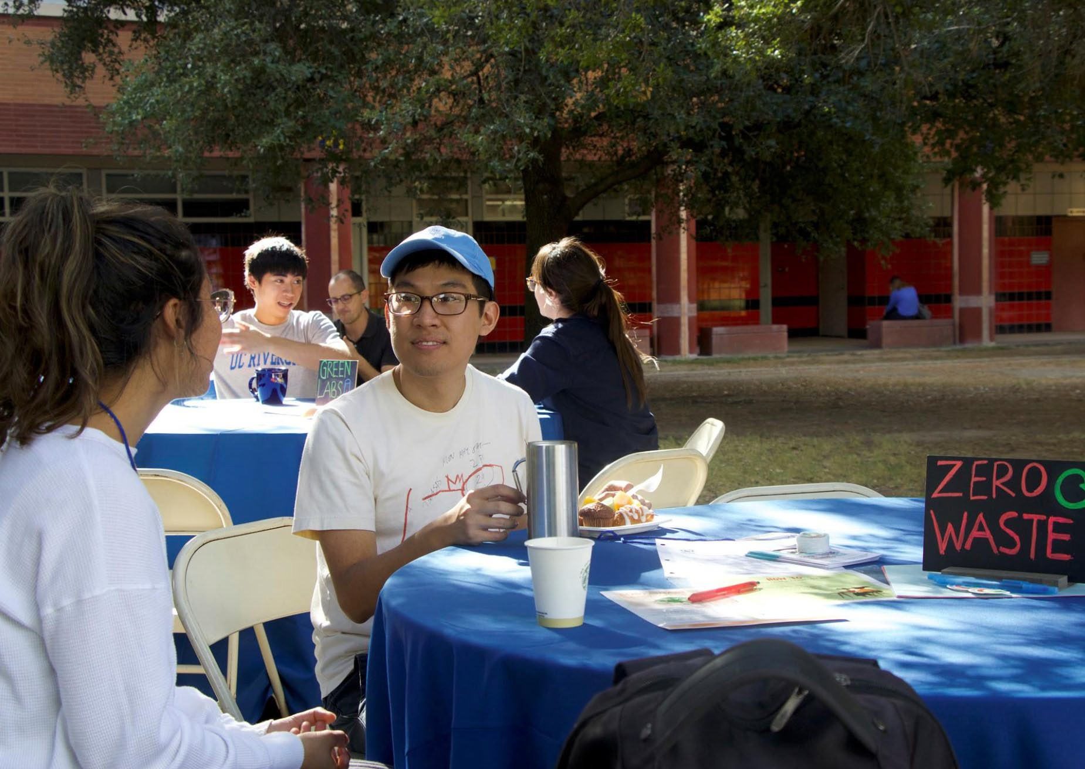
UC Definition - Zero Waste
The University’s zero waste goal is made up of incremental waste reduction and waste diversion targets.
The university recognizes the attainment of reduction goals stated in this policy and a 90% diversion of municipal solid waste as minimum compliance standard to be defined as zero waste for locations other than health locations.
- UC Policy on Sustainable Practices, p. 8

Slide 6
Ze ro Wa ste Ap proaches
Policy Are as
Decrease waste generated
Increase waste diversion
Track GHG emissions
Phase out single-use items

Slide 7
Ze ro Wa ste Ap proaches
Policy Goa ls
25% reduction per capita from FY 2015/16 levels by 2025
Divert 90% of waste from landfills
Zero GHG emissions by 2050
Complete phase out of
single-use items by 2023
50% reduction per capita from FY 2015/16 levels by 2030

Slide 8
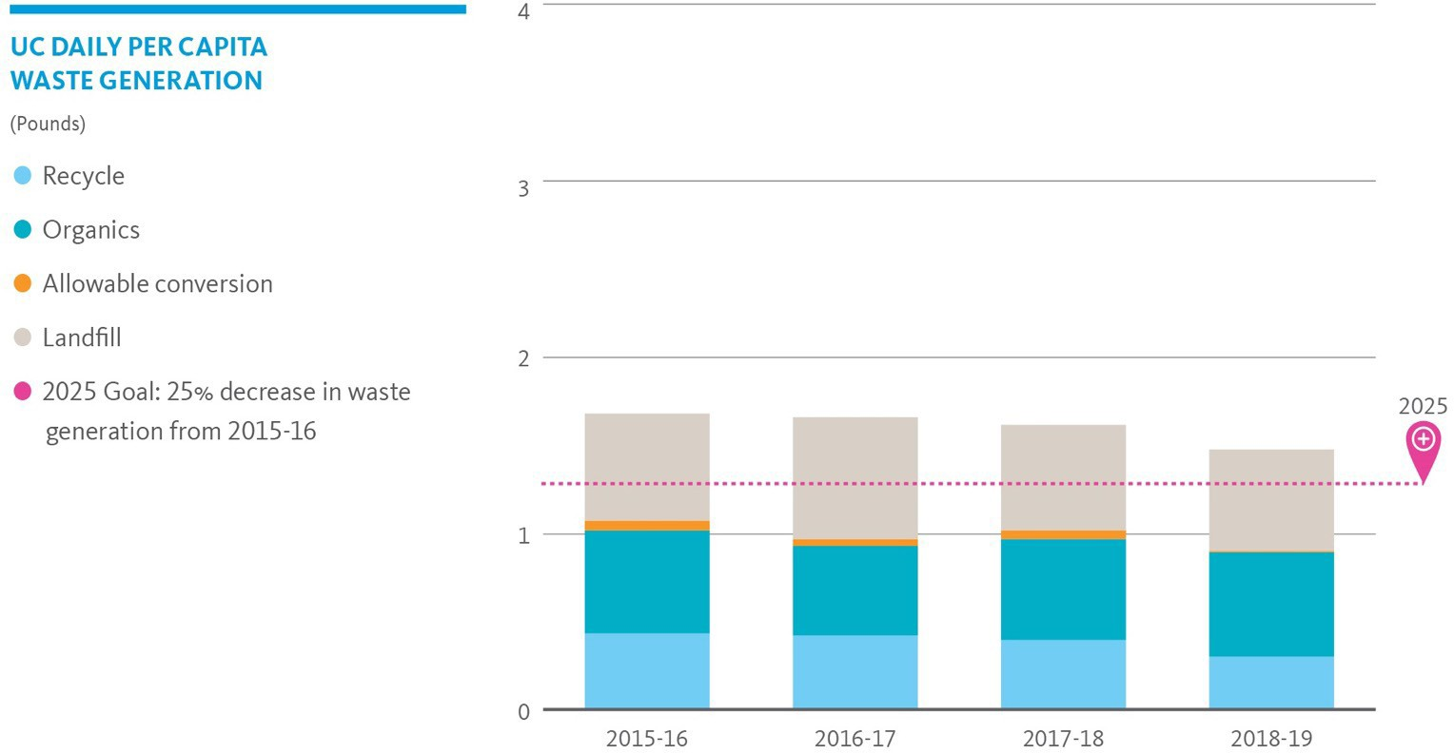
Systemwide Efforts: Waste Generation

Slide 9
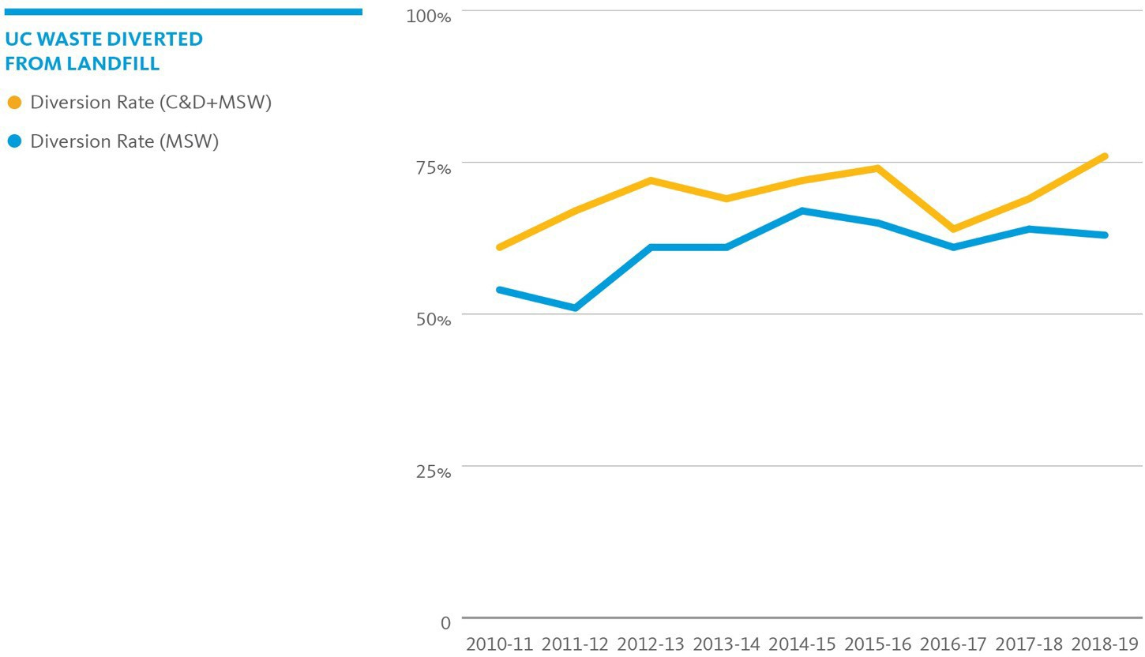
Systemwide Efforts: Diversion

Slide 10
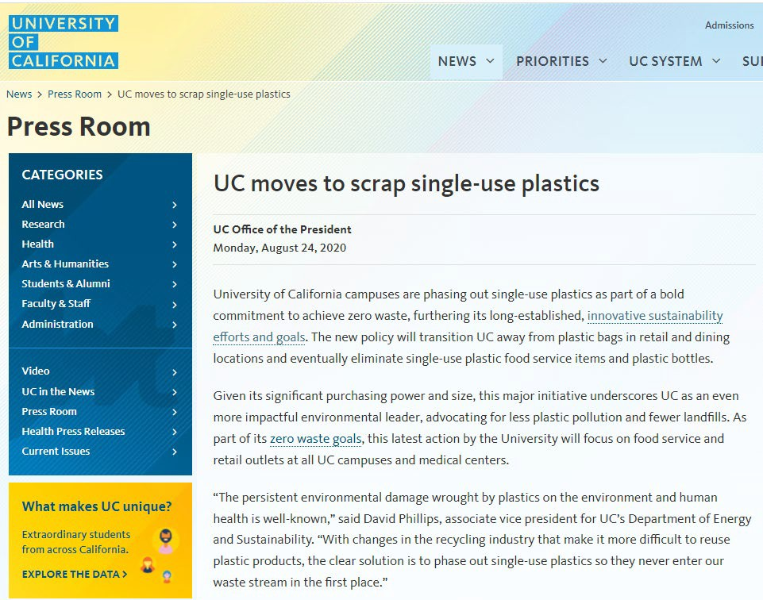

Slide 11
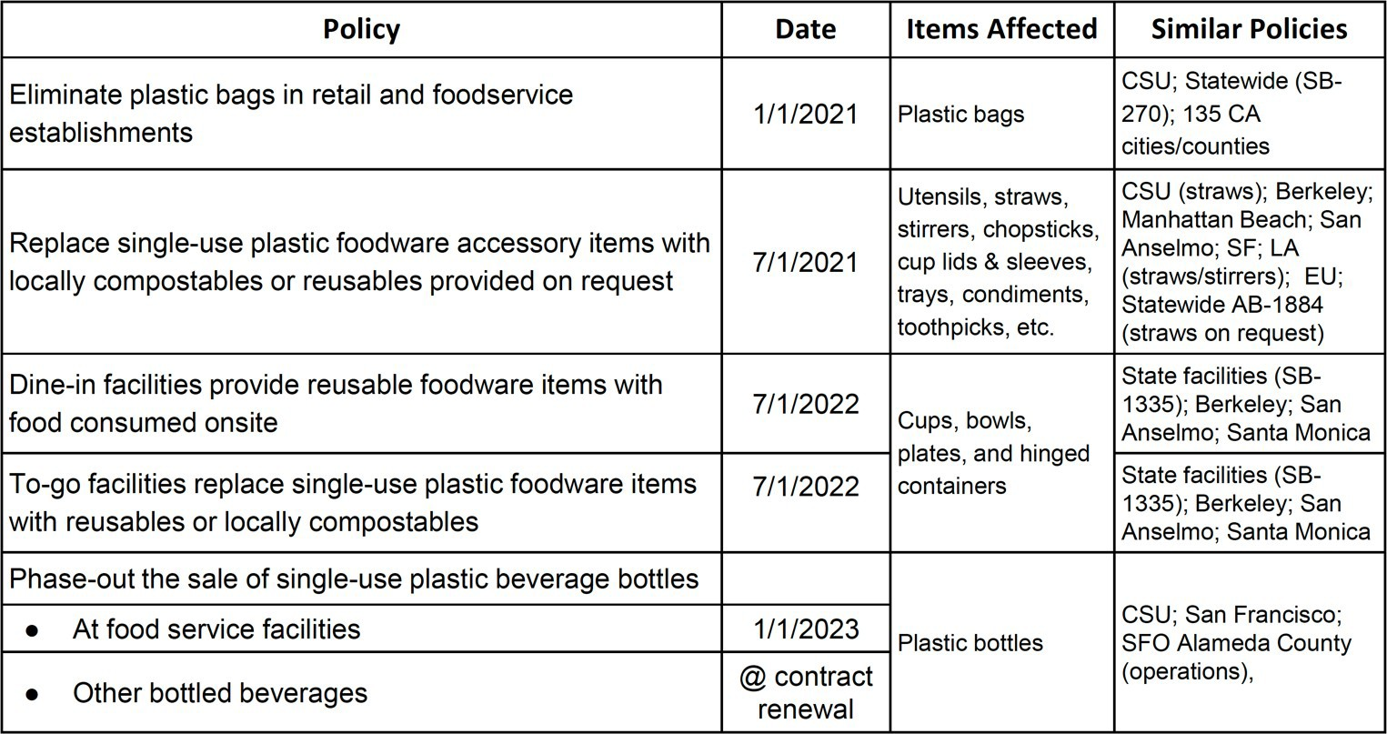
Summary of Single-use Plastic Policy Changes
https://www.universityofcalifornia.edu/press-room/uc-moves-scrap-single-use-plastics

Slide 12
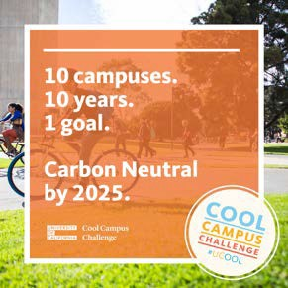
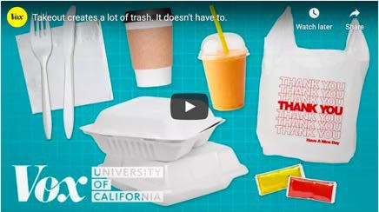
Systemwide Ed ucation and Enga gement
Vox & UC Collaboration Created 9 videos covering single-use & food waste along with other climate topics, Currently, there are over 19.2+ million views in total.
#MyLastTrash Campaign Created outreach toolkit for each campus to use for consistent messaging across the system.
Cool Campus Challenge Systemwide web-based challenge where individual climate actions are tracked in a point system.
https://www.universityofcalifornia.edu/climate-lab

Slide 13
UC Riverside’s Zero Waste Efforts

Slide 14
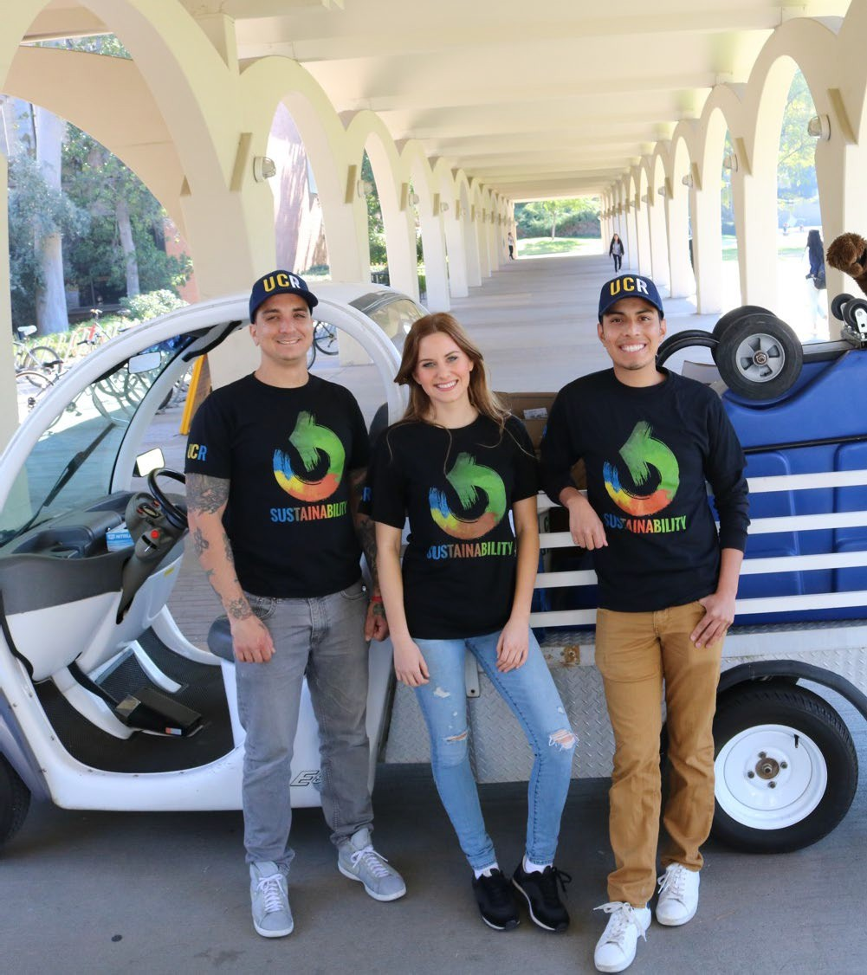
UCR Facilities Services
Zero Waste Office Stations to increase
sorting and reduce collection time.
Big Belly’s reduced collections by 89%.
30+ hydration stations installed across campus; help reduce single-use plastic water bottle waste.
Student Recycling Program to increase collection frequency in high traffic areas – Affected by COVID 19.
Coffee grounds pick up and drop off at the R’Garden – Affected by COVID 19.

Slide 15
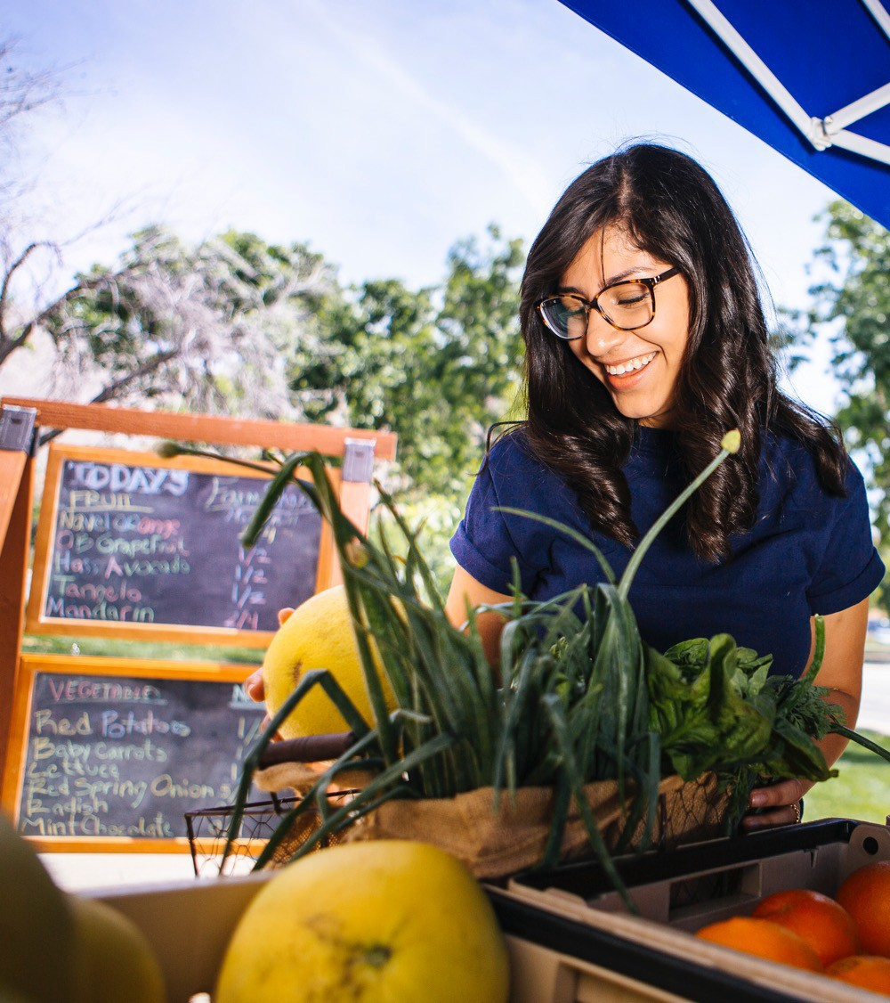
UCR Dining Services
Switched to compostable plate ware
materials in 2009
Implemented trayless dining in 2009 reducing food waste by 50% in Dining Halls
Conve nience stores changing their #1 selling item, water bottles, from plastic to aluminum.
Ve nding machines will convert to aluminum
Worked with Subway to convert from plastic bag to paper bag.
The new Barn will feature reusable plate ware for dine in guest

Slide 16
UCR’s Zero Waste Progress: Waste Generation
UCR Municipal Solid Waste Per Capita in Pounds by Academic Year
1.04
1.03
1.01
0.85
Pound s
0.74
2015-16
2016-17
2017-18
Academic Year
2018-19
2019-20

Slide 17
UCR’s Zero Waste Progress: Waste Diversion
Total Municipal Solid Waste Diversion In Tons By Academic Year
10,000
90%
9,000
80%
8,000
70%
7,000
60%
6,000
Diversion Rate
50%
Ton s
5,000
40%
4,000
3,000
30%
2,000
20%
1,000
10%
0
2010-2011 2011-2012 2012-2013 2013-2014
Organics Landfill
2014-2015
WTE
2015-2016 2016-2017 2017-2018 2018-2019
Total Waste Generation Diversion Rate
0%
2009-2010
2019-2020
Recycled

Slide 18
UCR COMPOST SITE
Richard Zapien R’Garden Manager 2021

Slide 19
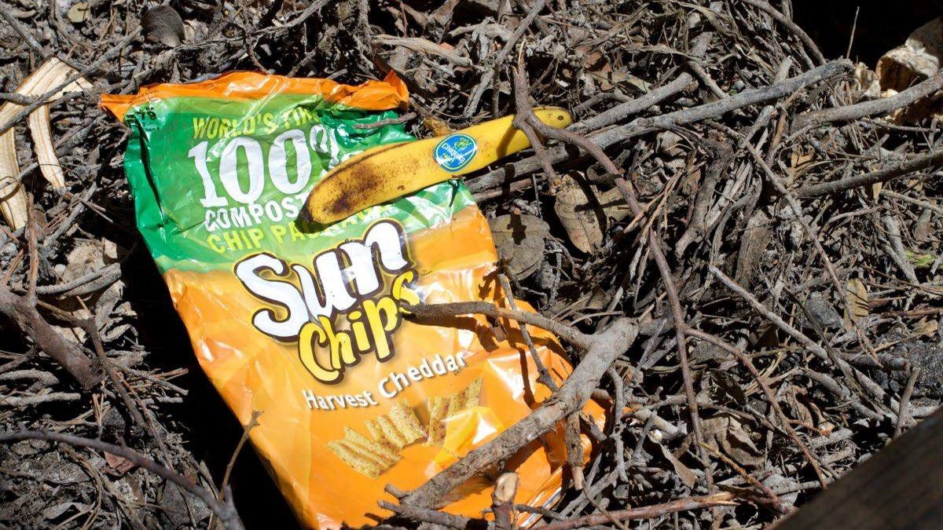
Cleaning of the green waste
When the green waste is received from
campus, it comes with trash and the
R’Garden interns start the cleaning
process. It takes 5 interns about 8 hours
to clean out trash from about 20 loads.

Slide 20
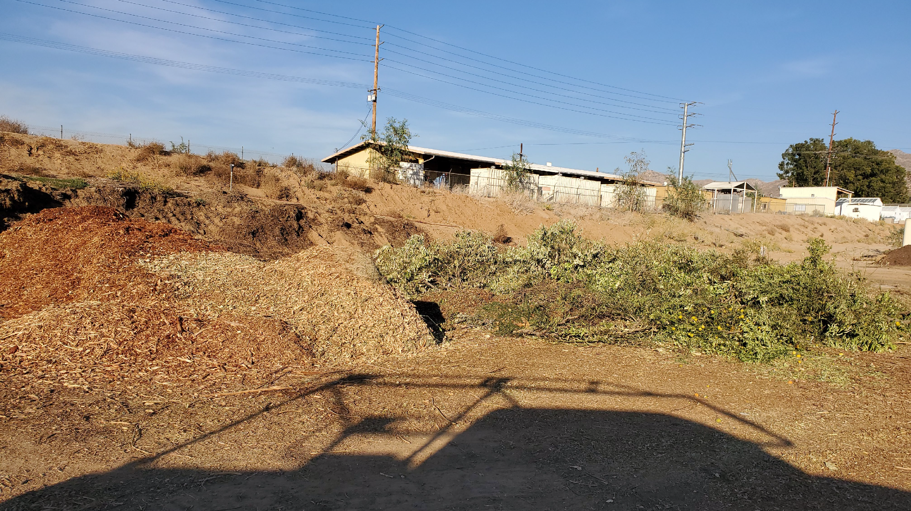
PROCESSING OF THE GREEN WASTE
Material is chipped and stockpiled till we have enough material to start the compost pile.

Slide 21
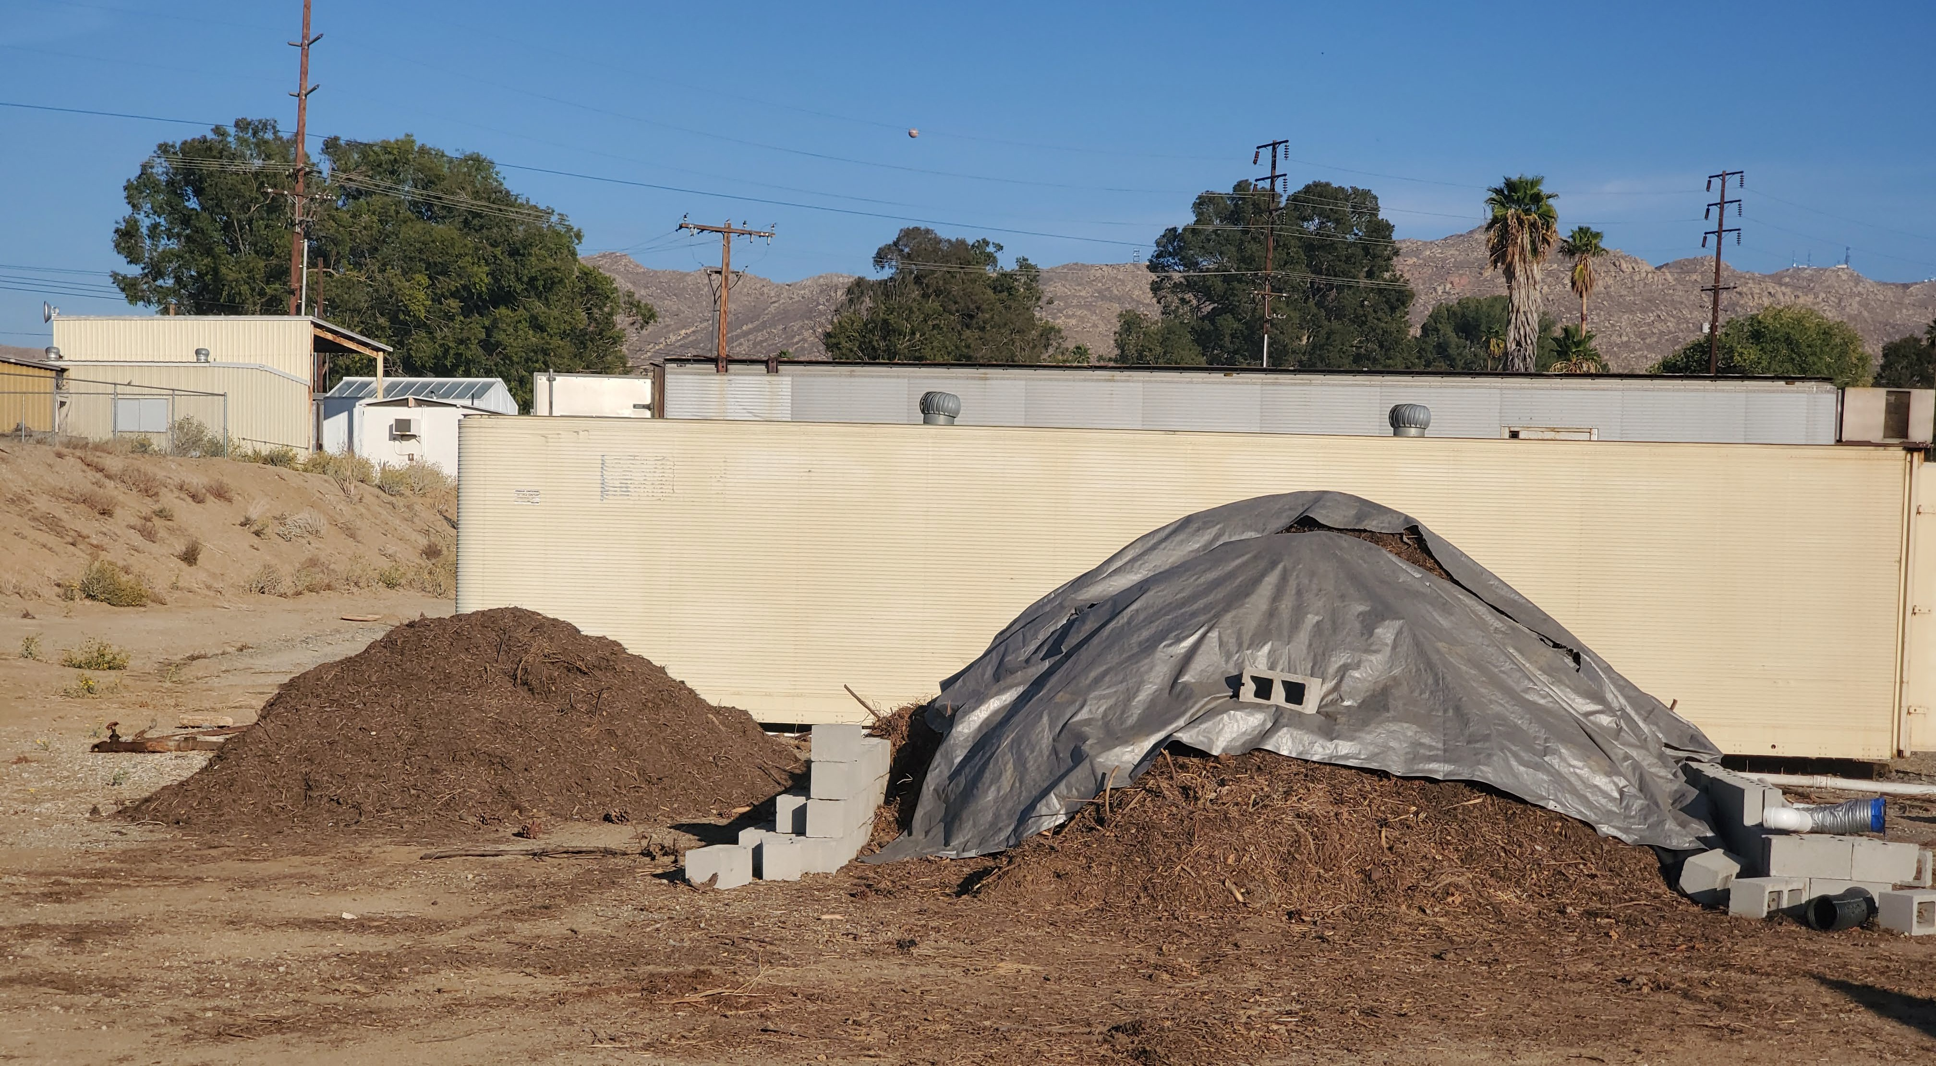
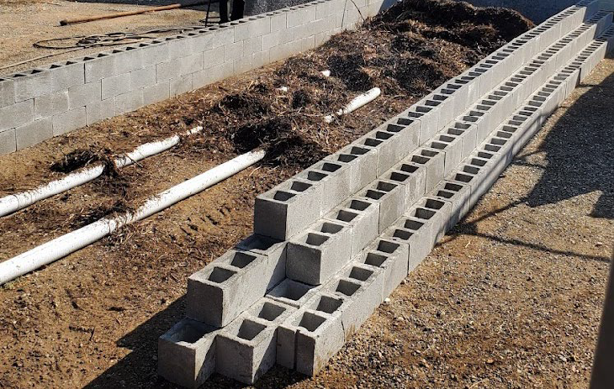
Air lines are set at the bottom of the pile to release air into the pile during composting. Normally we wait till temperature goes below 130 degrees F and call it complete.
Setting up the pile

Slide 22
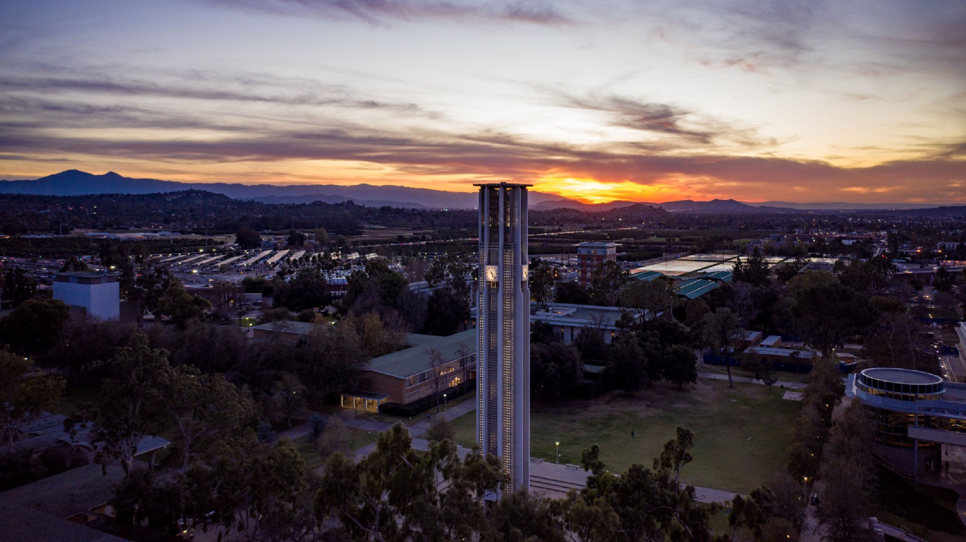
Q&A

Slide 23
Thank you!
Contact: Francis Mitalo
Sustainability Coordinator francis.mitalo@ucr.edu sustainability.ucr.edu
Contact: Richard Zapien
R'Garden Manager richard.zapien@ucr.edu rgarden@ucr.edu

