Slide 1
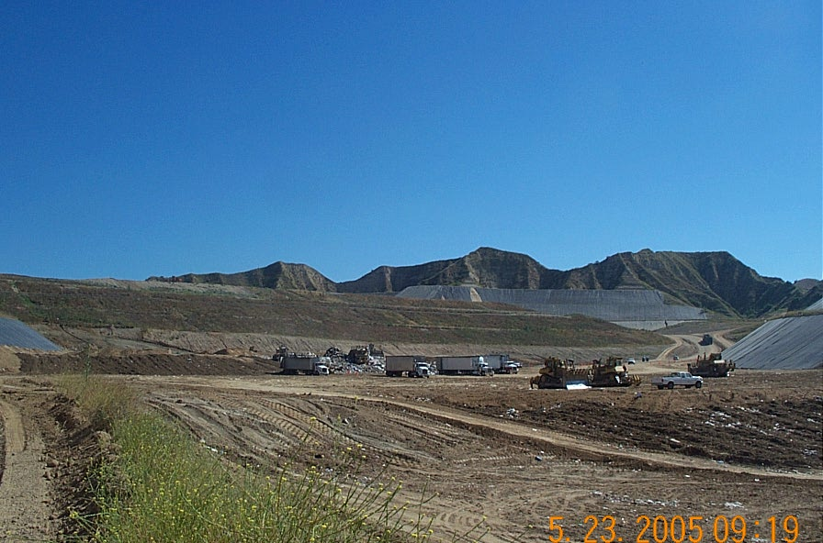
A Day at the Landfill
Notes:
Do you ever ask yourself – Where do things go when I don’t need them anymore?
It is very likely they will go to a landfill for a very, very long time. It is a storage vault for waste.
Riverside County operates 5 active landfills in the county: Badlands in Moreno Valley, Lamb Canyon in Beaumont, Blythe, Desert Center, and Oasis.
Today we are going to dig a little deeper in these necessary places for waste storage and learn that there is a lot more value to our waste and how important Riverside County landfills are to you.

Slide 2
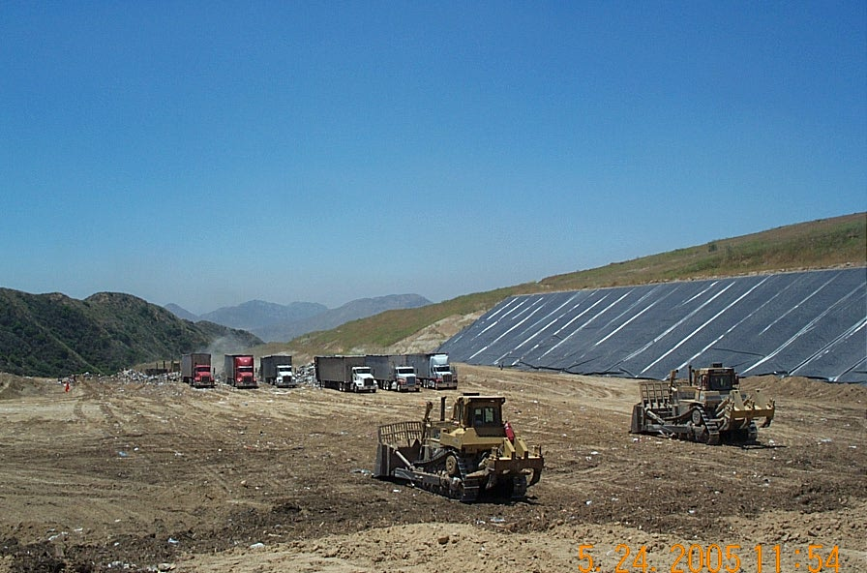
A Day at the Landfill
Notes:
Do you ever ask yourself – Where do things go when I don’t need them anymore?
It is very likely they will go to a landfill for a very, very long time. It is a storage vault for waste.
Riverside County operates 5 active landfills in the county: Badlands in Moreno Valley, Lamb Canyon in Beaumont, Blythe, Desert Center, and Oasis.
Today we are going to dig a little deeper in these necessary places for waste storage and learn that there is a lot more value to our waste and how important Riverside County landfills are to you.

Slide 3
Who Creates Waste?
Notes:
Who creates waste?
We all do.
At home, at work, at play, on vacation, when we make things, build buildings, do business, and many more life functions.
Imagine if you had to keep everything with you that you would normally throw away. You would end the day with a big bag of stuff. All the places that you visited would also have a big bag of stuff. We all have stuff…and aren’t we glad we don’t have to carry it around and keep it forever.

Slide 4
Where does my trash go?
Notes:
Do you evert think about where all that stuff goes? Are you sending the right things to the best place? How many of you have options to recycle?
These common curbside bins are tools to help you recycle easily and more.
Describe organic waste and where it goes
Describe recyclable material and where it goes. The importance of recycling to reduce contamination and the benefit of not filling up the landfill.
Lastly, the landfill - the last option…

Slide 5
Run video
VIDEO

Slide 6
Lamb Canyon Sanitary Landfill
Facts & Figures
Notes:
Read the facts

Slide 7
Lamb Canyon Sanitary Landfill
Facts & Figures
Located in the City of Beaumont, Riverside County
Service Areas: San Jacinto, Banning, Beaumont, Hemet
Coachella Valley
Permitted Maximum Daily Tonnage
Average Daily & Annual Tons of Waste
Notes:
MIKE Read the facts
Janet will tell you a little more about some of the unique programs that have been implemented at the landfill

Slide 8
Lamb Canyon Sanitary Landfill
Waste Recycle Park (WRP)
The WRP helps us reach the State of California mandated goal of
The WRP allows for collection and recycling of the
following materials:
Waste Recycling by 2020.
Notes:
JANET
We do have some features and programs at the landfill that we would like to tell you a little more about.
The Waste Recycle Park was developed to keep residential users safe and to make it easier to navigate unloading on a level pad. There are several materials that the landfill will accept that are recycled. These items can be dropped of at stations in the WRP on a daily basis.
However, when these items are commingled in the trash bin at the curb that goes to the landfill, we don’t sort through the garbage to separate them.

Slide 9
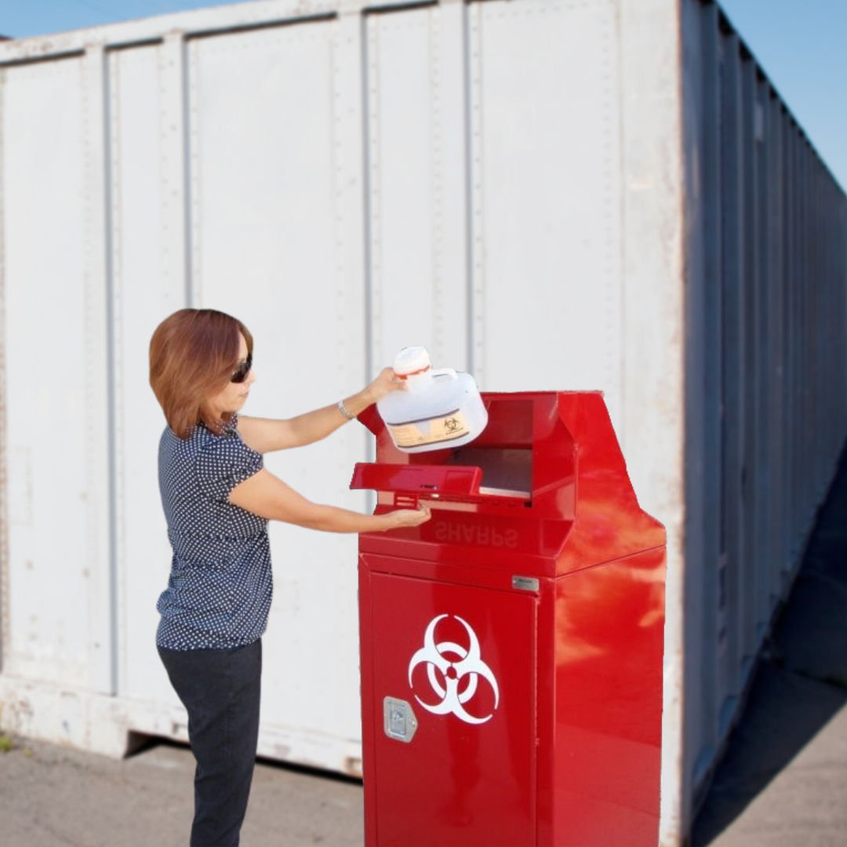
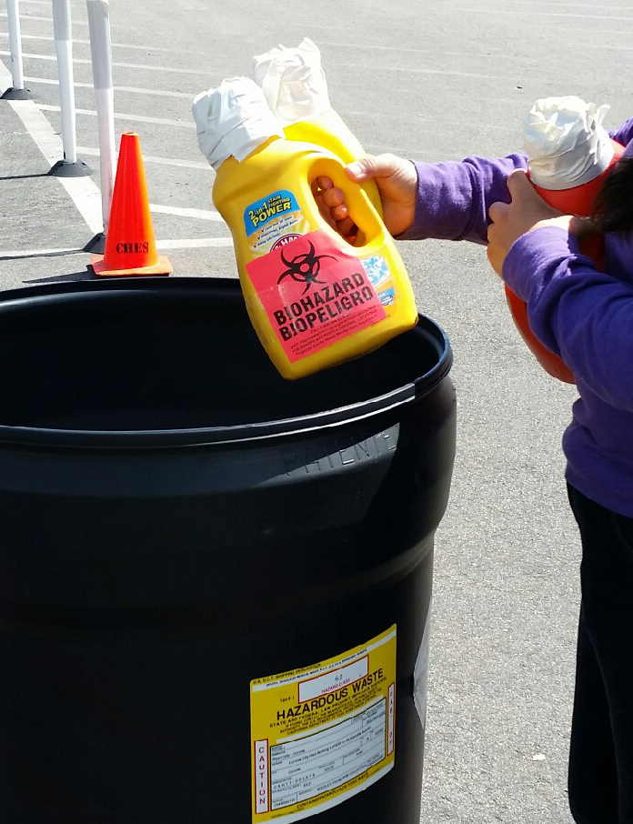
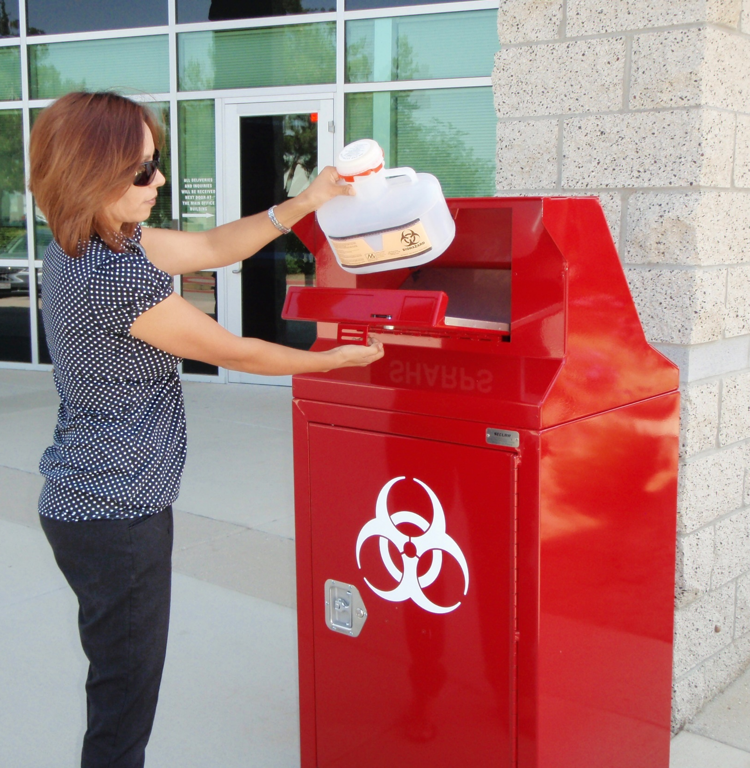
Sharps Disposal
Notes:
Sharps and needles in approved containers are accepted free at Lamb Canyon Daily.
Users can save money by making their own container out of a thick laundry detergent bottles, applying a sharps label, and taping the lid closed.
Do not use thin plastic bottles that may have contained food or water bottles.
Riverside County developed this program in 2008.

Slide 10
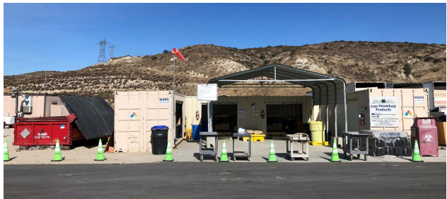
ABOP
Notes:
ABOP – Antifreeze, Batteries, Oil, and Paint, four of the most commonly used materials by households that contain materials that can be hazardous to the environment.
These items cannot go into the landfill and must be dropped off at the WRP for proper disposal. These items can be brought to the landfill daily.
Open daily during regular operating hours.
Additional ABOP locations can be found on our website

Slide 11
Hazardous Waste Control
Lamb Canyon Landfill has extensive programs that prevent landfilling of hazardous waste:
Household Hazardous Waste Collections
Waste Recycling
Hazardous Waste Inspection
Waste Approval
Notes:
Monthly HHW collections, THIRD SATURDAY OF THE MONTH
Waste inspectors check loads daily for items that must not go into the landfill.
If you have a material that you are not sure of, call the office or contact us for special waste approval.

Slide 12
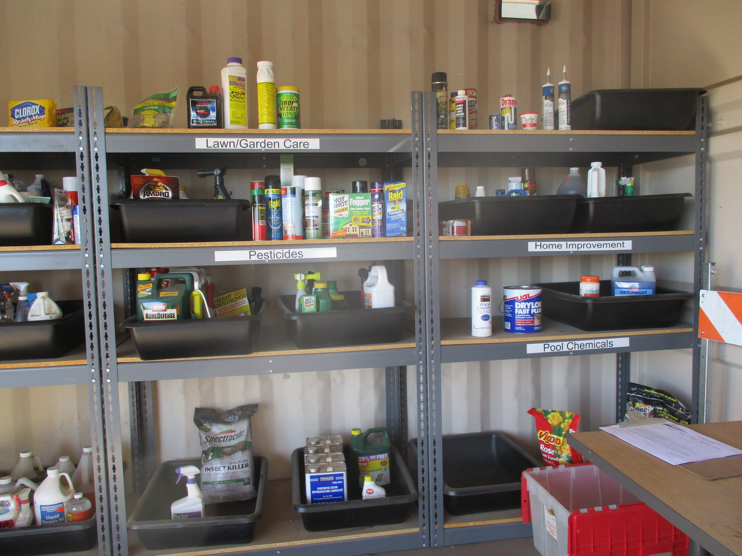
Drop & Shop
Notes:
Free Stuff at the Drop and Shop!
Good reusable items collected through HHW are set aside and are available free to residents and businesses.
Need a little paint for a project? Common materials are paint, cleaners, automotive fluids, garden fertilizer and weed killer, etc.
OPEN same day at Monthly HHW collections, THIRD SATURDAY OF THE MONTH

Slide 13
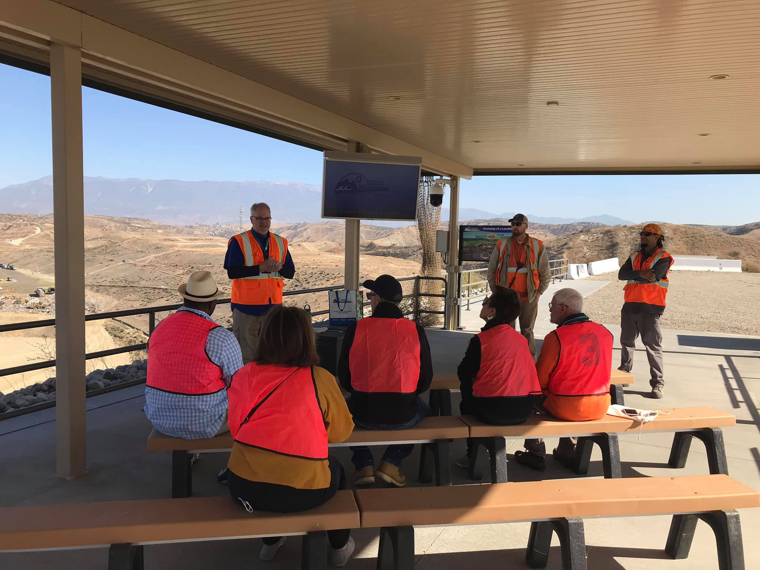
Education Center
Notes:
Education center host tours of the landfill from a safe observation area.
Built 2018
Retired Dozer for climbing, touching, photo opp
Schedule a tour for a group: https://www.rcwaste.org/outreach/educationcenter
Groups of 10 or more
March through October

Slide 14
California Gnatcatcher
Over 200 acres are conserved for a variety of sensitive plant and animal species
Burrowing Owl
Red-Tailed Hawk
Stephens’ Kangaroo Rat
Mountain Lion
Red-Diamond Rattlesnake
Western Sycamore
Notes:
Land has been conserved for native species like …
This conservation area is located at the entry to the landfill along Lamb Canyon Road

Slide 15
What Can I Recycle?
ORGANICS & GREEN WASTE
Did you know that most of California’s waste can be recycled?
Organic waste can be composted at home, we even offer classes to learn how.
Clean paper, plastic, glass, and metal can be thrown away in your curbside recycling bin.
We recycle E-waste at our Waste Recycling Park
Notes:
What can you do to conserve landfill space so we can make the landfill last longer and so we don’t have to build another landfill near your home
Be a better buyer - buy the right amount, think about the container or the waste it will create – is there a better option?
Be a better recycler – recycle more, recycle right. No wishcycling!

Slide 16
Lamb Canyon Sanitary Landfill Post-Closure Landuse Possibilities
What could happen when Lamb Canyon stops being useful as a landfill?
Notes:
Remember the bag of stuff that you would need to hold onto for a day, what would you do with it if there were no recyclers and no landfill?
With more recycling and less waste generation, we can extend the life of the landfill and hopefully in a few decades, it can be even more beautiful than it is now.
Optional questions to fill time:
Have you ever been to a landfill?
What changes will you make to generate less waste for the landfill?

Slide 17
www.rcwaste.org
Thank You
Notes:
Pleaase visit our website for your waste needs for home and business
Recycling information for home or buisness can be found on Waste Guide
Hazardous waste
Free classes
Volunteer Opportunities
Special events and programs
Request a speaker – we love talking trash
Thank you

