Slide 1
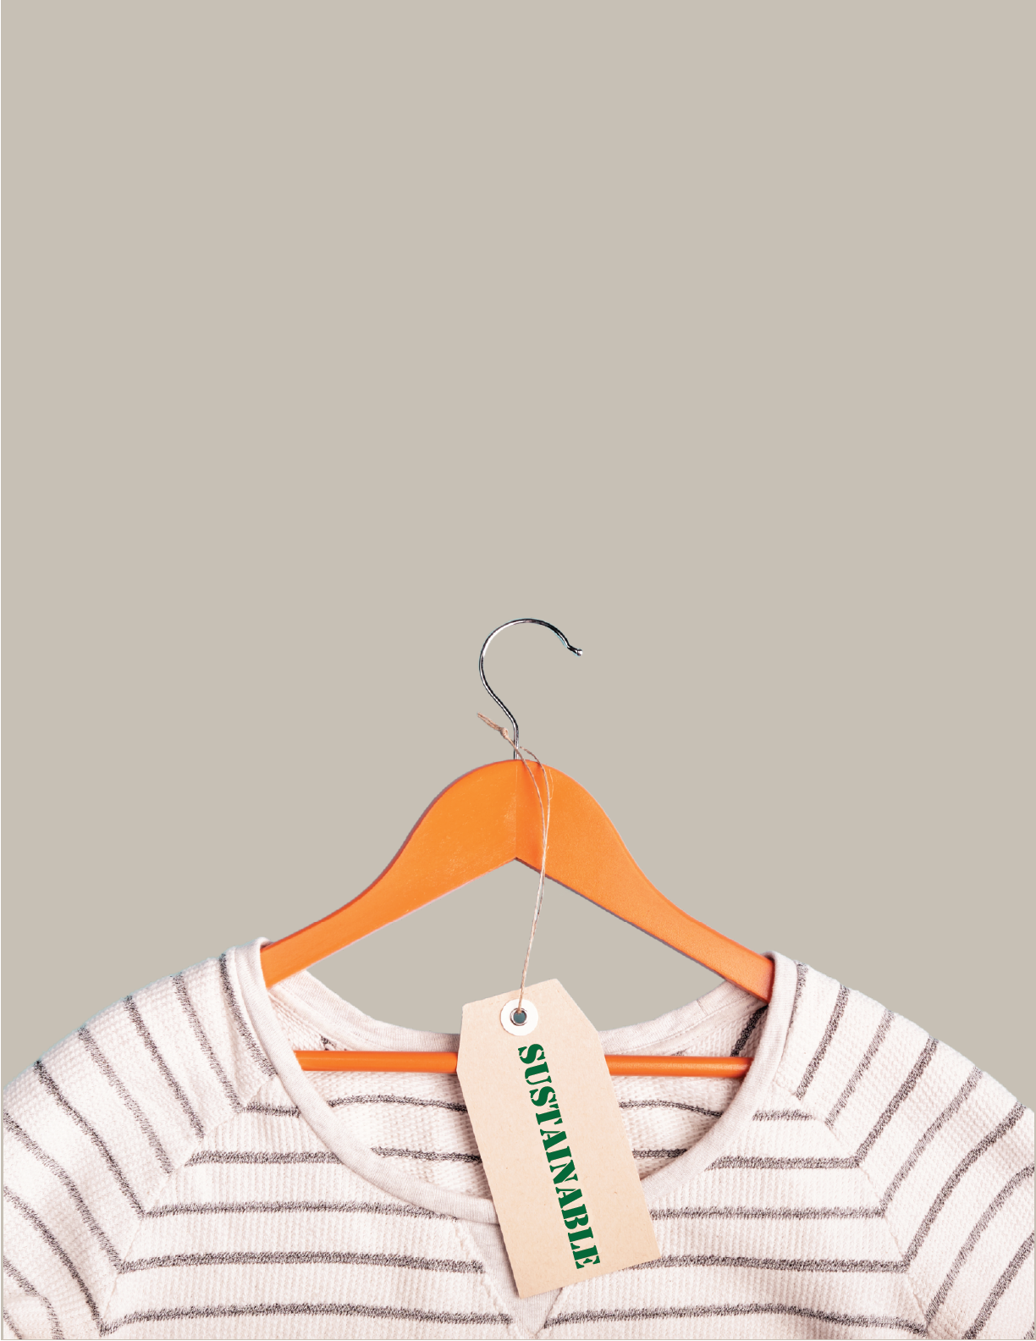
Green Wardrobe
Notes:
Good morning and welcome to Green Wardrobe! This class go over the environmental benefits of curating a green wardrobe. From extending the life of your current garments to changing your shopping habits, this class will provide you with solutions to closing the loop on textile waste and making the most of your sustainable closet.

Slide 2
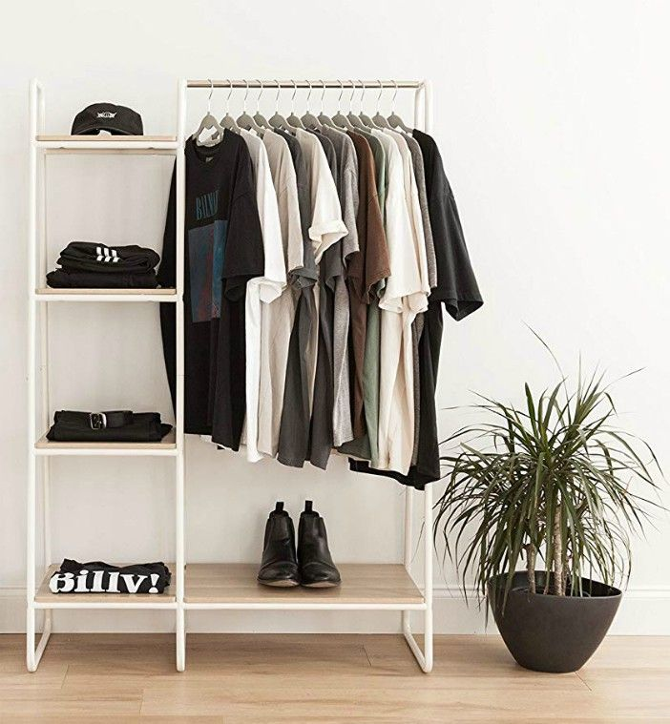
Agenda
01
Introduction
02
The Problem
03
The Solution
04
Questions
Notes:
Here is our agenda for today, we will be going over an introduction, the problem with textile waste and some solutions to combat that waste, then we will wrap it up by answering any questions.

Slide 3
01
Introduction
We are the Department of Waste Resources
Notes:
Just a quick introduction on who we are. We are the Riverside County Department of Waste Resources

Slide 4
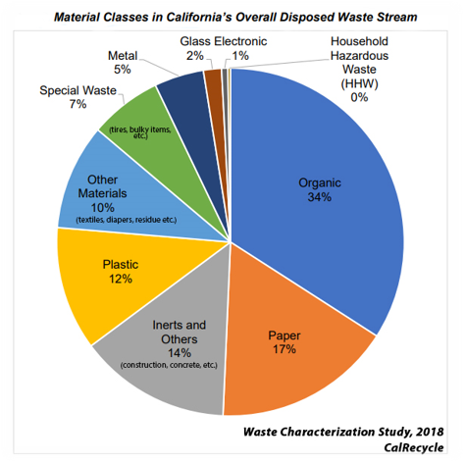
Our Department
The Riverside County Department of Waste Resources owns and operates the landfills.
This is a graph of the waste stream from 2018.
Notes:
So, who are we and why do we care about textile waste? Well, the Department of Waste Resources owns and operates the landfills, so what better way to start this presentation then by presenting a graph of the waste stream. You can see the big categories are Organics, paper and plastic. A lot of this material has potential to be diverted, and we work to educate our residents and businesses on how to execute that.

Slide 5
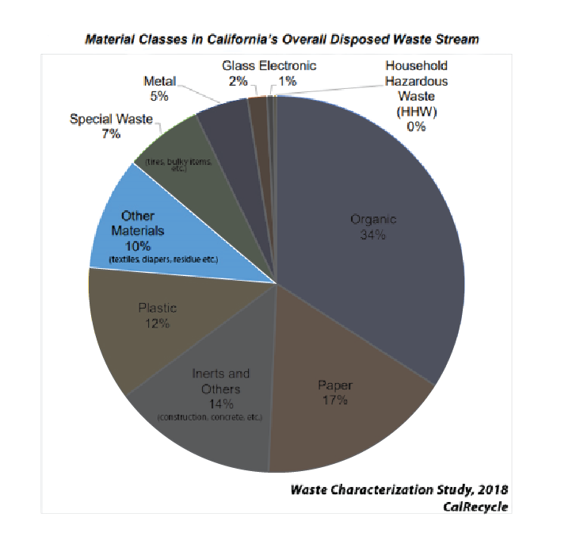
Our Department
This presentation will focus on that Other Materials that make up 10% of the waste stream, specifically the 5.8% of that waste that is textiles.
Notes:
For this presentation, we will be focusing on the “Other Materials” chunk of this pie. Of that “Other Material” 5.8% of that is textile waste. Sure, that might not seem like a lot, but that works out to be 17 million tons of textile waste. This is troubling because we continue to increase the number of textiles we send to the landfills each year. For reference, the EPA states that in 2000 that number was 9 million tons. Meaning in less than 20 years we have almost doubled our textile waste.

Slide 6
Problem
Textile Waste – American’s throw away an average of 70 pounds of clothing a year
Notes:
So what exactly is the problem with textile waste? Well textile waste in our landfills has been increasing since the 1960s, this can be attributed to the shift in the way we bought clothing. Prior to industrialization and the birth of big department stores, people had to get their clothing custom made, so excess clothing wasn’t really an issue. For example, Textile waste totaled more than 1.7 million tons in 1960 and is now at 17 million tons and growing.
You can’t mention textile waste without mentioning fast fashion, so let’s dive a littler deeper into that.

Slide 7
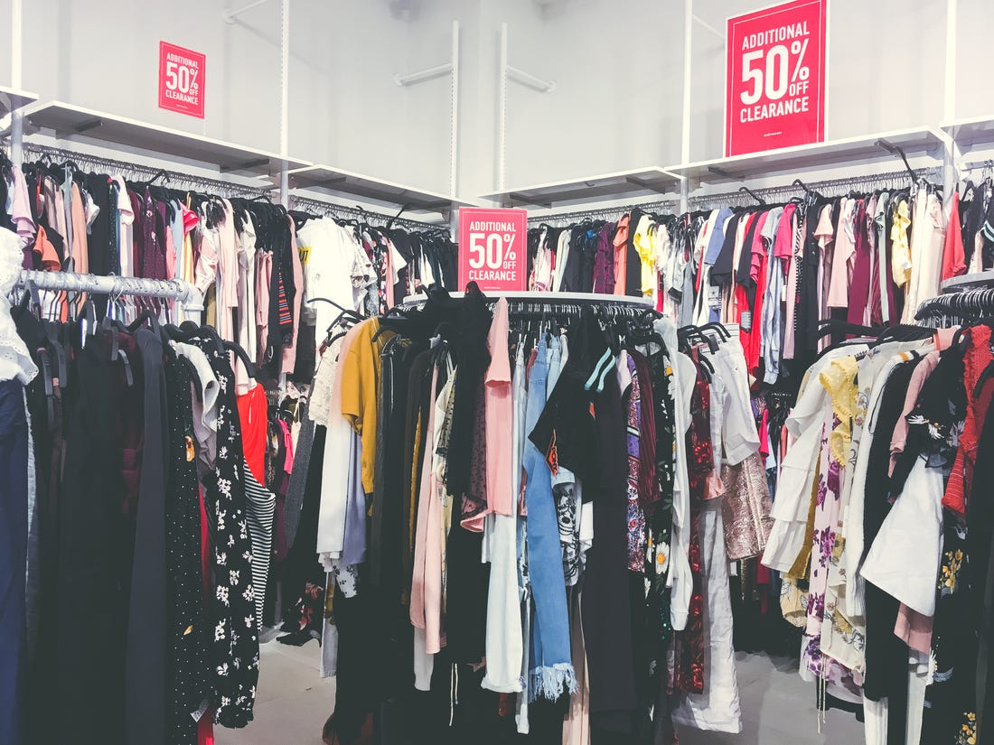
50 years of the company!
What is Fast Fashion?
Notes:
What exactly is fast fashion and why is it a problem? Well this picture is a great visual representations of that. I’m sure we can all think of several stores off the top of our head that look like that in your local mall, but let’s take a deeper look.

Slide 8
Fast Fash•ion [NOUN]
“
Inexpensive clothing produced rapidly by mass-market retailers in response to the latest trends.
Source: Oxford Dictionary
Notes:
Here is the Oxford Dictionary's definition of Fast Fashion: “inexpensive clothing produced rapidly by mass-market retailers in response to the latest trends”, but it’s a lot more complex than this. The term fast fashion was actually coined by the New York Times in 1990s to describe Zara's mission to only take 15 days for a garment to go from the design stage to being sold in stores, and that has become the standard for most major fast fashion brands today.

Slide 9
50 years of the company!
Why is Fast Fashion a problem?
Notes:
Why is fast fashion a problem? Fast fashion has issues in every stage of the supply chain, and while I know this presentation is focused on textile waste, I want to briefly go over some of the larger umbrella issues to really understand how we got to where we are today.

Slide 10
Impacts of Fast Fashion
Social Justice
Environmental
Economic
Exploited Garment Workers
Increased Textile Waste
Outsourced Manufacturing Jobs
Notes:
Here are some of the impacts of fast fashion including social justice, environmental, and for my numbers people, economic issues.
On the social justice side, we have the exploitation of garment workers
On the environmental side we have textile waste, but I’ll dive a little deeper into everything else that is happening behind the scenes before your clothing even makes it to the store.
Finally, we have the economic issues including the outsourcing of manufacturing jobs and really the slow death of the textile industry in this country.

Slide 11
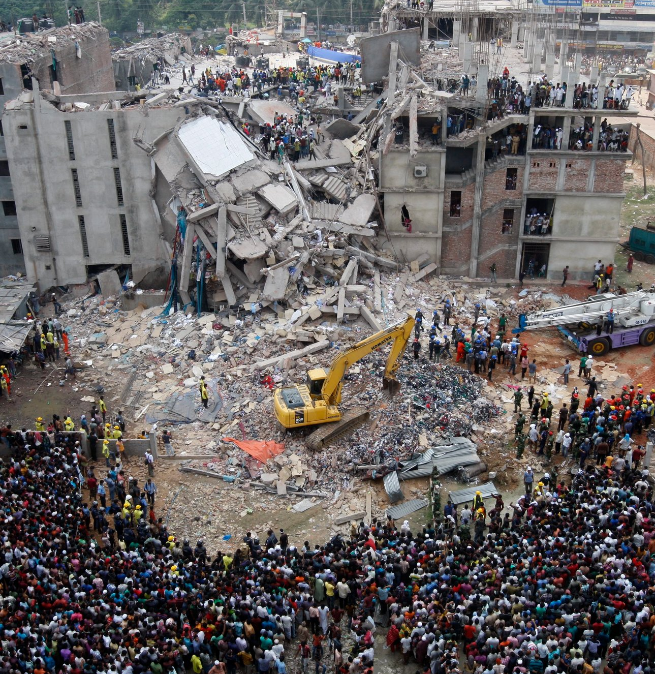
Social Justice Impacts
Of the 74 million textile workers, 80% are women of color
Exploitation of Garment Workers
Work 14 – 18-hour days
Unions are not recognized
Unsafe working conditions
The Rana Plaza Disaster
Businesses refusing to pay for orders due to COVID-19
Photo Source: Abir Abdullah/European Pressphoto Agency
Notes:
There are huge social justice issues associated with the fashion industry. It’s well known that garment workers are exploited, and of the 74 million textile workers, 80% of them are women of color. It’s not uncommon for them to work 14 - 18 hour days. In Bangladesh, the garment industry minimum wage is roughly $96 USD per month. Unions are not recognized, and they have little to no labor laws.
On top of all that, they also deal with unsafe working conditions. The picture you see here is from the 2013 Rana Plaza Disaster. In short, the building was deemed unsafe, yet garment workers were still required to work when it ultimately collapsed, leaving 1,134 dead, most of them women.
This past year, garment workers were required to work through the pandemic and faced several problems with large fashion retailers, like Kohls, canceling and refusing to pay for orders that were ready to ship out. This left developing countries with the debt of upfront production cost all while in the middle of a pandemic.

Slide 12
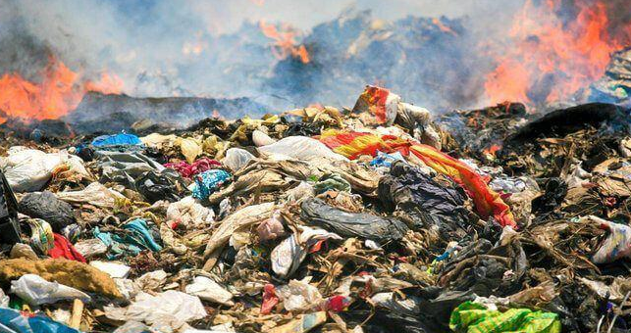
Environmental Impacts
Every second the equivilant of 1 garbage truck full of textiles is landfilled or burned
1,800 gallons of water for one pair of jeans
1 pair of jeans produces the CO2 equivilant to driving a car 50 miles
Fashion Industry produces 10% of all GHG
Microplastics Proliferation
1.5 trillion liters of water are used every year by the fashion industry
Photo Source: Yulia Omelich, Codogirl Journal
Notes:
Here you will see some of the environmental impacts of the fashion industry.
Every second the equivalent of 1 garbage truck full of textiles is landfilled or burned. For reference, a garbage truck can hold up to 6 tons of material. It takes 1,800 gallons of water to produce one pair of jeans. If you have 10 pairs of jeans in your home, the water it took to produce them could fill up a swimming pool. Actually, 1.5 trillion liters of water are used every year by the fashion industry.
Going back to that pair of jeans, 1 pair produces the CO2 equivalent of driving a car 50 miles. CO2 along with methane are some of the gases that contribute to greenhouse gas emissions that promote climate change and air pollution. When we think of greenhouse gas emissions in relation to industries, industries like automotive or agriculture come to mind. Well what if I told you the fashion industry is accountable for 10% of all greenhouse gases. Which is why the fashion industry does have an environmental impact.
That brings me to my next point, which is microplastics. Basically, textiles made from synthetic fibers, like polyester, shed millions of tiny piece of plastic every time they are washed. Unfortunately, they are so small that it’s nearly impossible to filter them out our water, so they are everywhere. Think about every time you wash clothes and the water discharges, that water is full of microplastics. The worst part is that since polyester is a relatively new material, we don’t really know the long term affects of consuming microplastic considering polyester is a petroleum product.

Slide 13
Economic Impacts
Supply Chain is not transparent, hard to hold companies accountable
Manufacturing jobs are outsourced
1960s - 95% of our clothing was made in USA
1990s – 50% of our clothing was made in USA
2013 – 2% of our clothing was made in USA
Notes:
Lastly, here are a few of the economic impacts of the fashion industry. The supply chain is not transparent at all. To put this into perspective, Nike owns 0 manufacturing factories. They actually outsource to 3rd party manufacturing companies. These 3rd party companies also source the raw material which can make it difficult to hold these large companies, like Nike, accountable.
Another notable economic impact is the loss of manufacturing jobs in this country, which is an issue that is not just isolated to the fashion industry. In the 1960s we were making 95% of all our clothing right here in the states, but by 2013 that number dropped to just 2%.

Slide 14
Solution
Although there is no quick fix for impacts of Fast Fashion, there are steps we can take as individuals to reduce our textile waste.
Notes:
Although there is no quick fix for the impacts of Fast Fashion, there are steps we can take as individuals to reduce our personal textile waste.

Slide 15
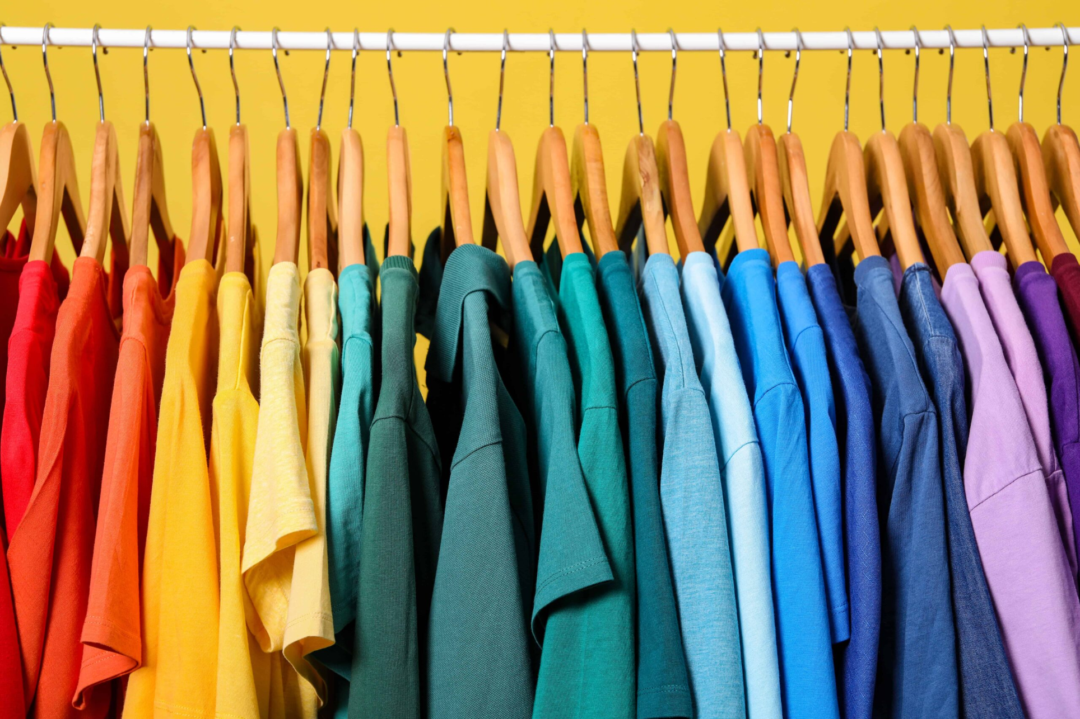
Changing Our Shopping Habits
Buy Less
Less clothes = Less textile waste
Identify the gaps in your closet
Color code
Group by item type/season
Clean out closet to avoid feeling overwhelmed
Notes:
The quickest way to reduce textile waste is to change your shopping habits. Buying less = less textile waste. I know this might be difficult with all the flashy marketing campaigns and sales constantly being pushed on us, but it will truly make a difference in the long run.
So how do you go about doing this? Well first look at your closet and assess your needs. Identify the gaps, what do you use the most, what do you need? Can anything be repaired?
Next I would suggest cleaning out your closet, often times we feel frustrated with our closet and that can be because it is overwhelming.
Cleaning out your closet can also seem overwhelming, so do it in sections, try color coding or group by item type. Pants with pants, dresses with dress. You can also put away seasonal items like jackets and boots to free up some space.

Slide 16
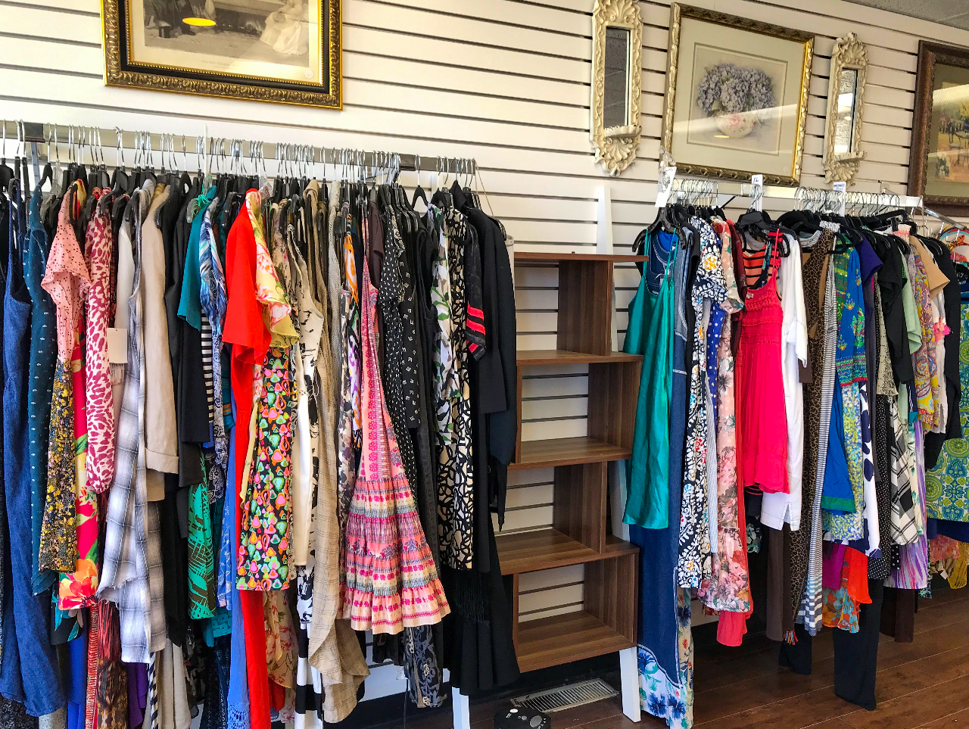
Changing Our Shopping Habits
Purchase Secondhand
Look for local thrift shops in your community
Keep an open mind
Know what you are looking for
Be willing to browse through the racks
Notes:
If you must purchase something, consider secondhand options. Goodwill and salvation army are the most popular, and the funds to go back to community programs, however they aren't the only secondhand stores. Look in your local city to find thrift stores to also promote public welfare where proceeds go to cancer, survivors and even animal welfare programs.
There are also secondhand stores that carry not only second hand material but also overstock material, like Savers.
Shopping these stores are not only easier on your wallet, but they carry a large variety of items. The key to shopping these types of stores is to have an open mind and to know what you are looking for. For example, if you are in need of a sweater, you know exactly where to look. You also need to be willing to browse through the racks, so make sure you give yourself plenty of time.

Slide 17
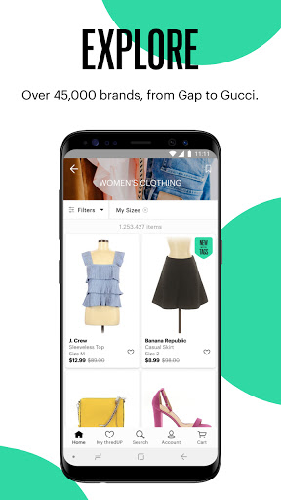
Secondhand Shopping Online
ThreadUP
Poshmark
Depop
The RealReal
Source: ThreadUp
Notes:
If shopping in person isn't your thing and you need something more curated, look no further than the world of online shopping. There are now many different online secondhand and resale shops making it easy to filter for exactly what you are looking for. Some popular options include ThreadUp, The Real Real, Posmark, and Depop.
The secondhand market is growing rapidly, and this can be related to an interested in secondhand clothing by the younger generations as well as a shift towards online secondhand platforms. Here are some examples of some secondhand and resale websites. ThreadUp is a big one, then you have poshmark and my personal favorite Depop, and we can’t forget about The RealReal for all your secondhand designer goods.

Slide 18
“Secondhand market is projected to double in the next 5 years, reaching $77 billon”
Source: ThreadUp 2020 Sales Report
Notes:
The secondhand market is projected to double in the next 5 years. In 2020, there were millions of new buyers and sellers in the secondhand and resell market, which is the exact opposite of what was projected to happen. Many were assuming that because of the pandemic most people would be hesitant to purchase pre-owned items, however it seems like people had a lot of time on their hands to clean out their closets and participate in the resale market.
Just a quick search on social media can show you tons of videos of secondhand hauls, but it is a double edge sword because now there is a trend in which people will go into thrift shops, and then flip the items that they found for extraordinary profit margins. The problem with thrift store flipping is it can take away from those who rely on these stores as a primary retail hub. So the take away here is even when it comes to shopping second hand, only buy what you need.

Slide 19
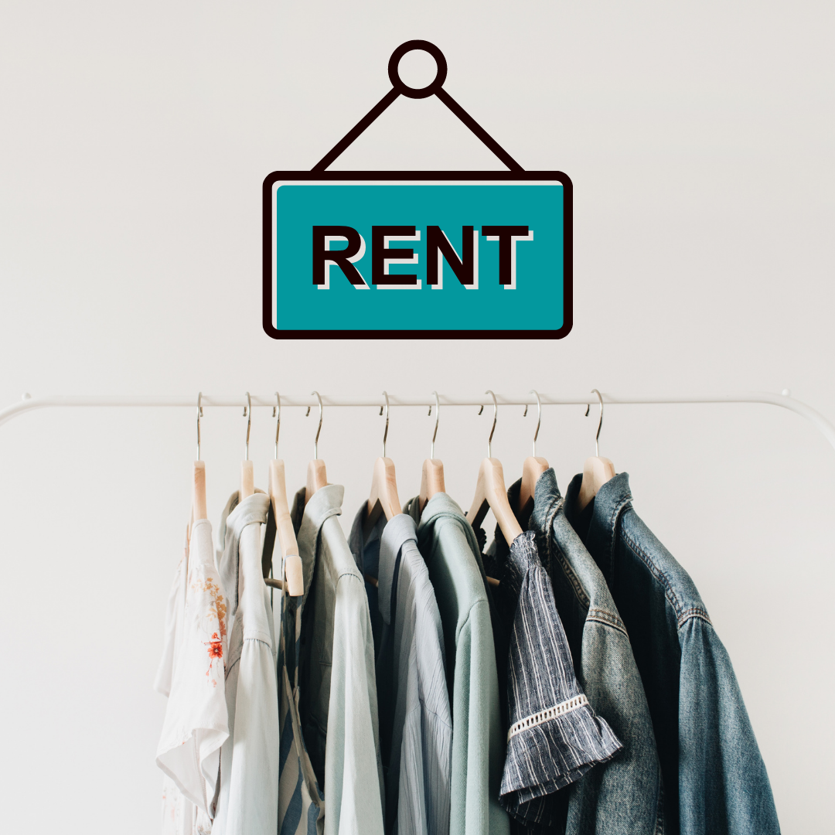
Changing Our Shopping Habits
Rent When Possible
Instead of buying an item that you will only wear once, consider renting it.
Most stores will have a program to let you purchase the item to own if you decide that you like it.
Notes:
Another trend that is gaining popularity is to rent pieces that you know you will only wear once or to refresh your wardrobe. You know that office holiday party that happens to have a semi-formal dress code? Rent the Runway is a great website for these special occasions, and you get to save money in the process! And if you like the item you can also purchase the item to own.

Slide 20
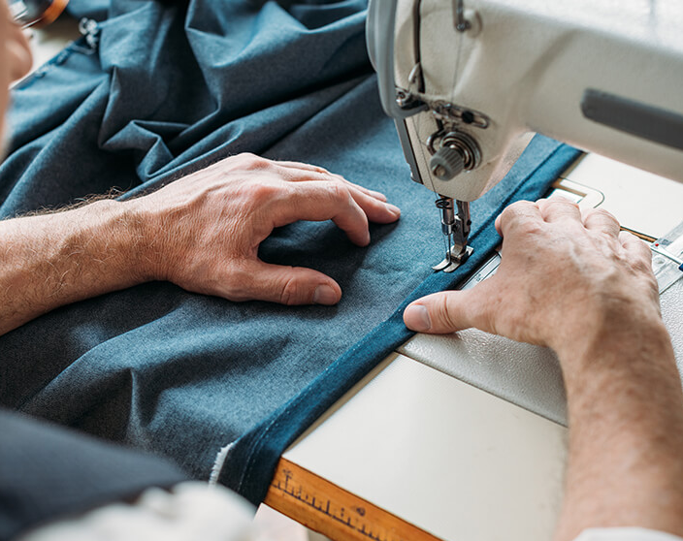
Changing Our Shopping Habits
Invest in High-Quality, Timeless Pieces
Name brand doesn't = high quality
Look at stitching of fabric, loose threads
Material used
The construction, can it be tailored?
Avoid trends
Learn to style your clothes
Resale value
Notes:
Finally, if you are going to buy new clothing, consider high-quality, timeless pieces. It will be more of an investment, but they will last longer through wears and trends.
Certain things to look for:
Name brand doesn't equal high quality
Look at the stitching, are there any loose threads? Look at the material used, the construction, can you take it in or out? On that note, consider getting items tailored so you know they will always look good on you.
Things to avoid:
Trends, think crop sweaters, it didn't age well in the 80s, and it probably won't in 2021.
Learn to style your clothing using apps like Pinterest.
If you do buy new, think of the resale value in 5 years, will it stand the test of time?

Slide 21
Extend the Life of Your Textiles
Care Instructions
Air Dry
Reduce Detergent
Washing your clothes correctly will make them last longer ad reduce the number of textiles you send to the landfill each year
Notes:
The next step in reducing textile waste is to extend the life your textiles by washing them correctly. Failing to do so will result in your clothes breaking down sooner than they should. The first tip is to follow the care instructions on the label. I get it, I also hate looking at a label only to read “hand wash only,” but it is there for a reason, and it will help extend the lifespan of those pieces.
Next is to air dry – it saves energy, saves money and helps preserve the fibers of the textiles.
Lastly, there is a good chance we are all using too much laundry detergent. Adding too much detergent can leave a film on your clothing and make them harder to dry. It’s best to follow the instructions on your detergent bottle to ensure you are using the right amount of detergent.

Slide 22
Reduce & Reuse
#30WearsChallenge
Capsule Wardrobe
Fast Fashion pieces are typically designed to last 10 wears, so extending that to 30 wears will cut back on excess textile waste.
Capsule wardrobes let your personal style shine through your clothing by avoiding passing trends.
Notes:
Here are a few more tips:
Take the 30 Wears Challenge. So fast fashion pieces are typically designed to last only 10 wears, so by challenging yourself to extend that to 30 wears will cut back on excess textile waste. And watch out for microtrends (popular with teens and young adults), you might not even get a chance to wear something 10 times before it’s already deemed “out of style.”
You can even take it a step further by creating a capsule wardrobe. A capsule wardrobe is a small collection of garments designed to be worn together. The idea is that you have this foundation of essential pieces, and you can mix and match, creating tons of outfits. There are a lot of examples and even templates online to help you get started. It’s a great idea for workwear and I even like to apply the concept when I’m packing for a trip

Slide 23
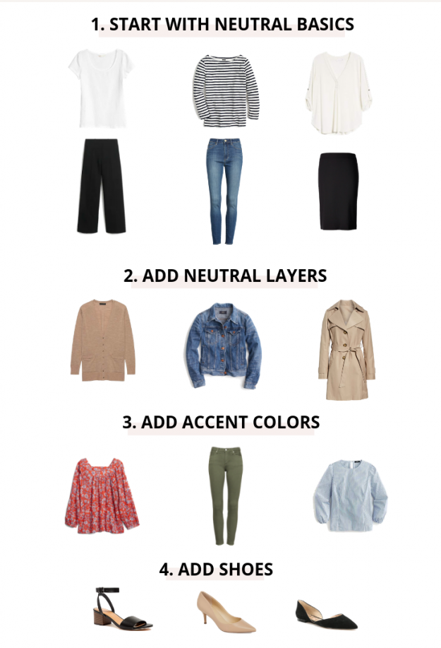
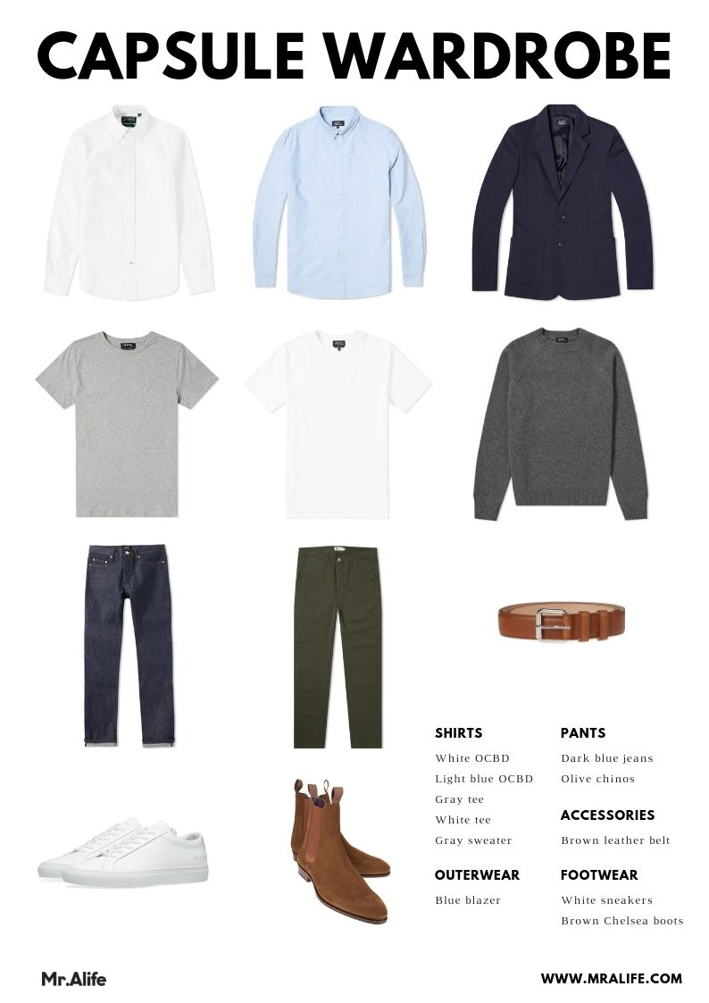
Capsule Wardrobe Examples
Photo Source: Classy Yet Trendy; Mr. Alife
Notes:
Here are some of those examples I mentioned in that last slide, both for women and men.

Slide 24
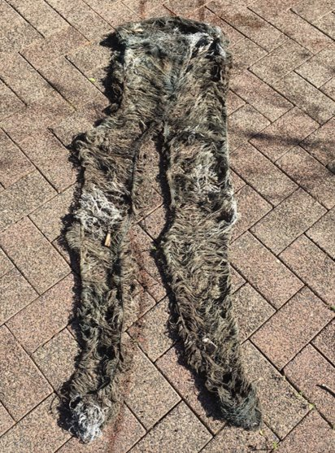
Fabrics: Synthetic vs. Natural
Stay away from synthetic material (polyester, rayon & nylon) instead look for these fabrics:
Linen - requires little water/energy, biodegradable
Cotton – uses a lot of water, but it is biodegradable
Tencel (Lyocell) – Synthetic, but made from wood pulp
Notes:
On to the fabric debate, what should you choose synthetic or natural? Natural fabrics like cotton and linen are easier to recycle, however you have to make sure they aren’t blended with synthetic material. When you end up with a 50/50 cotton polyester blend it is almost impossible to separate the two materials and you end up with something that looks like the picture here. This is a pair of jeans that were composted. What you are seeing are all of the synthetic fibers that weren't able to break down, and this is typically that elastane that gives our jeans that little stretch we all love.
Well, like I mentioned earlier some synthetic fabrics like polyester are made from petroleum, making them basically plastic. Polyester is the dominate fabric right now, 60% of all clothing is now made with polyester so it can be difficult to avoid and even more difficult to recycle. Some synthetic are better than others, like Tencel or Lyocell, it’s made from mainly Eucalyptus and is a good substitute for silk and cotton.
Cotton is a good natural fabric; however, it requires a LOT of water. I mean a lot of water. The nice thing about cotton is if you wanted too, you could essentially compost like a cotton t-shirt and it will break down in the compost pile.
Linen is almost like a step up from cotton, it require very little water and energy to make, and it also breaks down naturally.

Slide 25
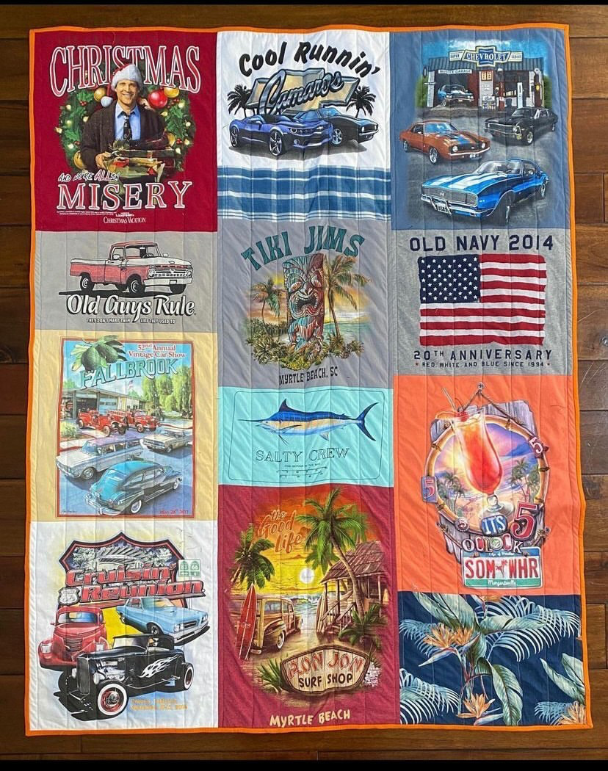
Sentimental Clothing
We all have them, but what do you do with them?
Store it in a different place other than your closet
Repurpose it –
Buttons turn into jewelry
Sweaters turn into pillows
T-shirts turn into memory quilts
Etsy has sellers that specialize in repurposing sentimental clothing if you aren’t great with a needle and thread.
Notes:
Sentimental clothing. We all have them. From concert t-shirts to old homecoming dresses. Here are a few tips on what to deal with them. First store them in a different location from your everyday wardrobe, that way your closet won’t feel overwhelming. You can also repurpose old pieces into fun mementos, like jewelry, pillows, quilts. Just a quick google search and you will have thousands of ideas of what to do with your sentimental clothing. And if you aren’t that crafty, Etsy has sellers who will take your items and repurpose them for you! This photo here is a quilt made of t-shirts, last year we lost one of our colleagues, Jim, and another colleague was able to repurpose all of his favorite t-shirts into a quilt.

Slide 26
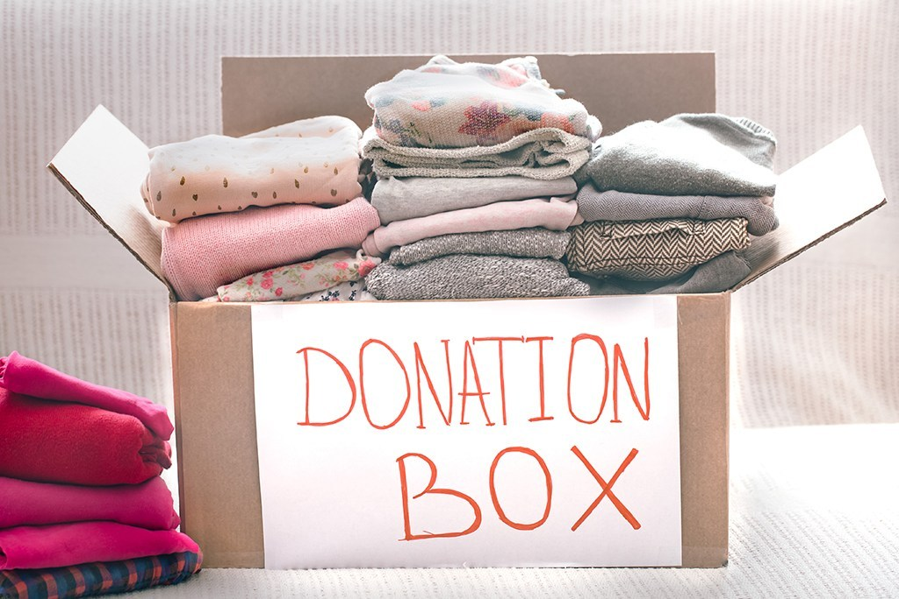
Donations
Instead of putting your clothes in the trash, donate them!
Rules for Donations:
Clothing should be free from holes, rips and stains
Clothing should be clean and free of any questionable odors
Do not put clothing into the recycle bin, it will just end up in the landfill
Notes:
Donating clothing is a great way to give your clothes a second life while reducing your textile waste. Not to mention, the secondhand market heavily relies on donations to thrive.
While donating clothing is usually the first thing that comes to mind when we think of cleaning out our closet, if you aren’t following these rules, you might be doing more harm than good.
First we want to put a big emphasis on donating gently used clothing, any clothing donated should be free from holes, rips and stains.
While on the topic, clothing should also be clean and free from any questionable odors. The employees sort through all the items, so it’s not fair to them to include items that should have turned into rags or tossed in the trash. They also price based on the condition of the items.
Finally, do not put clothing in the recycle bin in hopes that it will be donated, I’m here to tell you that it will go straight to the landfill.

Slide 27
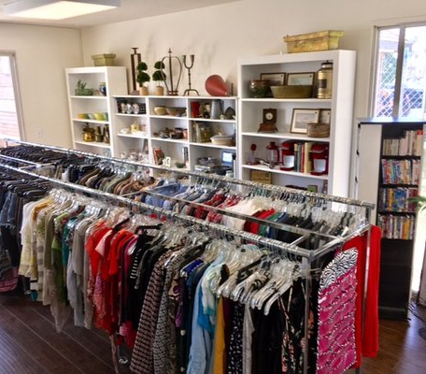
Local Resources
Pink Ribbon Thrift, Red Cross, Salvation Army, Goodwill and Savers
Community Outreach Centers
i.e., Women’s shelters, nursing homes, places of worship & shelters for people without housing
Facebook Marketplace
Mobile Apps
i.e., ThredUp, Poshmark, Depop & Swap.com
Consignment Shops
Animal Shelters
Most shelters accept old towels, blankets & sheets
Host a Clothing Swap
Notes:
Here are some local resources if you are interested in donations. Thrift shops are always a great resource when it comes to donations. In the city of Riverside, we have Pink Ribbon Thrift, which is a thrift shop where all proceeds go towards funding resources for families who have been impacted by cancer. Great store with a great cause, I would highly recommend checking it out.
Community Outreach centers are always a great resource and in need of donations as well. Women’s shelters, nursing homes, places of worship, usually always in need of donations.
If you need to get rid of something, but also meet your neighbors, facebook marketplace is a great resource too.
Then you have websites and apps like thredup, Poshmark, Depop and swap.com.
Consignment shops,
animal shelters, they are almost always in need of donations. I know the riverside county department of animal services said they are always accepting new or gently used textiles, bedding, and towels.
Another great local resources is to host a clothing swap. We are actually gearing up to host one internally here at the department. It’s essentially a gathering where everyone brings a few times from their closet that they wouldn’t mind parting ways with, then you lay everything out and everyone is able to shop through the items. It makes for good entertaining too if you want to get a group of friends together!

Slide 28
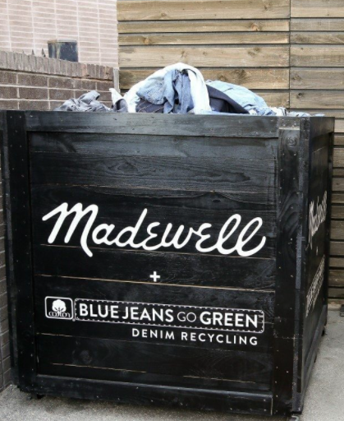
Textile Recycling
In Store Textile Recycling Programs:
DSW Give-a-Pair
New or Gently Worn Shoes
H&M Garment Collection Program
Clothing Only (any brand, any condition)
Levi’s Recycle Your Jeans
Denim Only (any condition, any brand)
Madewell Blue Jeans Go Green
Denim Only (any condition, any brand)
Nike Reuse-a-Shoe Program
Athletic Shoes Only
The North Face Clothes the Loop
Clothing & Footwear (any brand, any condition)
Notes:
Here is a list of in-store recycling programs. A small disclaimer, I can’t speak to whether any of these stores are currently accepting donations due to covid, however they do have recycling programs, and some of them will ever offer you a discount on you next purchase if you donate. This list will also be available on our website. Some of these places only accept denim or shoes, so make sure to check ahead of time before you haul all your items down to the store.

Slide 29
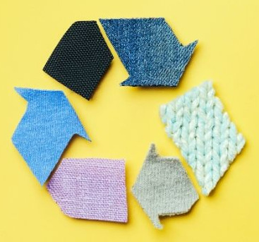
Textile Recycling
Online Textile Recycling Programs:
For Days Take Back Bag
Clothing Only (any brand, any condition)
TerraCycle Textile Recycling Box
Fabric and Clothing (any brand, any condition)
Zappos For Good Recycle Program
Shoes and Denim Only
Notes:
And here is a list of online textile recycling programs, if you prefer to send your items in.
For Days – online retailer where you can purchase a bag, stuff it with your textiles you want to recycle, and ship it back to them.
TerraCycle has a similar program, however they sell large boxes that you pack and ship back.
Zappos for Good is also similar, however this program is free, but they only accept shoes and denim.

Slide 30
Questions?
Notes:
Are there any questions?

Slide 31
Thanks
Stay in contact with us!
@deptofwasteresources
www.rcwaste.org
@rcwaste
(951) 486 - 3200
@rcwaste
Waste-CompostingRecycling@rivco.org
Notes:
Thank you so much for joining us, please stay connected with us! Here is our social media handles, and then of course if you ever have any questions call or email us. Have a great day everyone!

