Slide 1
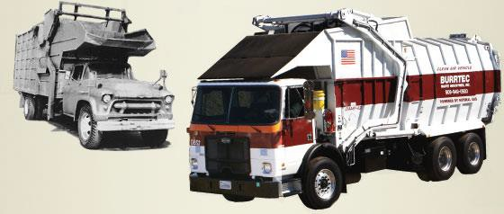
RIVCO RECYCLES COMMUNITY SUMMIT
TUES DAY NOVEMBER 16, 2021
A Presentation by Clara Vera

Slide 2
OUR S T R E N G T H S
We offer customized commercial services that are tailored to meet every businesses profile. We understand that every community and every business is unique.
SERVICES AT A GLANCE
OUR GOAL
We not only provide trash and recycling services but ultimately, we want to encourage every community member to be environmental stewards of the communities we serve.
OUR O P P O RT U N I T I E S
We understand our communities are being faced with State Diversion goals and we are dedicated to meeting each milestone and enhancing each recycling program!

Slide 3
OUR RECYCLING SERVICES PROGRAM
WHAT OUR CUSTOMERS WANT
Identify Business Type
Customize Recycling Program
for Business Needs
Creative and intuitive public
education
Quality Outreach
RivCo Recycles Community Summit 2021

Slide 4
"We'll Take
Care
C O M M E R C I A L S E R V I C E S
Bin Services
C O M M E R C I A L S E RV I C E S
Barrel Services
of It!"
C O M M E R C I A L S E RV I C E S
Industrial
RivCo Recycles Community Summit 2021

Slide 5
MEET THE TEAM
WHO'S BEHIND "WE'LL TAKE CARE OF IT!"?
OUTREACH
District Environmental
Coordinators
C O M P L I A N C E
M CR |M ORe and M ore!
PUBLIC EDUCATION
Strategic Educational
Campaigns
RivCo Recycles Community Summit 2021

Slide 6
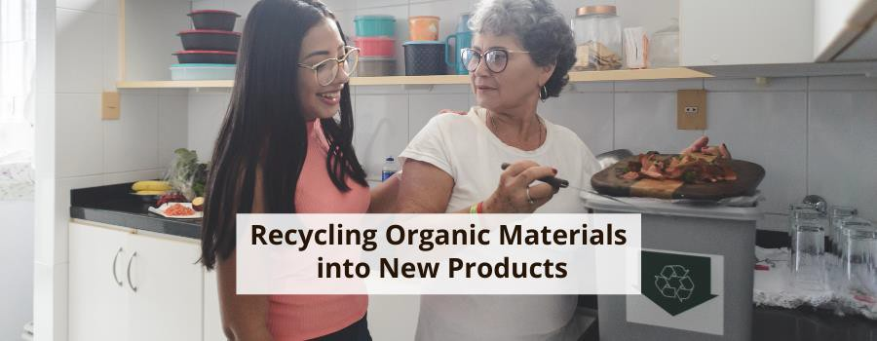
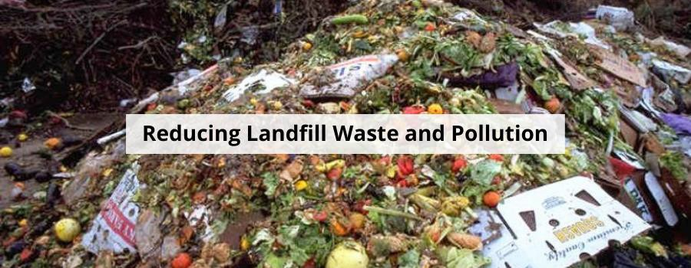
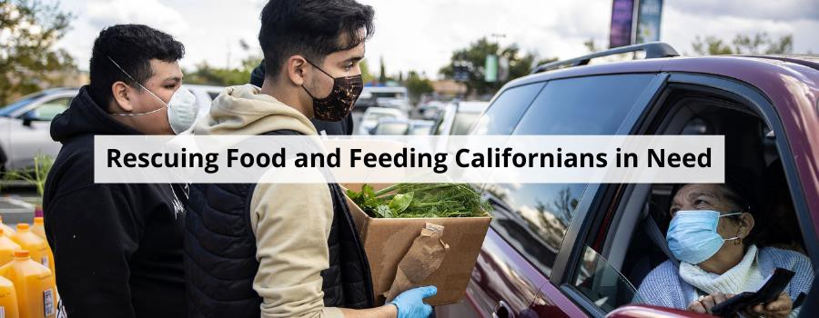
SB1383 AT A GLANCE

Slide 7
"We'll Take
Care
P a r t n e r i n g w i t h o u r C o m m u n i t i e s f o r a m o r e s u s t a i n a b l e t o d a y a n d a g r e a t e n v i r o n m e n t a l t o m o r r o w !
Riverside County Departments
Cities & Special Districts
Utility
Agencies
of It!"
Environmental Health
Local Non- Profits
Public Parks
Food banks and Pantries
Public Works
RivCo Recycles Community Summit 2021

Slide 8
SB1383: A brief overview of community implementation
Bundled Recycling Programs
for our Community Needs
Identify Business Type
Supportive and Tailored Education (Bilingual)
Quality Outreach
RivCo Recycles Community Summit 2021

Slide 9
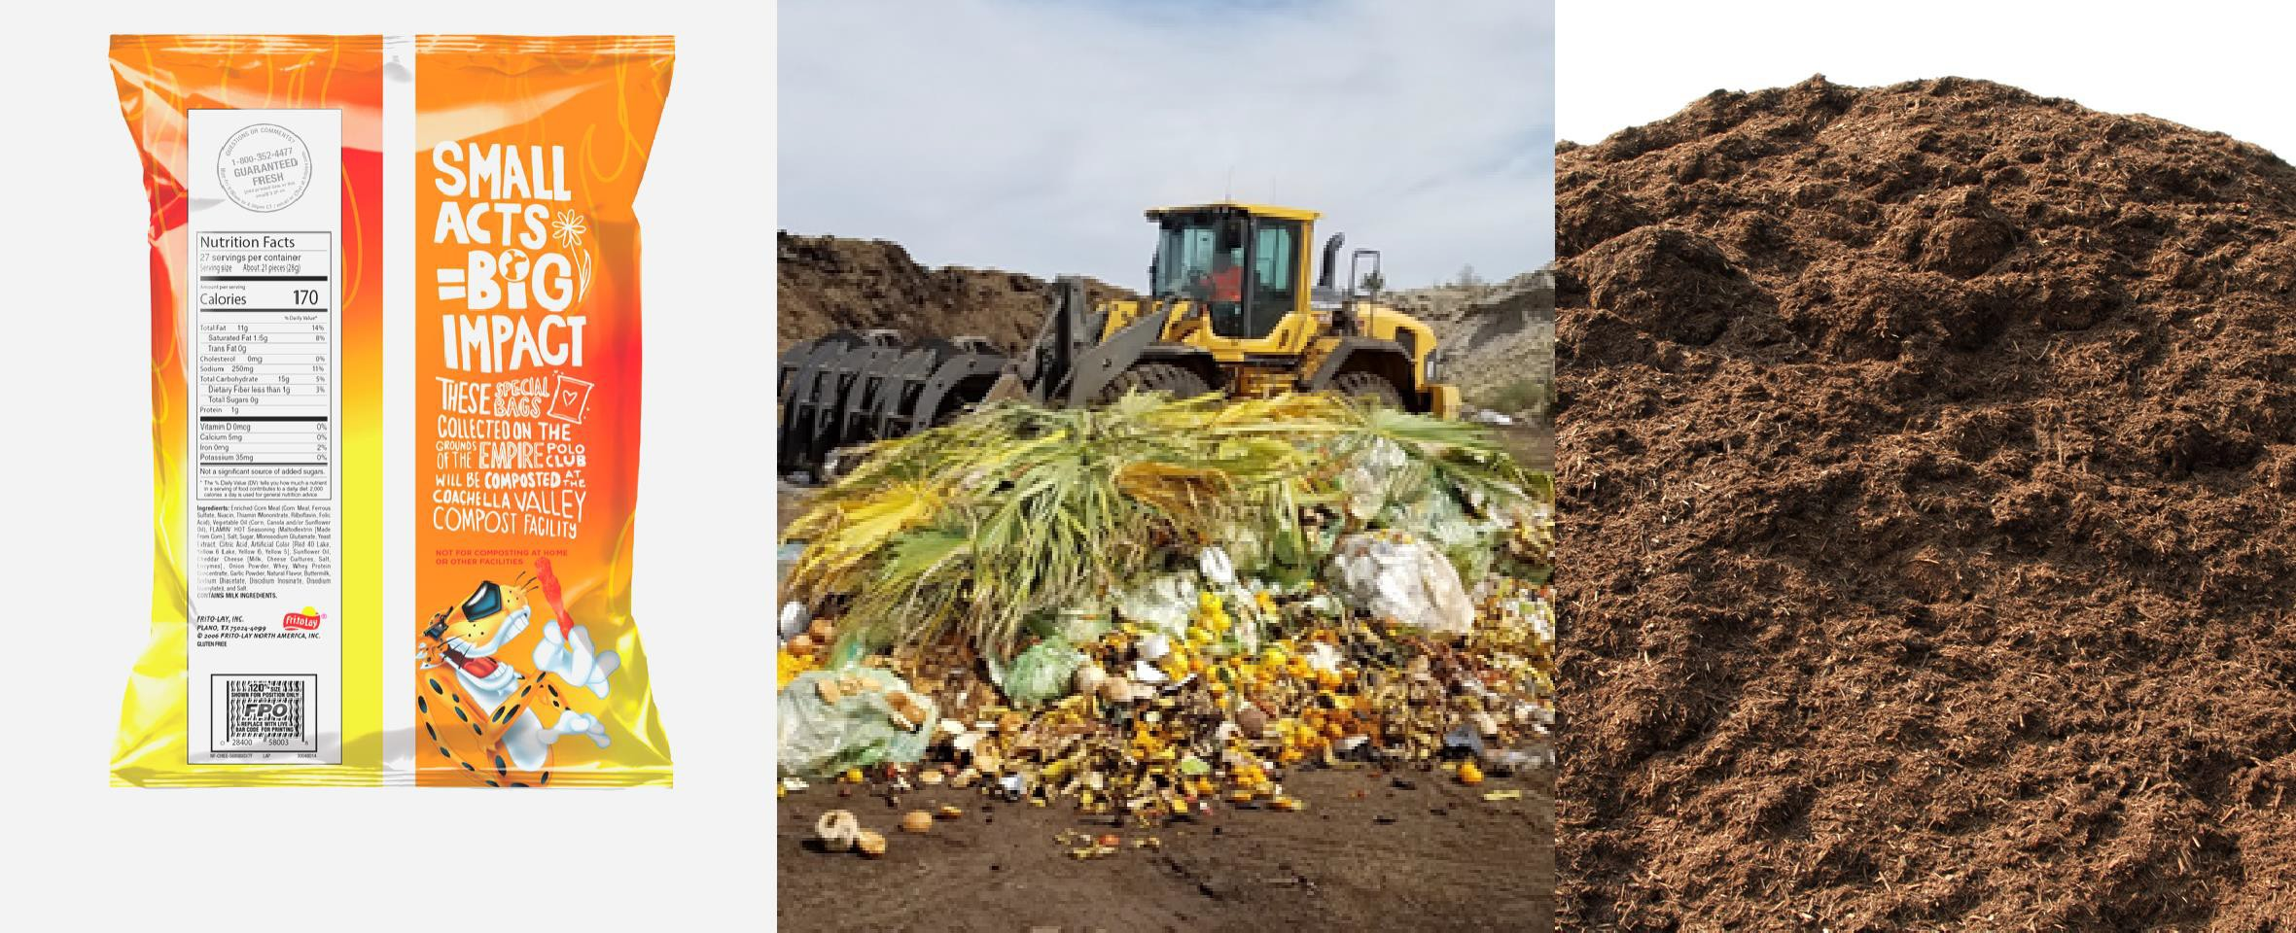
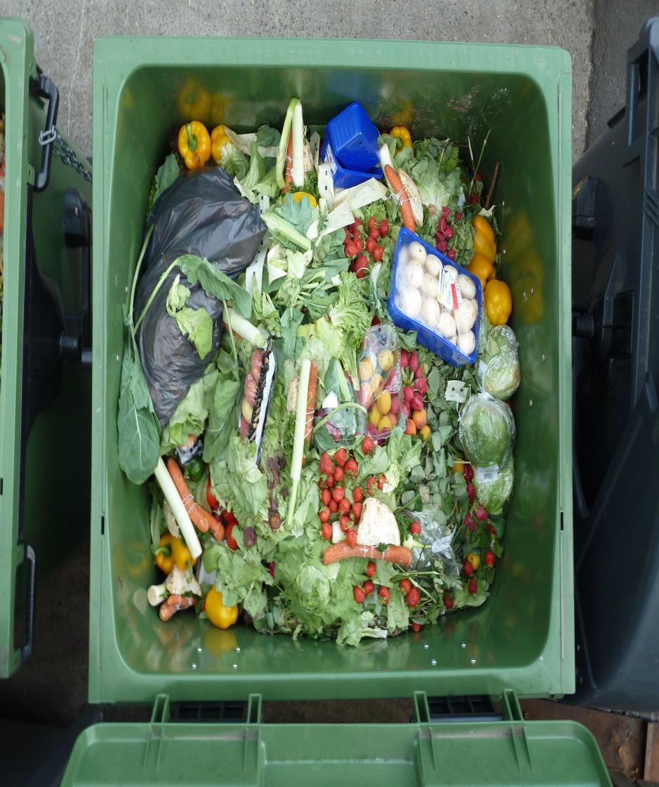
Where will our Organics Go? CVC!
STAGE 1
STAGE 2
The Processing
STAGE 3
The Results
The Collection
RivCo Recycles Community Summit 2021

Slide 10
CONTACT
INFORMATION
M A I L I N G A D D R E S S
41-575 Eclectic St., Palm Desert,CA
E M A I L A D D R E S S
cvera@burrtecdesert.com
WE'D LOVE TO HEAR FROM YOU!
P H O N E N U M B E R
(760) 340-2113
RivCo Recycles Community Summit 2021

