Slide 1
SB 1383 Organic Waste
Notes:
SB1383 Brief overview: https://youtu.be/7ZoiQVyIW3M
Contaminations: https://www.youtube.com/watch?v=OMLqPANSkW4
Tips on keeping organic waste carts clean: https://youtu.be/cMIeuxEnExk

Slide 2
SB 1383 - New Statewide Mandatory
Organic Waste Collection Regulation
What is the new law?
The California State Legislature passed Senate Bill 1383 (SB 1383) which requires cities and counties to reduce organic waste disposal by 75% by 2025. Beginning January 1, 2022, all California residents, businesses, and multifamily complexes will be required to separate food waste and yard waste from their trash and recycle in a separate organics cart.
SB 1383 Goal
Reduce organic materials going to the landfill, decrease greenhouse gas emissions,
and slow climate change.
Organics like food scraps, yard trimmings, soiled paper, and cardboard make up half of
what Californians throw away.

Slide 3
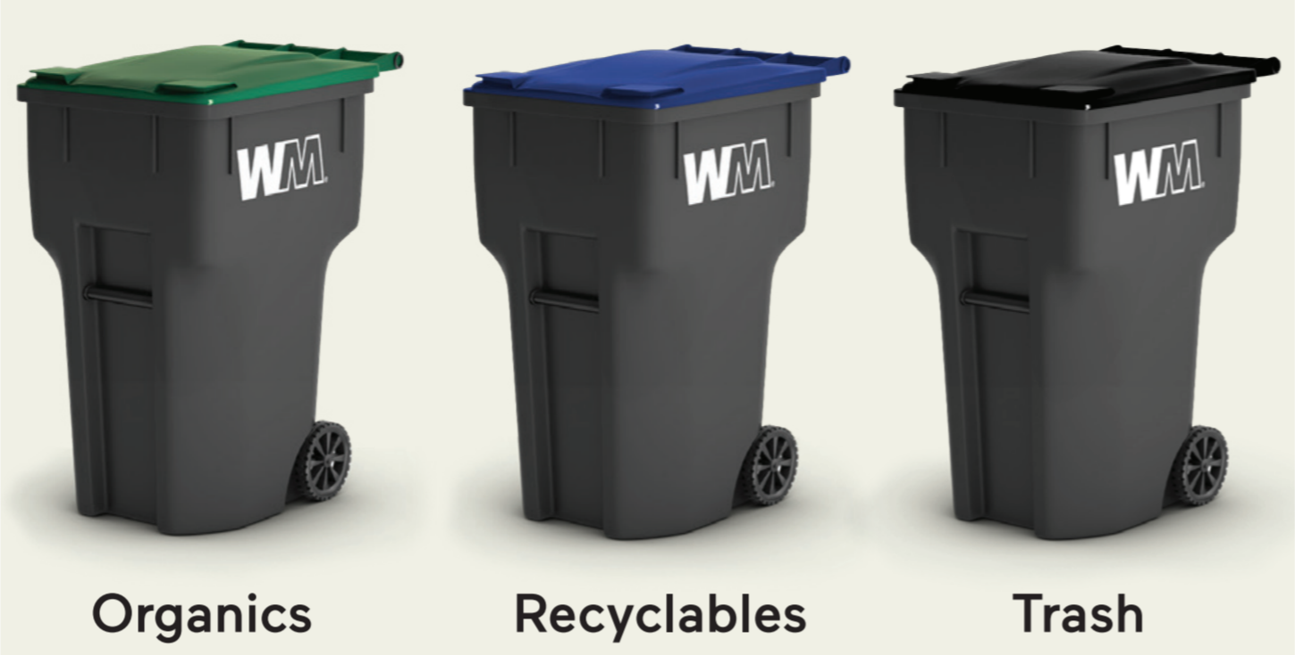
Residential Container Changes
SB 1383 requires that carts be uniform colors across the state by 2036.
Eventually carts will have dark grey bodies with different colored lids – a green lid for organics, blue lid for recycling and black lid for trash.
We will make these cart changes gradually to minimize disruption in your community. When it comes time to replace carts, watch for the new color scheme. Make sure you ‘Check the Lid’ for instructions on to use the carts correctly and avoid contamination.

Slide 4
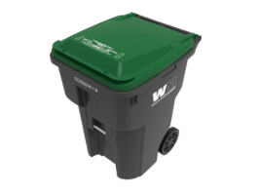
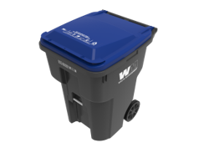
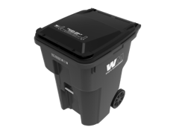
3-Cart System for Residents
Green Container Lid
Used for any type of organic waste such as food waste, green materials, pruning, landscape waste, wood
Deliver to Composting Facility
Blue Container Lid
Use for nonorganic recyclables (cans, bottles, paper, cardboard)
Deliver to Recycling Facility
Gray Container Lid
Use for nonorganic waste
Use for designated organics (textiles, carpet, plastic coated paper, human or pet waste; hazardous wood waste or material subject to quarantine)
Deliver to Landfill

Slide 5
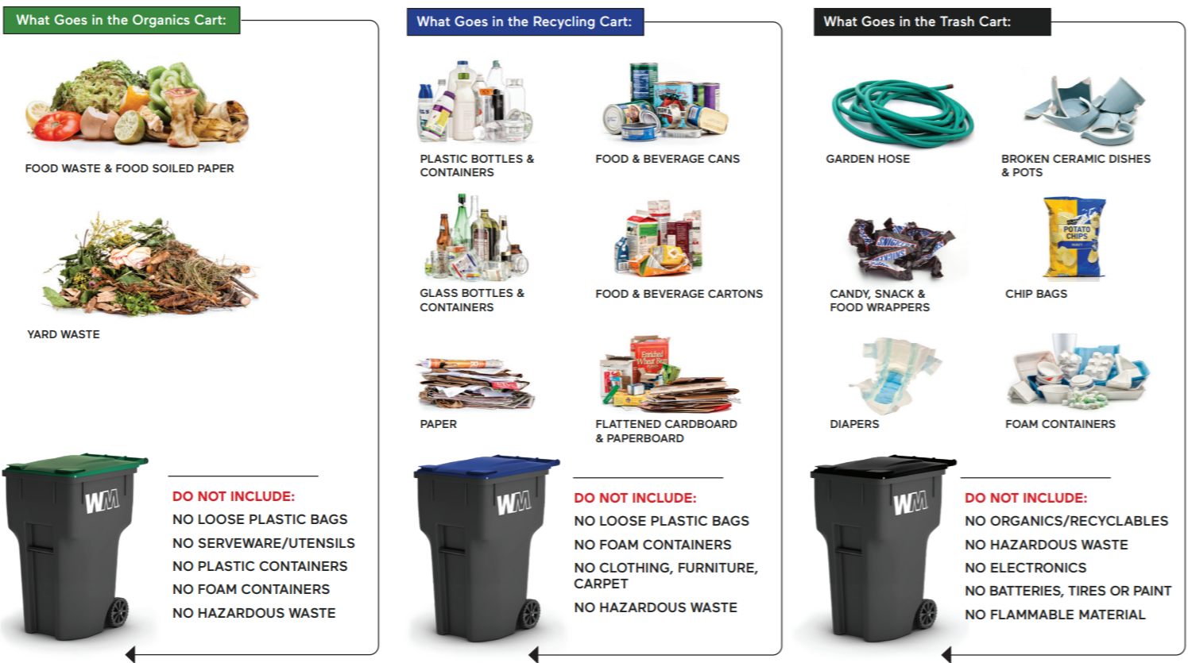
Residential Container Changes
Recycle food scraps and yard trimmings will now be collected in your existing green waste container.

Slide 6
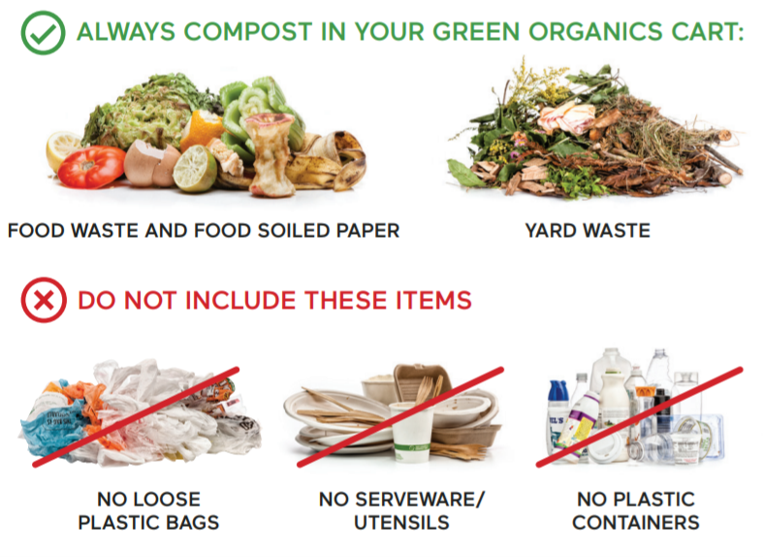
SB 1383 Cart Monitoring and Enforcement
Regulations passed by the state from SB 1383, requires a contamination cart monitoring and enforcement program to help reduce contamination in the recycling and organic collection cart.
Keeping organics waste streams clean will help ensure that the organic material can be processed
What is contamination?
Contamination occurs when you place non-acceptable items in the wrong cart. Contaminants can ruin an entire load of organics or recyclables and prevent these materials from going on to have a second life.
Loose plastic bags and bagged materials in organics and recycling containers are the most common contaminants.
Please empty your organics and recyclable materials directly into your organics or recycling carts to give them the best chance of becoming new products.

Slide 7
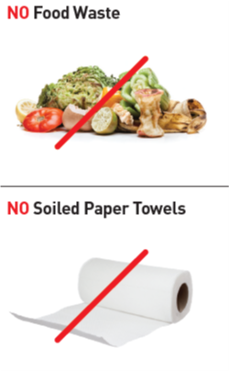
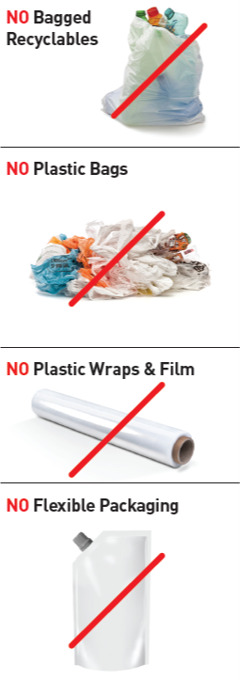
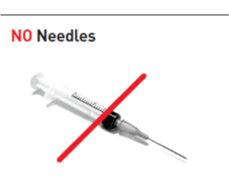
Recyclable Contaminants

Slide 8
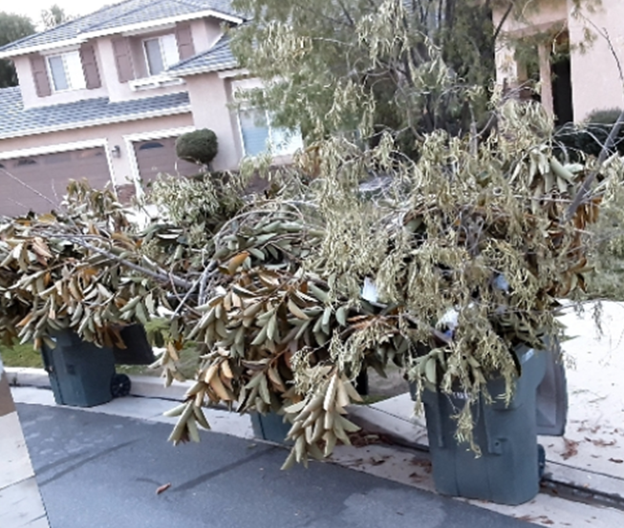
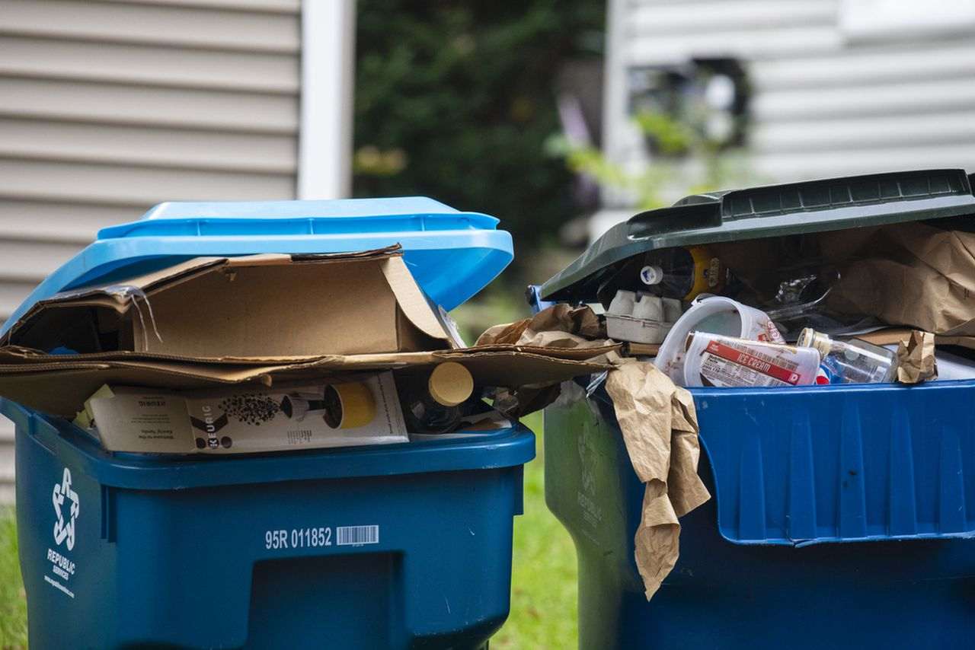
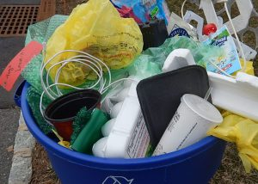
Contamination

Slide 10
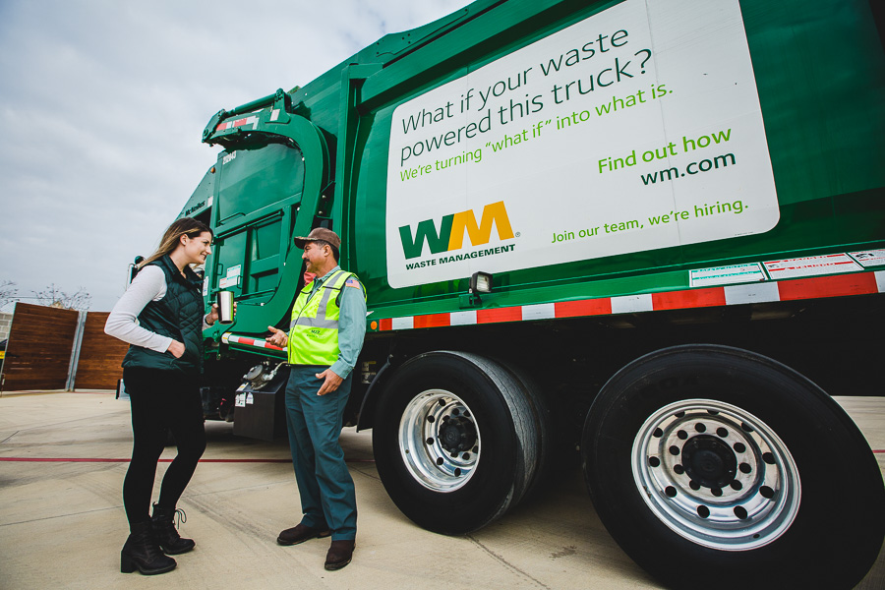
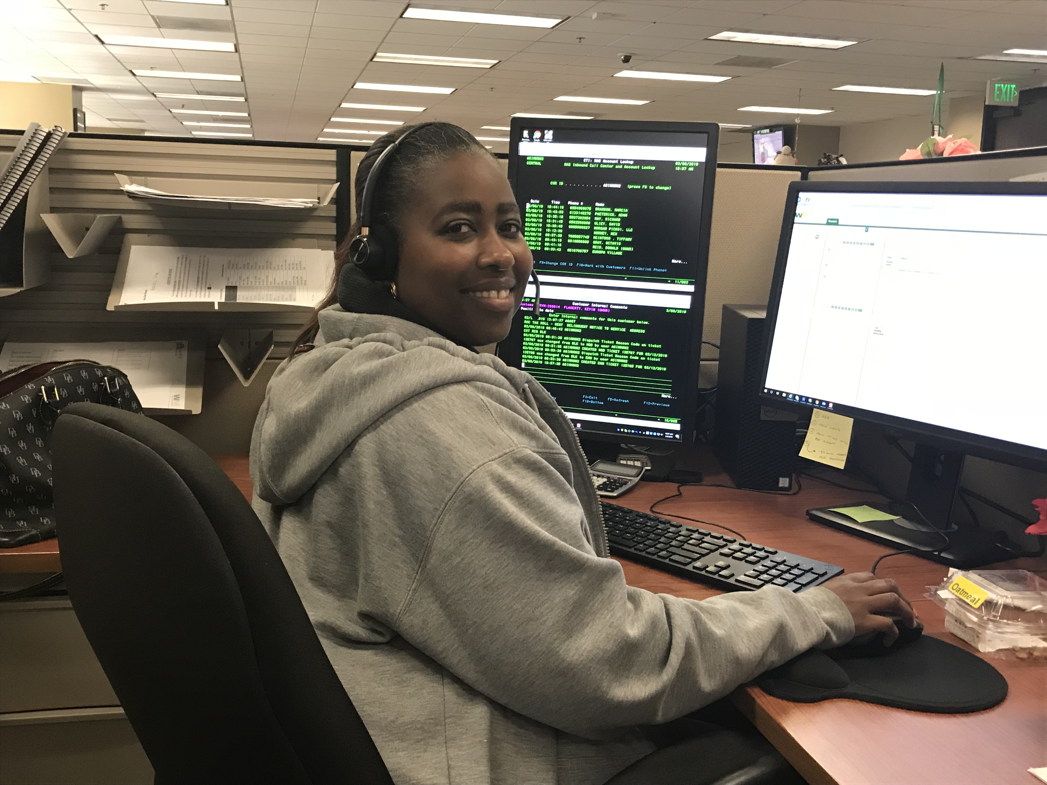
WM- Commitment to Customer Service
Customer Service Representatives available from 8a.m.-5 p.m. Monday- Friday and Saturdays 8 a.m. – 12:00
Average speed of answer is less than 30 seconds for non-peak hours and 60 seconds during peak hours
Call back available so you don’t have to wait.
Spanish/Mandarin : If other languages required, access to language translation services
Missed Pickup?
Call customer service 1-800-423-9986
Call before ? Will return by 6:00 p.m. to service your cart

Slide 11
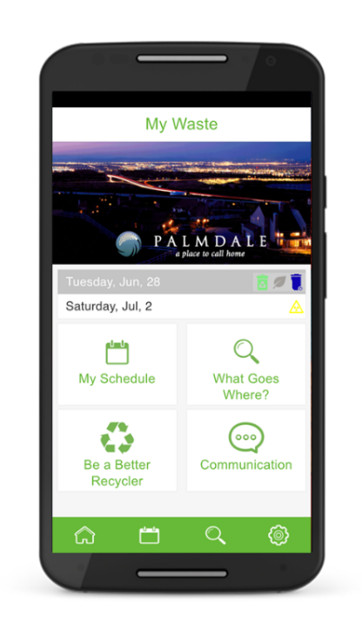
WM- Using the Latest Technology to Connect with Our Neighbors
Onboard Computer System
Local Website wm.com /WM Mobile App
Real time information to all truck locations, and stops serviced
Drivers able to note missing or damaged carts so tickets can be created to request a cart swap or repair.
Missed pickups- easily able to identify customer issue to resolve quickly
Self Service features to quickly:
Communicate with Customer Service:
Via live chat, or email
Obtain Holiday Schedule
Recycling Information
Estimated Collection Time
Discover Community Events
Cleanups, Education Workshops
Request Changes to Existing Service
Request Large item collection or other Service Programs
Billing-
Manage your account, change payment method,
Paperless Billing

Slide 12
Resources
• Create a My WM profile online to put you in control of your WM account: www.wm.com/us/local/ca/residential
• For more information about the law, visit California Department of Resources Recycling and
Recovery (CalRecycle) website at www.calrecycle.ca.gov/organics/slcp/
• For updates and further information on how to Recycle Right, visit www.wm.com/us/en/recycle-right

