Slide 1
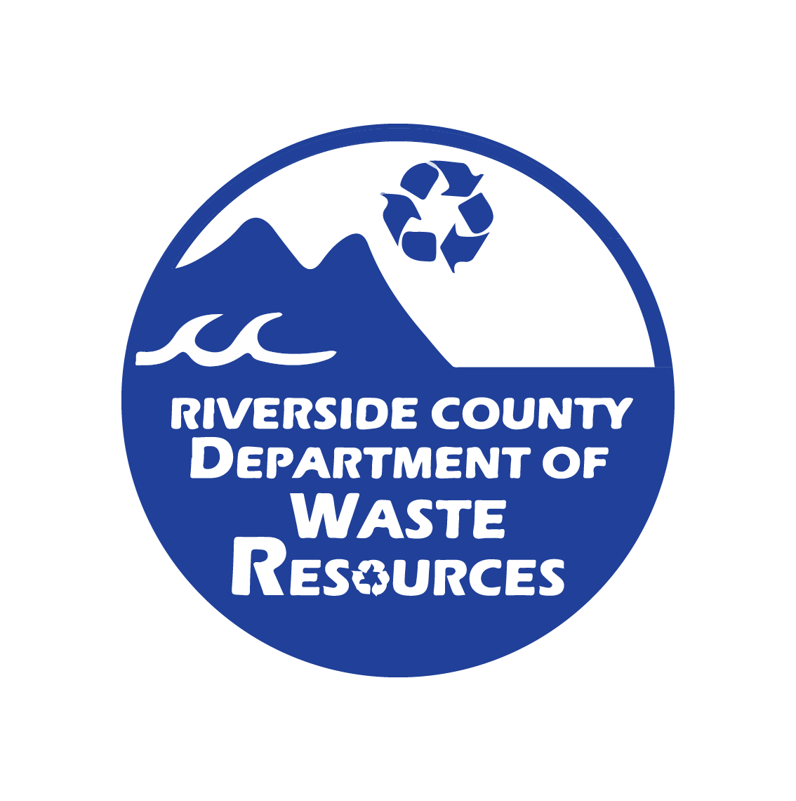
Sustainability 101
Riverside County, Department of Waste Resources Rivco Recycles Community Summit 2022

Slide 2
Agenda
What is Sustainability?
Why is sustainability important?
How to be sustainable as a resident

Slide 3
Sustainability
"Meeting our own needs without compromising the ability of future generations to meet their own needs."
-Brundtland Commission, Our Common Future
Notes:
REWRITE: Regardless of who we are, where we live, and what we do, we all have a moral obligation to each other, our future generations, and other species to sustain the planet. Our present choices and actions have huge long-term impacts on future generations. Practicing sustainability ensures that we make ethical choices that bring a safe and livable future to everyone. If we deplete the resources of the Earth, future generations will be depleted. For example, if we over fish our oceans, we risk not only depleting the supply of fish, but also depleting the supply of every organism in the food chain related to that fish.

Slide 4
Notes:
Sustainability improves the quality of our lives, protects our ecosystem and preserves natural resources for future generations. One way to make sure you're meeting the rate of sustainnablly that's essential for future generations is adopting and understanding zero waste practices.

Slide 5
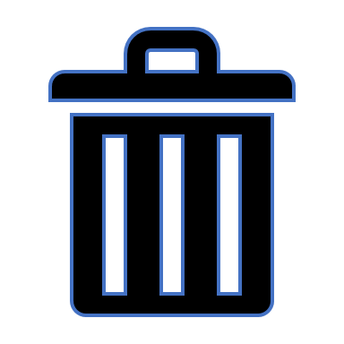
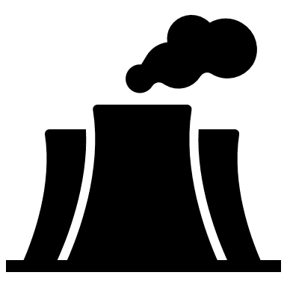
Importance of Zero Waste
Less waste in landfills 91% of packaging waste is sent to the landfills and/or in the environment.
Conserves natural resources New products are made by extracting fresh, raw material from the Earth, through mining and forestry.
Less carbon emissions Every stage of packaging production emits greenhouse gases from manufacturing to transporting.
Less pollution of our air, water, and soil A truckload of plastic waste enters the ocean every single minute, endangering marine life and impacting human health.
Toxicity CEPA deems plastic as toxic due to its immediate or long-term harmful effect on the environment and its biological diversity.
Notes:
Why sustainability and zero waste practices are important: Less waste in landfills Landfill space is limited. And as of now, 91 percent of packaging waste is sent to landfills or it ends up in our environment, like the ocean or in our conserved spaces and in our soil. So reducing single-use plastics would lighten the load for waste-management systems around the world and increase efficiency for the necessary waste needed for processing. .. Landfills are very expensive to maintain. There's lining, piping, constant oversite, upkeep, engineering. So decreasing the amount of trash in landfills enables landfills to last longer, ultimately saving the city a lot of money. So that brings us to our 2nd reason: Zero waste conserves natural resources.....and that's by decreasing our need to create new landfills, AND decreases our need to extract the raw materials that go in to creating and manufacturing packaging in the first place. When products at the store are purchased and taken off the shelves by consumers, new products need to be created and manufactured to continuously replace those purchased items. And with every new item, materials and resources have to be extracted and sourced one way or another again, through oil, coal, mineral mining or logging to replenish those purchased items, as well as all the packaging for those items. Therefore, by reusing what we have will minimize our need to buy new products, thus conserving the materials needed to produce and replace purchased products. .. AND let's not forget that landfills were once natural lands and habitat for wildlife. So zero waste saves natural lands from used for landfills or being used for mining or logging.
And thirdly, Zero Waste means Less carbon emissions and that's because a lot of energy is used during the manufacturing process as well as the transportation process of all those goods, and these processes emit tons of GHG emissions along the way. So yes, every stage of the packaging production emits GHG: 1.) extracting the raw material in the first place (that uses a lot of energy and also produces GHG's (2). Transporting the raw material to the processing plant – that also adds GHGs (3) then once at the plant, the manufacturing process itself also emits GHG's (4) then there's all the transportation to the stores or to our doorstop. GHG emissions are created every step of the way when it comes to extracting, transporting and processing new products.
Next: Zero Waste means less pollution of our air, water, and soil
We just talked about how less products means less GHG emissions in our air, but it also effects our water and soil. For instance, packaging now accounts for a quarter of the 245 million tons of plastic that are used globally each year, making packaging the single most common use of plastic. And globally, only 14% of this plastic packaging actually get's recycled, while a third of it escapes collection entirely, leaving it to pollute our streets, beaches and oceans. So much so that's it's estimated that a truckload of plastic waste enters the ocean every single minute. And plastic can take centuries to break down which is why it's so dangerous. In fact, The National Geographic sites that there are five trillion pieces of plastic in our oceans today – enough to circle the Earth over 400 times.
World Wide Fund for Nature: WWF International conducted a study that suggests every human consumes about a credit cards worth of plastic a week, and that's mainly because of microplastics getting into our soil and into our ocean and ultimately our dinner plates. Lastly, plastic is toxic. Under the CEPA, a substance can be declared toxic if it has an immediate or long-term harmful effect on the environment or its biological diversity, or if it may constitute a danger to human life or health. The latest science suggests that plastics certainly do fit into this definition. In October 2020, Canada released a scientific assessment of plastic pollution and concluded that plastic pollution poses a significant risk to the environment and its biodiversity (although the risk to human health was found to be low). Dioxin is a chemical which is found commonly in plastic and is released when it is heated. Ingestion of this chemical over prolonged periods repeatedly (high levels) is harmful to health since it gets deposited in the fat tissue and causes infertility and cancer. BOOK: Plastic, a Love Story -------------------------------------------------------
(because slimmer packages increase the number of items that can be shipped in one truck, thereby reducing the need for additional vehicles)
And not only saving money, but also saves a lot of harmful emissions from entering our air. We've learned that yes, Landfills are the third-most source of methane, a green house gas that's 25x more potent than carbon dioxide. So any material that's sent there is adding to the landfill's emissions. But those emissions don't just start and end with the landfills. Every stage of packaging production emits greenhouse gases from manufacturing to transporting. From the material mining, to the processing, then to transportation of materials for distribution- A LOT OF emissions are created for a packaging, that is used ONCE. Then thown almost immediately.
Our current culture of consumption is unsustainable. Extracting raw materials from natural spaces requires large amounts of energy and causes pollution, whether it is logging a forest, mining for minerals or drilling for oil.
Reducing and reusing means fewer products are made, as people buy less and as products are made to last. While recycling can also help keep waste out of landfills, reduce and resueign ensures the least amount of carbon emissions are being created. Processing these materials requires more energy and causes more pollution. Once they’re used, the goods are simply dumped in a landfill or destroyed in an incinerator.
In contrast, a zero waste approach conserves natural resources and reduces pollution from extraction, manufacturing and disposal.
-----------------------
https://supplychain.edf.org/resources/sustainability-101-packaging-waste-the-problem/#:~:text=Reduce%20waste&text=As%20of%20now%2C%2091%20percent,and%2For%20in%20the%20environment. https://storage.googleapis.com/gpuk-static/legacy/Bottling-It_FINAL.pdf
-----------------------------------------------------------
Food packaging makes up a large portion of your weekly waste. The most common use of plastic is for packaging – making up 25% of the 245 million tonnes of plastic that are used annually worldwide. Globally, humans buy 1 million plastic bottles per minute, making PET (polyethylene terephthalate) bottles the second largest contributor of plastic used for packaging. In contrast, the 6 biggest soft drink companies in the world use only an average of 6.6% of recycled PET.
That means an average of 93.4% of those bottles are made from virgin material! Plastic are not infinitely recyclable. Even if we recycle everything we use, they eventually end up in the landfill, where it’ll linger for 500 years. Or in the incinerator, where it’ll burn and pollute the air with greenhouse gases.
We’re still going to “lose” a substantial amount of it in the ocean, where it’ll continue to harm marine life and destroy its ecosystem.
https://storage.googleapis.com/gpuk-static/legacy/Bottling-It_FINAL.pdf --------------------- The energy sector—including coal mining, natural gas systems, petroleum systems, and stationary and mobile combustion—is the largest source of U.S. methane emissions, accounting for 303 MMTCO2e in 2009. Agricultural emissions (primarily from livestock management) and emissions from waste management (primarily landfills) also are large sources of U.S. methane emissions, contributing 216 and 208 MMTCO2e, respectively, in 2009.

Slide 6
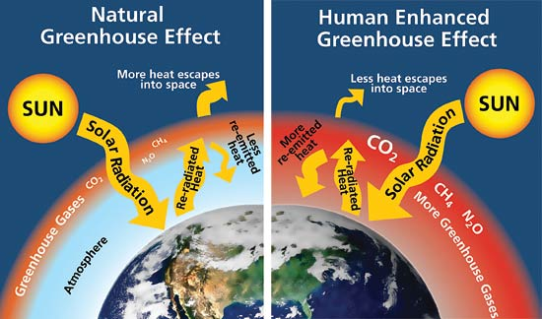
Carbon footprint
A carbon footprint is the total amount of greenhouse gases (including carbon dioxide and methane) that are generated by our actions.
– The Nature Conservancy
Reducing our consumption and using clean energy can lower individual carbon footprint.
Notes:
Human related carbon emmisions are responsbile for heating the Earth planet. Like a green house keeps plants warm, so do greenhouse gases keep the planet warm. The greenhouse effect is a natural occurance which is actually vital to sustaining life on the planet. Although – the natural green house effectis meant to let more heat escape, as it was before industrial revolution, it's estimated to have gotten 1.2 to 1.4 F degrees warmer in just the last century. Redusing our carbon footprint means reducing the amount of greenhouse gases we release into the atmousphere. Reducing our consumption and using clean energy can lower individual carbon footprint.

Slide 7
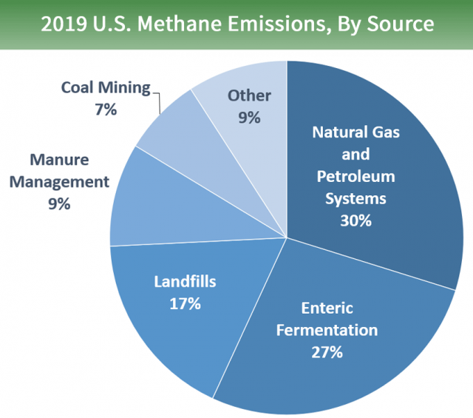
Where is methane coming from?
Methane, a green-house gas, is 20x more potent than Carbon Dioxide.
Notes:
We can be sustainable through our actions by first understanding where emmisions come from and learn how to tackle the main contributors. The largest source of greenhouse gas emissions from human activities in the United States is from burning fossil fuels for electricity, heat, and transportation. This is what "natural gas and petroleum systems" refers to. This encompasses processing facilities, manufactoring and transportation of goods across country. Next is Enteric Fermentation (fancy way of saying Cow flactulents and belching). Emissions from cows and agriculture have been on the rise since meat has become a prominent industry in the United States. Next are landfills. In all settings, when food decomposes, it releases methane. Landfills unfortunately concentrations of methane since that's where the trash goes – including evvverrrything that evveryonne throwns away, making landfills the 3nd most producer of methane.

Slide 8
Ways to be sustainable as a resident
Recycle / Reuse
Incorporate Zero Waste Tactics:
Food Rescue / Compost
Shopping
Wardrobe
Advocate for Environmental Policy

Slide 9
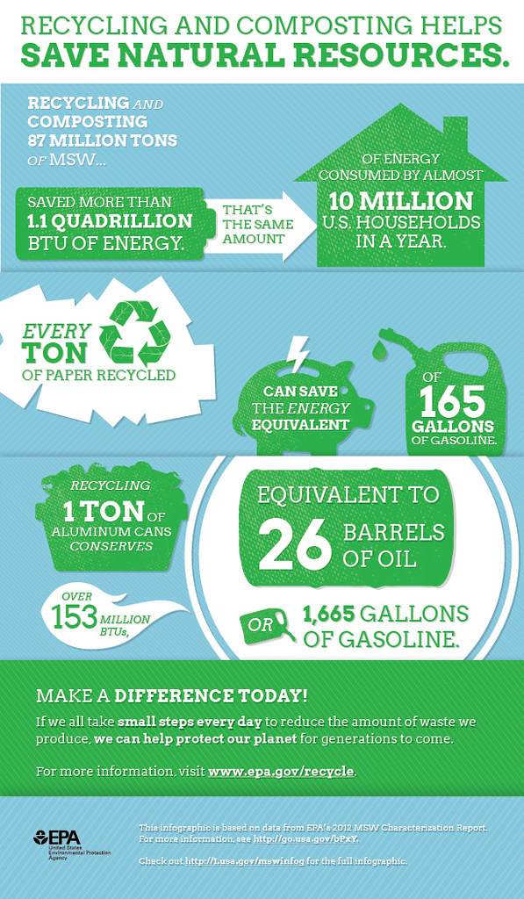
Recycle / Reuse
When we recycle, used materials are converted into new products which reduces the need to consume natural resources. If used materials are not recycled, new products are made by extracting fresh, raw material from the Earth, through mining and forestry.
Notes:
A very easy way to be sustainable as a student or as anyone – is to recycle. When we recycle, not only is less waste is going to landfills, but it also puts that matieral back into the production line. once sources by virgin material back into the production line circulating them in a closed loop across the supply and manufactoring chain also there is less matieral that needs to be aquired by virigin sources. which means less methane is generated, and fewer landfills need to be sited and built. Recycling helps alleviate this process by keeping the matieral back into productions, . need to consume natural resources

Slide 10
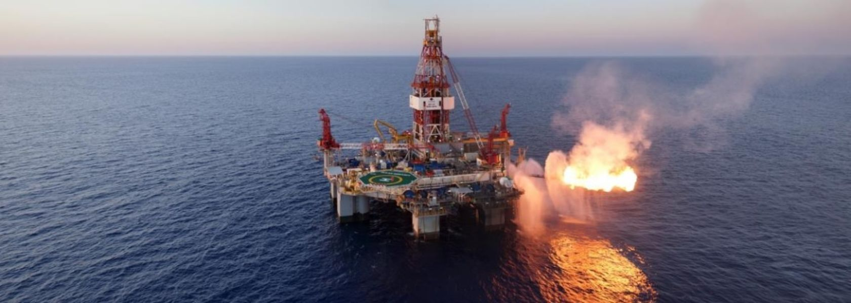
Recycling Prevents
Notes:
--Recycling relieves pressure off trees and forests – since recycling uses paper products that have already been produced instead of having to source the material from virgin sources aka forests. If the current rate of deforestation continues, the world's rain forests will vanish within 100 years - eliminating the majority of plant and animal species on the planet.
--Reusing products and packaging prevents more product from having to be created, thus relieving mining productions, which currently contribute to climate change by generating pollution, disrupting wildlife and damaging public lands
--Oil is essential for creating plastic. And the continuous use and purchasing of plastic, plastic products, plastic packaging contributes to ongoing oil drillings efforts which has been a long-time issue for the enivornment by soffocating marine life, and polluting oceans.

Slide 11
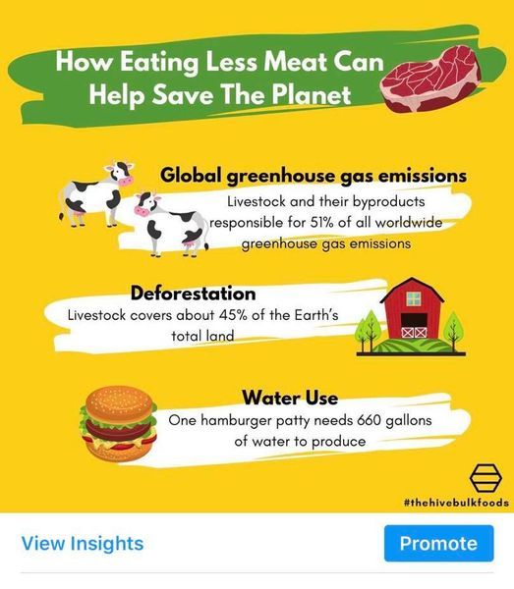
Incorporating a plant-based diet
Beef production is the top driver of deforestation in the world's tropical forests.
Just above landfills, Ruminants/cattle are the 2nd leading cause of human-related methane emmissions.
Notes:
One way to reduce carbon emmisions and conserve land and resources is incorporating a plant-based diet into your lifestyle. This might mean cutting meat out enitrely – or even just having meatless mondays. Beef production is the top driver of deforestation in the world's tropical forests. The rate of deforestation due to the meat indistry more than doubles over the rate of deforestation due to palm oil industry and logging for wood – which are the 2nd and 3rd most leading causing of deforestation. Therefore, plant-based diet conserves land and water. One hamburger patty needs 660 gallons of water to produce if you take into consideation the water needed to keep cows hyrdrated as well as the water it takes to grow their food. Plus - just above landfills, Ruminants/cattle are the 2nd leading cause of human-related methane emmissions – this is due to Enteric Fermentation – again - Cow flactulents and belching) https://www.forksoverknives.com/wellness/vegan-diet-helps-environmental-sustainability/

Slide 12
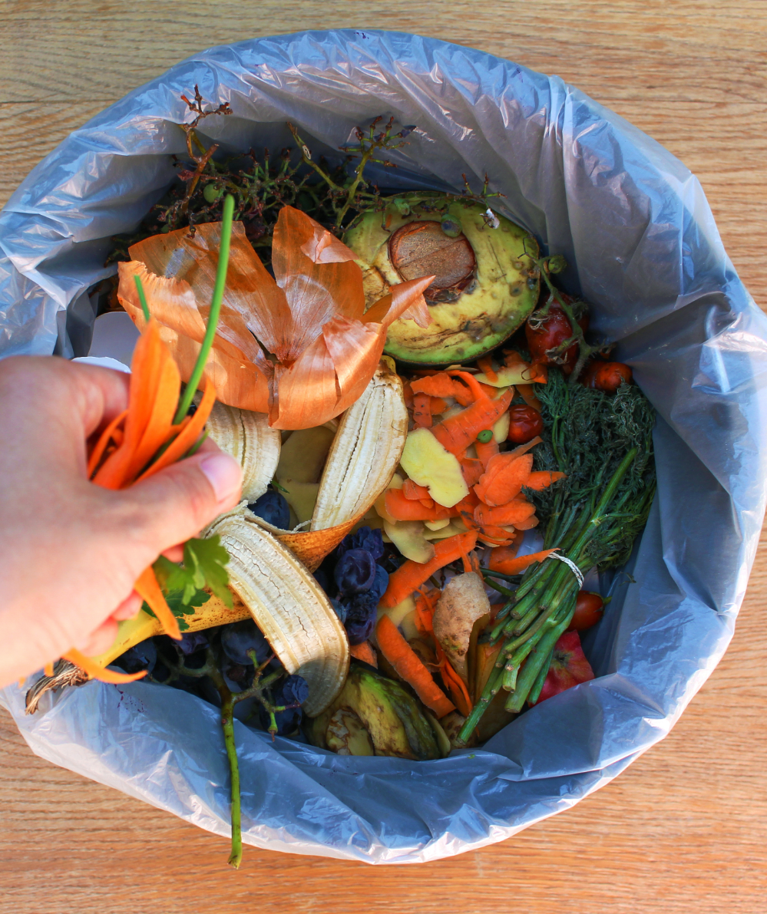
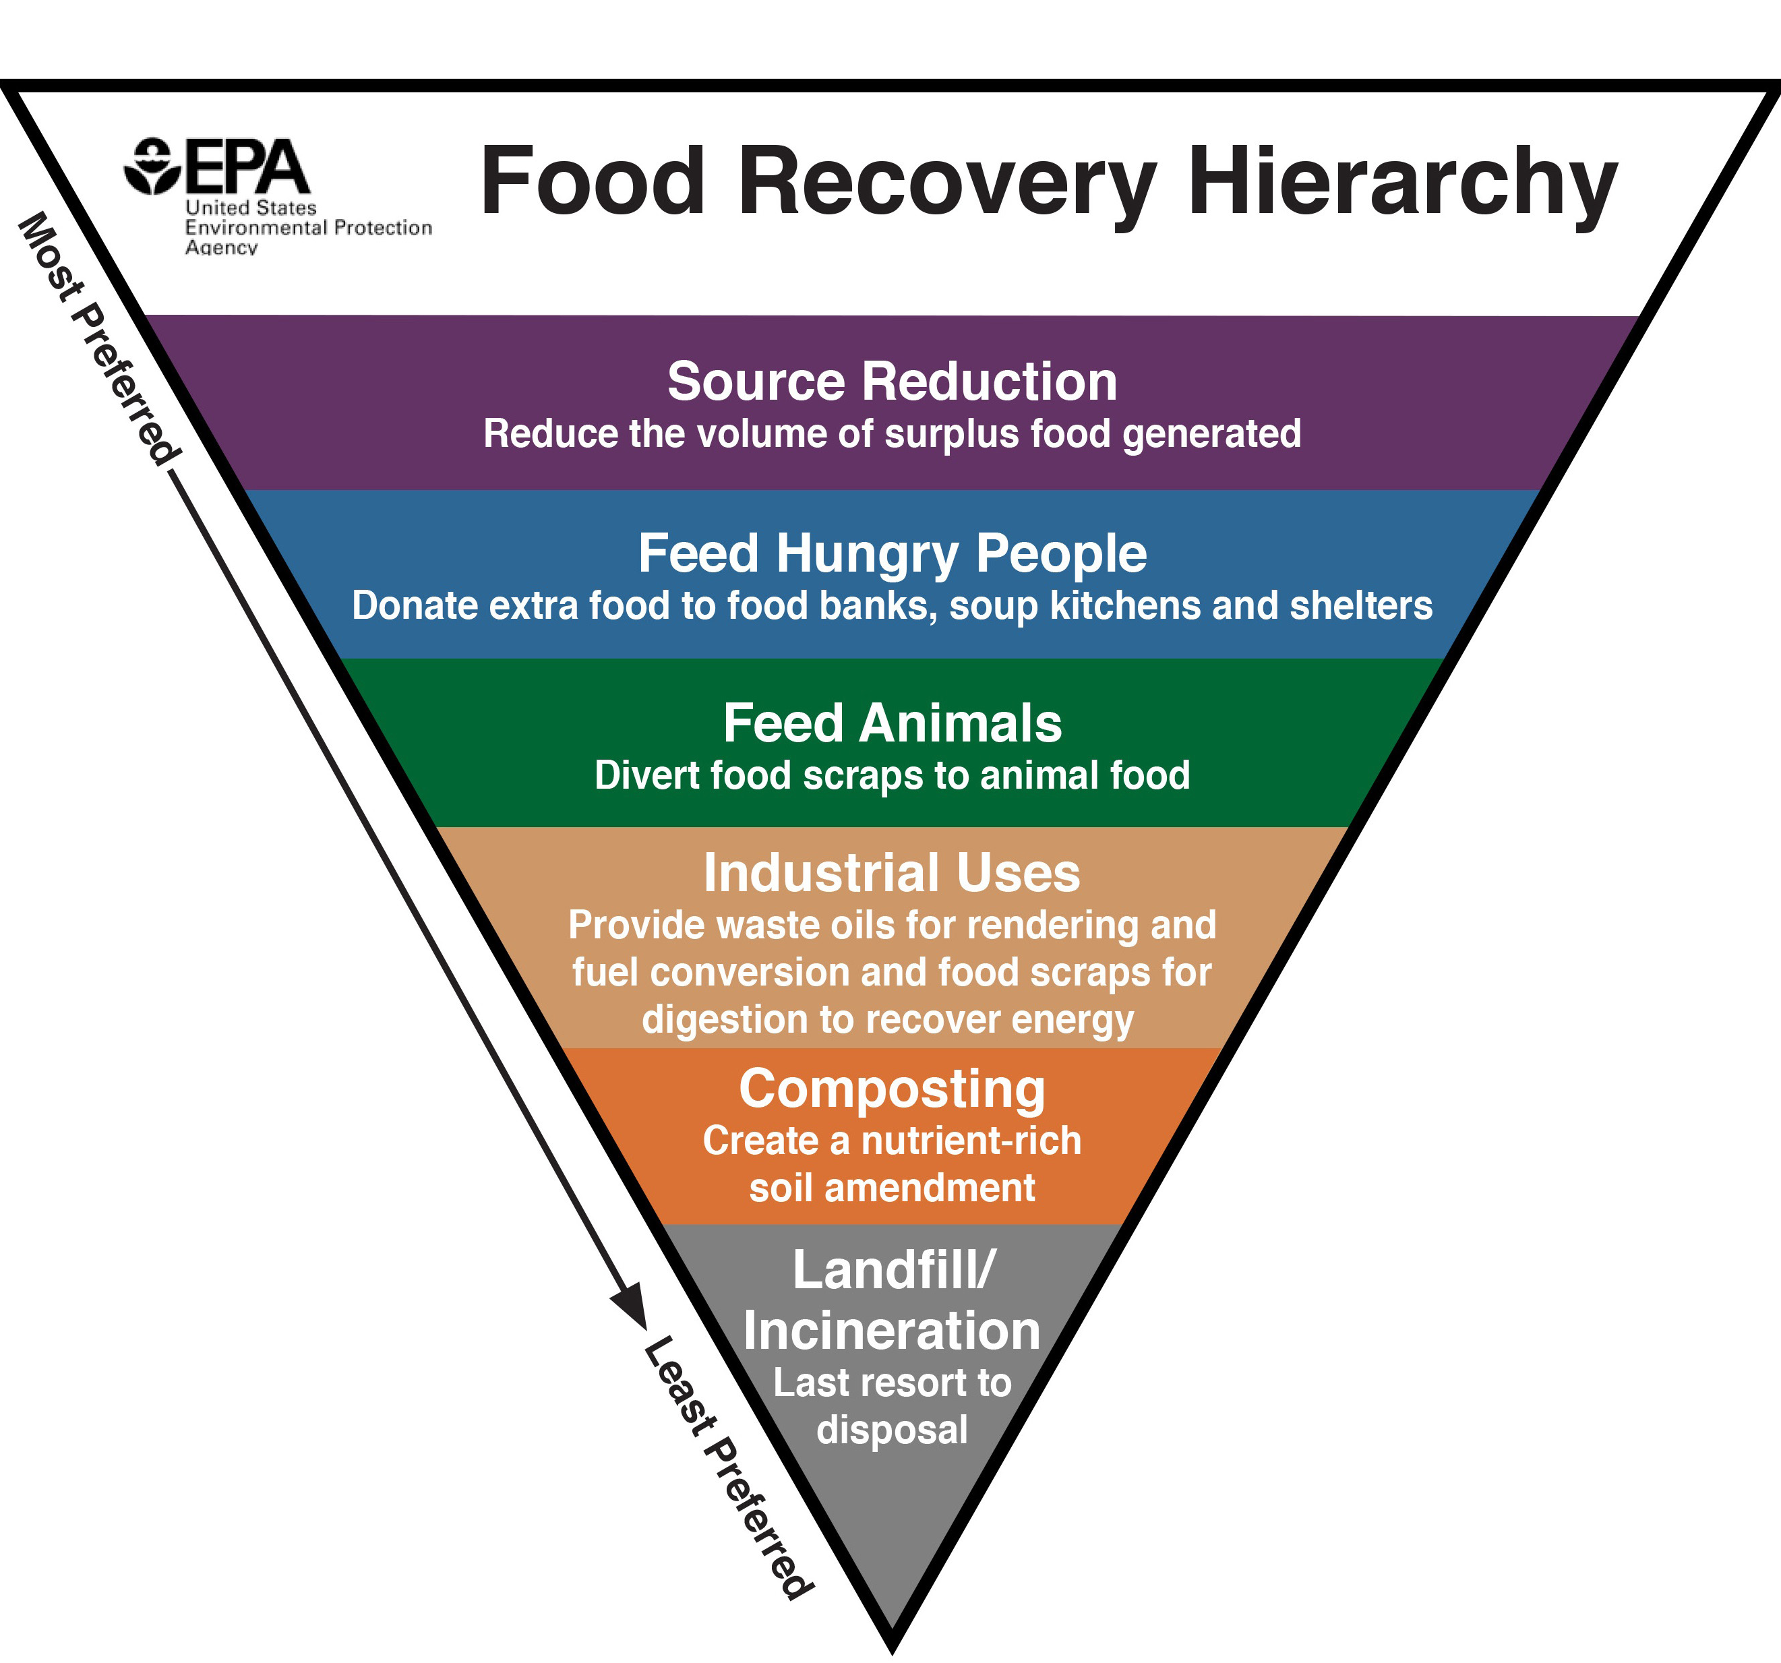
Food Waste
Landfills are the 3rd largest methane emitters in the world.
Prevent food waste by:
Eat your whole meal
Eat your leftovers
Compost / garden
Buy less food
Glean!
Notes:
-Landfills are the 3rd largest methane emitters in the world -Ways to prevent food waste: EPA's Hierarchy Triangle
-Effects on the economy, environment and people
-Where does food waste come from? Mostly from homes!
-How to prevent: Date label confusion, order less first, more later, gleaning, compost, vermi-composting, garden

Slide 13
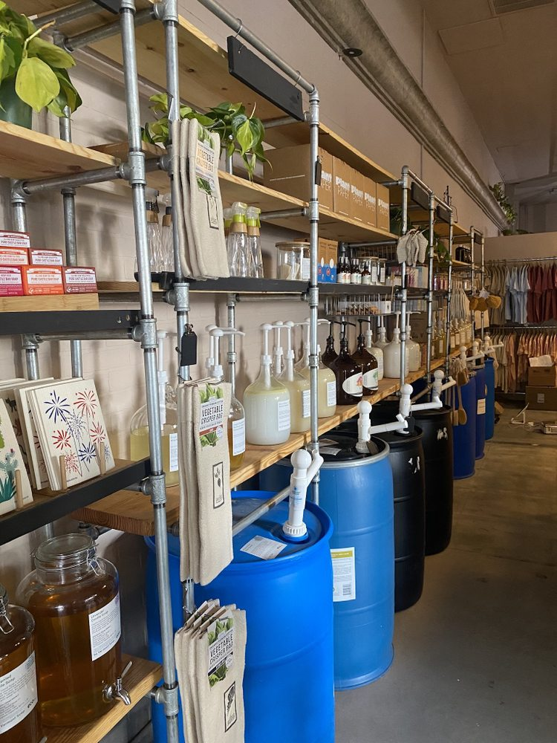
Go Zero Grocery Shopping
Avoid Plastic & Styrofoam
Choose aluminim, glass, or paper
Buy larger containers
Buy imperfect
Buy in Bulk
Eco-Now (New location opening November 2022)
Notes:
Avoid plastic. Why? Because plastic matieral is downgraded. Though it is possible to recycle plastic bottles back into plastic bottles, few recycling plants have the capabilities to do it.
When plastic is recycled, their structure becomes weaker, unlike metal, glass, and paper. As a result, most plastic are down-cycled into fiber for clothes, fleece, fluff for insulation, park benches, carpeting or drainage pipes etc.
Even then, the quality of recycled plastic is often not good enough for even textiles
Buy larger containers
Most bulk purchases have significantly less packaging per use than smaller purchases have. Jumbo packs of toilet paper, for example, are covered in one layer of plastic wrap, whereas individual smaller packs have just a few rolls covered in plastic.
For example, if you compare two cylindrical containers, one that holds a quart and another holding eight ounces, to match the volume of the quart-size container, you’ll need four of the smaller, cup-capacity ones, and they’ll require about 60 percent more plastic to hold as much as the one big container.
Buy imperfect
Imperfect foods that look wonky or are bruised maight not look the same but it probably tastes the same. Especially if it’s being cooked, chopped or made into a desert or smoothie. But imperfect foods at the grocery store are always more likely to not be picked up and therefore more likely to get thrown out and wind up as food-waste. Buy in bulk
Buying in bulk means you're using your own conainers to fill up on food or cleaning products. That way, no excess packaging is being created. Stores like Eco Now located in downtown Riverside allow you to bring and weigh your own container, fill up on product then pay at the register for a 100% free plastic transaction. Plus, weighing is nessesary do you're only paying for the product and not the weight of your container.

Slide 14
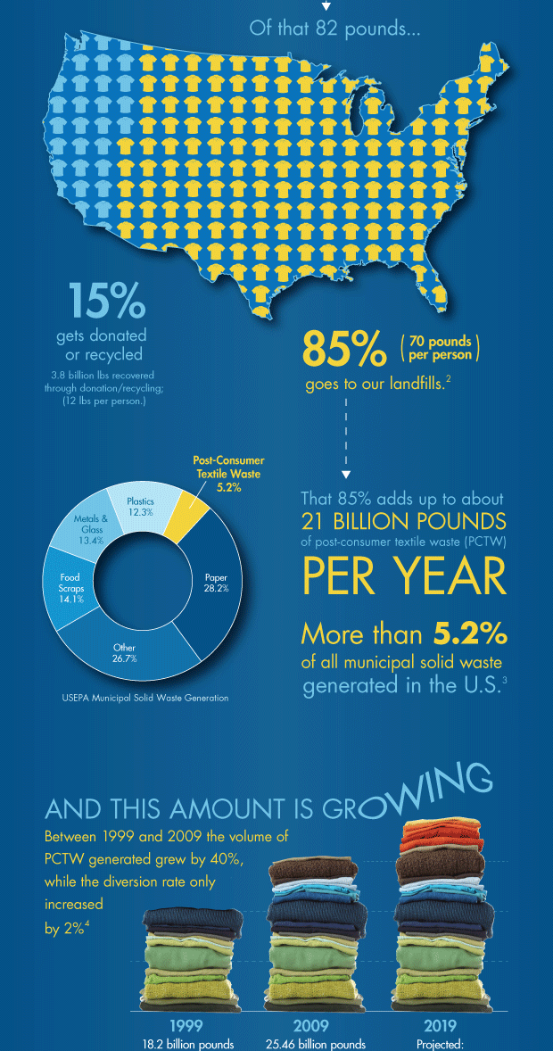
Wardrobe
The U.S. generates an average of 25 billion pounds of textiles per year.
According to the Council for Textile Recycling, the average US citizen throws away 82 pounds of clothing and other textiles annually.
Textiles make up just over 5%
of all municipal waste.

Slide 15
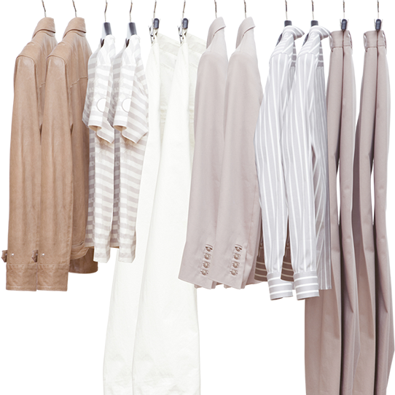
Wardrobe
Buy Second Hand
Clothing swaps
Donate/ sell instead of throwing them away.
Make into rags

Slide 16
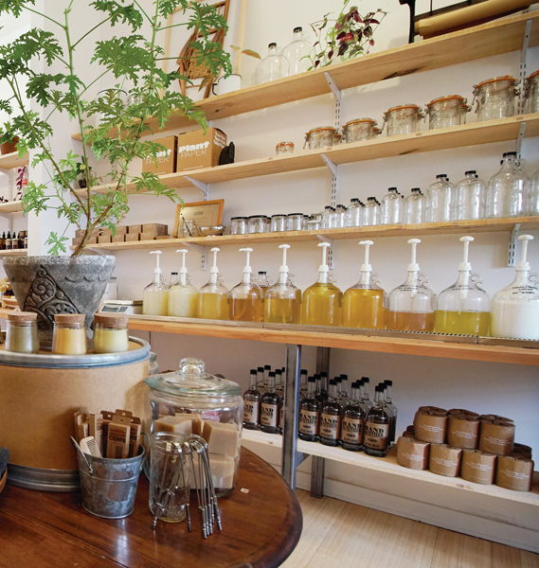
Zero Waste Shopping
Avoid Plastic/Styrofoam
Buy in bulk
Buy larger containers
Buy imperfect
Notes:
Shop at Farmers market
Local produce – less local farmers, but you have the option to choose plastic/package free items. Talk to the vender to explain you don't buy plastic & would like a package-free option

Slide 17
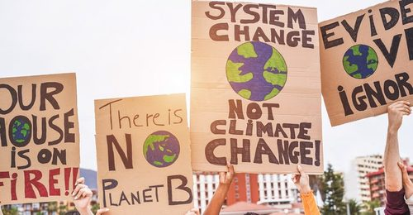
Advocate for Environmental Policy
Policies addressing water and air pollution & wildlife protection EPR – Extender producer responsibility
Clean Renewable Energy Infrastructure
Notes:
Lastly, advocate for Environmental policy! This takes the form of petitions & voting for policies addressing water and air pollution, smog, drinking water quality, land conservation. and wildlife protection, protection of endangered species, including EPR – Extender producer responsibility

Slide 18
Sustainability 101
Riverside County, Department of Waste Resources Rivco Recycles Community Summit 2022
Notes:
Thank you!

