Slide 1
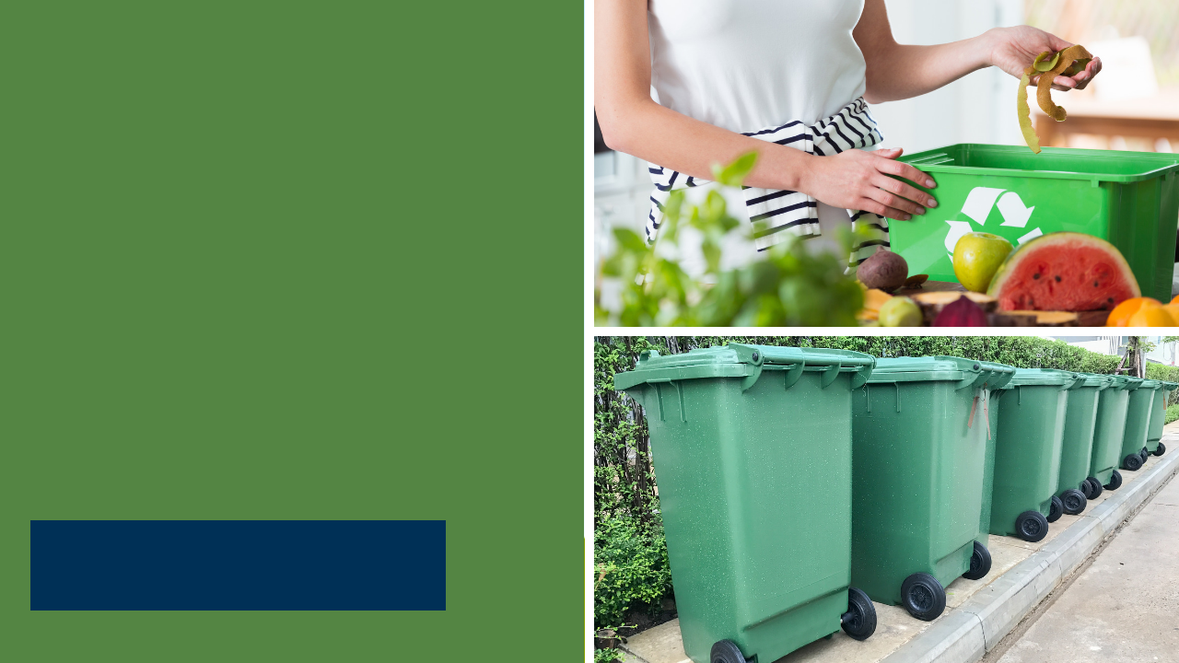
SB 1383 for
Local Education Agencies & Model Programs
Andrew Smyth – Environmental Scientist
CalRecycle
11.17.22
Notes:
Introduction - Opener

Slide 2
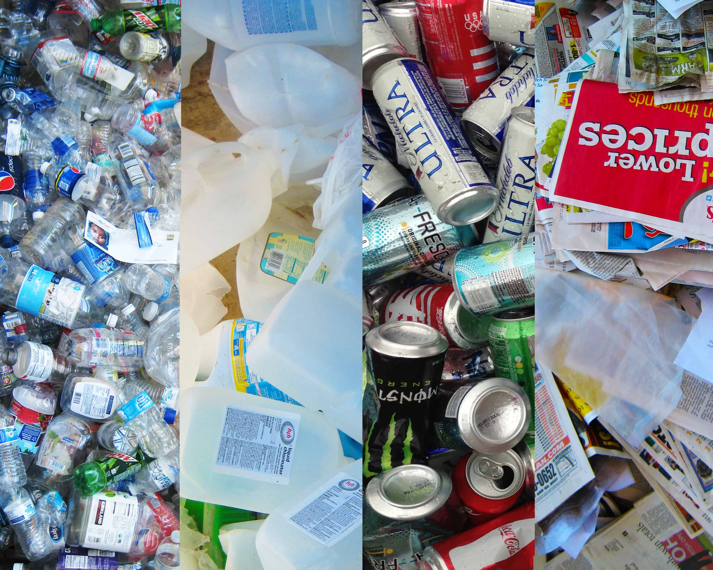

Current Solid Waste Laws
AB 32 California Global Warming Solutions Act (2006): The first comprehensive program of regulatory and market mechanisms to achieve real, quantifiable reductions of greenhouse gases (GHG).
AB 341 Mandatory Commercial Recycling (2012): Requires public entities that generate four cubic yards of solid waste per week to reuse, recycle, compost, or otherwise divert solid waste from disposal.
AB 1826 Mandatory Commercial Organics Recycling (2016): requires public entities that generate two cubic yards of solid waste (total of trash, recycling, and organics) per week to implement an organic waste recycling program.
Notes:
Many individuals monitor school waste, including school district administrators concerned about increases in solid waste disposal costs, recycling-conscious teachers and students, and city/county recycling coordinators working with a local school districts.
There are a number of recycling laws that affect school districts and schools that I will briefly touch on before diving into the SB 1383, which builds on these regulations' requirements:
Mandatory Commercial Recycling, impacting schools that generate at least 4 cubic yards of municipal solid waste per week.
Mandatory Commercial Organics Recycling, impacting schools that generate 2 cubic yards of solid waste per week, that is 2 cubic yards of trash, recycling, and organics total.

Slide 3

Current Solid Waste Laws
AB 827 (2020): Builds off AB 341 and AB 1826. Public entities must make recycling and organic recycling containers available. These containers must be placed adjacent to trash containers and be visible, easily accessible, and clearly marked.
SB 1383 Short-Lived Climate Pollutants: Organic Waste Methane Emissions Reduction (2022): Schools and local education agencies will be required to prevent, reduce the generation of, and recycle organic waste. Additionally, in 2024, schools and local education agencies with an on-site food facility will be required to recover edible food.
Notes:
AB 827- the collection container requirements, impacting schools in areas where recycling and organics is generated. Schools must provide an appropriate container adjacent to the solid waste container to collect and divert recycling and organic waste.
In September 2016, Governor Brown set methane emissions reduction targets for California, SB 1383, in a statewide effort to reduce emissions of short-lived climate pollutants by reducing organic waste disposal by 50% by 2020 and 75% by 2025.
As part of California’s larger strategy to combat climate change Senate Bill 1383 established an edible food recovery goal
No less than 20 percent of currently disposed edible food must be recovered for human consumption by 2025
Why is this so important? In short, it will reduce food insecurity, which has doubled since COVID, and reduce super pollutants like methane, which is 84 times more potent than CO2.
Recycling organic waste and recovering edible food is a fast track to combating climate change.

Slide 4
Definitions
Local Education Agency: a school district, charter school, or county office of education that is not subject to the control of city or county regulations related to solid waste.
Organic Waste: Solid wastes containing material originated from living organisms and their metabolic waste products including, but not limited to, food, green material, landscape and pruning waste, organic textiles and carpets, lumber, wood, paper products, printing and writing paper, manure, biosolids, digestate, and sludges.
Notes:
SB 1383 defines a Local Education Agency as a school district, charter school, or county office of education that is not subject to the control of city or county regulations related to solid waste.
Examples include all public school sites and other facilities such as a district office, central kitchen, and maintenance and operations locations.
Organic waste is defined on the slide.

Slide 5
SB 1383 Organic Waste Requirements
Article 5. Generators of Organic Waste (Section 18986.1 & 18986.2)
  Subscribe to an organic waste collection service, or self-haul organic waste to a recovery facility
  Need to provide containers for the collection of organic waste and non-organic recyclables in all areas where disposal containers are located, except restrooms
  Prohibit employees from placing organic waste in a container not designated for organic waste
  Periodic inspections of containers for contamination and inform employees if containers are contaminated
  Provide information to employees and students on methods for prevention of organic waste generation
Notes:
These are the organic waste recycling requirements in the SB 1383 regulations for local education agencies:
Local education agencies must either subscribe to collection service or self-haul organic waste.
They can have a 3, 2, or single unsegregated collection service but the service must comply with the requirements in Article 3.
Local education agencies need to provide containers that conform to the container color and label requirements for the collection of organic waste and non-organic recyclables in all areas where disposal containers are located, except restrooms.
The next requirement:
Prohibit employees from placing organic waste in a container not designated for organic waste to help to minimize contamination and ensure that the maximum amount of organic waste is recovered.
Next requirement:
Periodically inspect organic waste containers for contamination and, if the containers are contaminated, inform employees of the requirement to only use those containers for organic waste.
This ensures that local education agencies are communicating to employees when containers are contaminated, and when needed, educating employees about the proper use of organic waste containers.
And finally:
Provide information to employees and students on methods for the prevention of organic waste generation

Slide 6
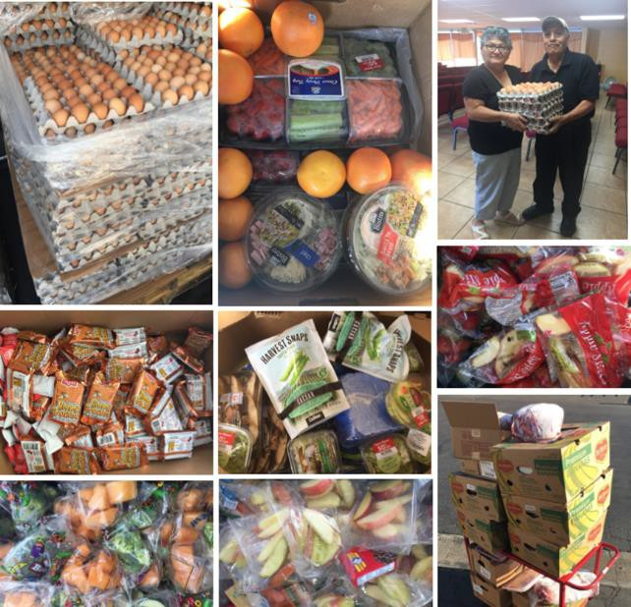
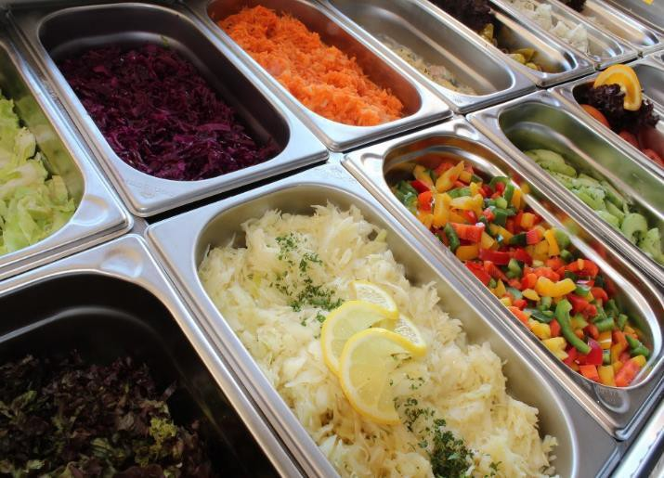

WHAT DOES “EDIBLE FOOD” MEAN?
In addition to collection and diversion requirements: Tier 2 (2024) Edible Food Recovery – Food donors must arrange to recover the maximum amount of edible food that would otherwise go to landfills starting January 1, 2024.
“Edible food” means food intended for human consumption.
“Edible food” is not solid waste if it is recovered and not discarded.
Nothing in this chapter requires or authorizes the recovery of edible food that does not meet the food safety requirements of the California Retail Food Code.
Notes:
Additionally, schools and school districts that have on-site food facilities must arrange for edible food recovery starting Jan. 1, 2024. The law phases food donors in - using two tiers.
Edible food means food intended for human consumption
We specify in the regulations that nothing requires that edible food be recovered if it does not meet the food safety requirements of the California Retail Food Code
So just because the food is intended for human consumption does not mean it is safe to recover.
It must be intended for human consumption and also meet all of the food safety requirements that are specified in California’s Retail Food Code
The photos on the left were taken from one of CalRecycle’s waste prevention and rescue grant recipients.
These are some of the recoveries that are occurring in K-12 schools and school kitchens
So showing a contrast. The food on the right is from an unsupervised open buffet line where customers serve themselves.
Most county health departments would not allow that food to be donated.

Slide 7
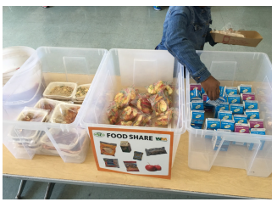
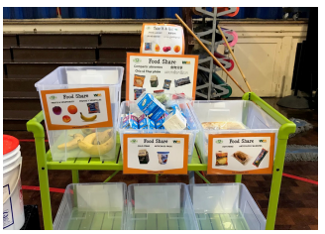
Examples
Food Share Table and Sorting Station
Notes:
Here’s some examples from a school that shows food share table and sorting station.

Slide 8
Davis Joint Unified School District (NorCal)
The Davis Joint Unified School District has a garden in every school. Students plant in mosaic planters, raised beds, landscaped areas and more. They learn about plants, insects, soil, composting and growing fresh and tasty food.
We support school site garden coordinators and are a resource for lessons, supplies, volunteers, workshops, networking and communicating with district maintenance staff. We also work with district administration to craft school garden policies.
Notes:
​
GARDENS
​
School Gardens
Davis Farm to School supports school garden programs in Davis through monthly meetings for garden coordinators at all schools, lesson content, videos and a competitive grant program.
Davis Farm to School and DJUSD co-sponsor the district-wide waste reduction and recycling program called DavisRISE (Recycling Is Simply Elementary). Each school site DavisRISE coordinator works with students, custodians, administrators and staff to implement a customized recycling and composting program. The recent ALL (All Lunch Leftovers) Compost Program, part of the commercial food scrap collection program sponsored by the City of Davis and Davis Waste Removal, has led to increased savings in solid waste removal costs. The monetary savings to DJUSD produced by the DavisRISE program provides all DavisRISE coordinators with a stipend for their work. Custodians can also earn recognition and monetary awards for their recycling work.
​Davis Farm to School and the Davis Joint Unified School District co-sponsor the district-wide, waste reduction program called DavisRISE (Recycling Is Simply Elementary). DavisRISE is a hands-on, real world program that works to reduce solid waste and save money.
Local volunteers, farmers, and businesses donate vegetable starts to Davis Farm to School for distribution to Davis schools and families. Davis Farm to School provides instructional videos on how to plant, harvest, and prepare the vegetables. Students use a plant observation journal to record the growth of their plant.

Slide 9
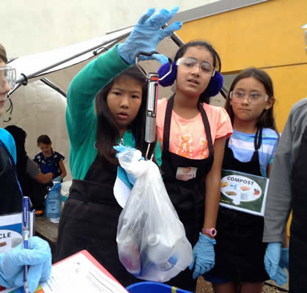
Bay Farm School
Alameda, CA
Notes:
Bay Farm School has implemented an efficient three-stream waste diversion program that diverts 85 percent of solid waste from the landfill. Students are critical to these efforts, monitoring lunchtime sorting and conducting multiple waste audits to keep recyclables out of classroom and playground trash. Bay Farm's Outdoor Learning Center (OLC) is managed by a full-time garden teacher. All students regularly learn outdoors in part by working in the OLC and eating the food they grow there. *Green Ribbon School

Slide 10
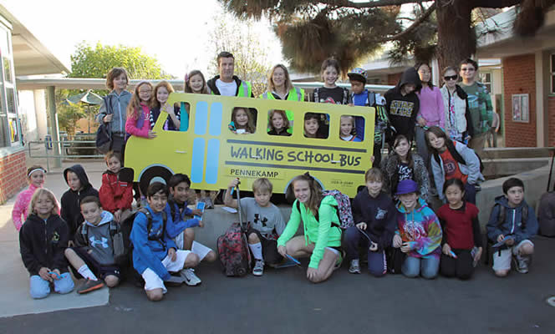
Manhattan Beach Unified School District
Notes:
Manhattan Beach Unified School District (MBUSD) has documented a 33 percent reduction in non-transportation energy use and a 44 percent reduction in greenhouse gas emissions from a 2009 baseline. All MBUSD schools are ENERGY STAR certified. MBUSD diverts 100 percent of food waste by combining on-site composting with a municipal program that converts food waste into Engineered Bioslurry used to generate energy. MBUSD was the first district to pilot and implement the parent-initiated programs Grades of Green External link opens in new window or tab. and Growing Great External link opens in new window or tab.. MBUSD earned a California Green Ribbon Schools Silver Level Award in 2015, and Grand View Elementary School was recognized as a U.S. Department of Education Green Ribbon School in 2012.

Slide 11

Los Angeles Unified School District
Notes:
In an effort to avoid discarding excess or unused food served, the Board of Education passed the “Healthy Students, Healthy Families, Healthy Communities” resolution to make surplus edible food and edible food waste available to charitable organizations.
Second largest in the nation, the Los Angeles Unified School District enrolls more than 565,000 students in kindergarten through 12th grade. The District covers 710 square miles and includes Los Angeles as well as all or parts of 25 smaller municipalities plus several unincorporated sections of Los Angeles County.

Slide 12
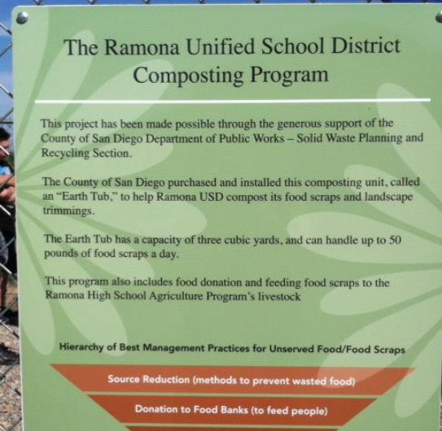
K-12 Food Recovery
Ramona Unified School District
Notes:
The Program
RUSD participates in a comprehensive food donation and composting program in partnership with the County of San Diego. Benefits of diverting organics from the landfill
• Feeding people
• Feeding animals
• Composting food discards
• Students involved in improving the Earth’s
environment and reducing greenhouse gas
emissions.
All schools divide kitchen scraps. These are kept in buckets with lids and are refrigerated until collection. They are then weighed before designating to animal feed or composting each day. Food that is left over from self serve fruit and vegetable salad bars, as well as non wrapped entrees from the 8 school cafeterias is collected for animal feed. Compost is utilized in the Culinary Garden.

Slide 13

San Diego Unified School District
Notes:
The San Diego Unified School District spends more than $1.2 million on waste collection each year. In order to reduce costs and conserve resources, the District operates a District-wide waste reduction and recycling program at more than 180 educational facilities, offices, and departments. The Recycling Program is coordinated through the District's Energy / Utilities Management Program.
The Edible Food Recovery program offers an avenue for leftover food from the school meal program to be diverted from the landfill to local organizations facing food shortages. Focusing on reducing sources of food waste and recovering unused prepared food, the program has been widely successful.
The “Love Food Not Waste” program is a partnership between San Diego Unified and Feeding San Diego. Feeding San Diego coordinates with additional local partners, such as the San Diego Rescue Mission and a number of smaller organizations who are given the opportunity to pick up surplus food from production kitchens throughout the district.

Slide 14
Waivers
Article 5. Generators of Organic Waste (Section 18986.3)
  De Minimis:
    Solid waste is 2 cu. yd or more and organic waste is less than 20 gallons per week
    Solid waste is less than 2 cu. yd and organic waste is less than 10 gallons per week
  Space Constraints: no adequate space for organic containers must be determined by a hauler, licensed architect or engineer
  The entity is located within a jurisdiction or census tract that has been granted a waiver by the Department pursuant to Section 18984.12.
Notes:
CalRecycle shall waive a local education agency’s obligation to comply with some or all of the organic waste collection requirements if the local education agency provides documentation demonstrating that any of the following situations applies:
If a local education agency generates a de minimis amount of material in the blue and/or green container, it can be issued a waiver. De minimis amounts are either of the following:
Solid waste is 2 cy or more and organic waste is less than 20 gallons per week
Solid waste is less than 2 cy and organic waste is less than 10 gallons per week
A space waiver may be granted for a local education agency if it provides documentation that there is inadequate space for separate organic waste containers.
If a jurisdiction that a local education agency is located in is granted a waiver pursuant to Section 18984.12, then the local education agency will not have to comply with the requirements in Article 5. The local education agency will need to submit a request to CalRecycle.
This was done because if the jurisdictions in these areas do not have to comply with Article 3 then there will no be collection services available for local education agencies to utilize.
We will be publishing on the CalRecycle website the jurisdictions and census tracts (for unincorporated areas) that meet the thresholds for a waiver after the 2020 Census data is available.
I would like to note that a school site may want to coordinate with the school district to determine if the entire school district is eligible or just certain sites and then determine if the school district will submit the waiver requests.
References:
Low Population:
(1) A jurisdiction may apply to the Department for a waiver for the jurisdiction and some or all its generators from some or all of the requirements of this article if the following apply:
(A) The jurisdiction disposed of less than 5,000 tons of solid waste in 2014 as reported in the Disposal Reporting System.
(B) The jurisdiction has a total population of less than 7,500 people.
(2) A jurisdiction may apply to the Department for a waiver from some or all of the requirements of this article for census tracts that have a population density of less than 75 people per square mile that are served by the jurisdiction and are located in unincorporated portions of a county.
Rural exemption:
The Department shall grant an exemption from complying with the organic waste collection requirements specified in this article for rural jurisdictions that meet the definition of a “Rural Jurisdiction” in Section 42649.8 of the Public Resources Code (MORe), if the governing body of the jurisdiction adopts a resolution that includes a finding as to the purpose of and need for the exemption.
Elevation

Slide 15
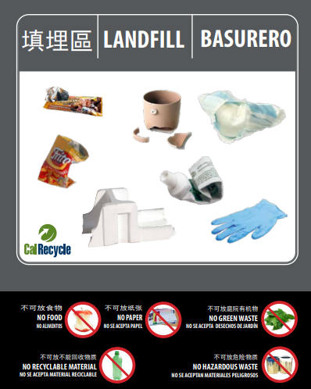
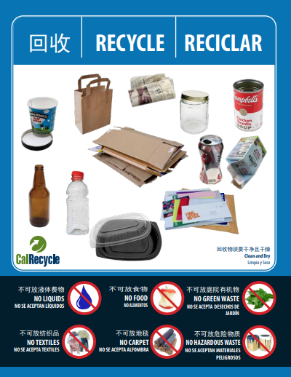
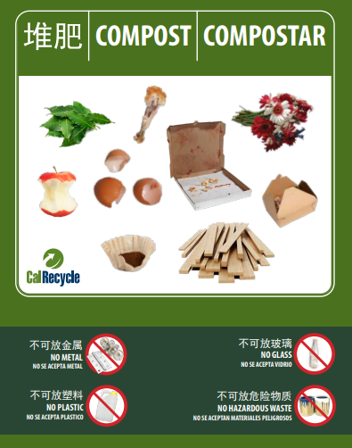
Resources
SB 1383 Schools Homepage:
https://calrecycle.ca.gov/organics/slcp/schools/
Outreach, Education and Signage: https://www.calrecycle.ca.gov/recycle/commercial/organics/prtoolkit
Model Food Recovery Agreement:
https://www2.calrecycle.ca.gov/Docs/Web/117921
Webinar for School Requirements:
https://www.youtube.com/watch?v=sCEHOurf6OY
Notes:
Visit our SLCP webpages for updates and requirements on SB 1383.
CalRecycle developed and posted on our website SB 1383 compliant model labels, signage, and brochures for local education agencies to utilize.
The signage is available for three-, two-, and single unsegregated collection services in English, Spanish, Mandarin, Punjabi, Russian, and Korean.
Each sign is fully customizable using Adobe Acrobat Pro. Users can add and delete the material(s) they collect in their program.
I also have the link there to the Model Food Recovery Agreement
We continue to develop and share best management practices for local education agencies. We have a host of School Waste Reduction pages that include case studies, model programs, award programs and tips so that you do not have to recreate the wheel.

Slide 16
More Resources
Statewide Local Education Agency webinar on YouTube:
https://www.youtube.com/watch?v=sCEHOurf6OY
To stay up to date, sign up for CalRecycle’s Schools and Short-Lived Climate Pollutants (SLCP) listservs: https://www2.calrecycle.ca.gov/Listservs/
Local Assistance & Market Development Staff: https://www2.calrecycle.ca.gov/LGCentral/Contacts
SLCP In-Box: slcp.organics@calrecycle.ca.gov
School In-Box: schools@calrecycle.ca.gov
Notes:
The information I have provided on these slides is available as a statewide webinar on CalRecycle’s YouTube page. Please feel free to send it to anyone in your school district or use it as a training tool.
To stay up to date, you can sign up for the SLCP and Schools listserv. We send information out that we believe will be helpful for schools like if we hear about grant programs, we send that information along.
We have CalRecycle staff currently assigned to every city and county across the state. They are your points of contact if you need assistance in implementing school programs. We want our schools to be successful and we are here to provide technical assistance if you need it.
We also have general emails for you to reach out if you have any questions.

Slide 17
Disclaimer
This guidance tool was developed by CalRecycle as a courtesy for informational and example purposes only. Use of this tool is optional and is not a regulatory requirement. In the event of any conflict with this guidance tool or information herein, applicable statutory and regulatory provisions shall control. This tool and information herein are based on known facts and legal authority as understood by CalRecycle at the time of release. Any analysis, guidance, or other information herein may be subject to change based on changed facts or legal authority, actual or understood, subsequent to the time of this communication. The provision of this guidance tool and any analysis, guidance, or other information herein shall not be construed as a waiver of any rights or remedies available to CalRecycle. Recipients of this communication are encouraged to seek the assistance of legal counsel to comply with applicable state law based on their pertinent facts and circumstances. CalRecycle makes no representation that use of this tool will ensure compliance with regulatory requirements. The user assumes all risk and CalRecycle accepts no responsibility or liability to any person because of the use of, or reliance upon, this tool or the information herein.
Notes:
This concludes my presentation and we will open it up for questions.

