Slide 1
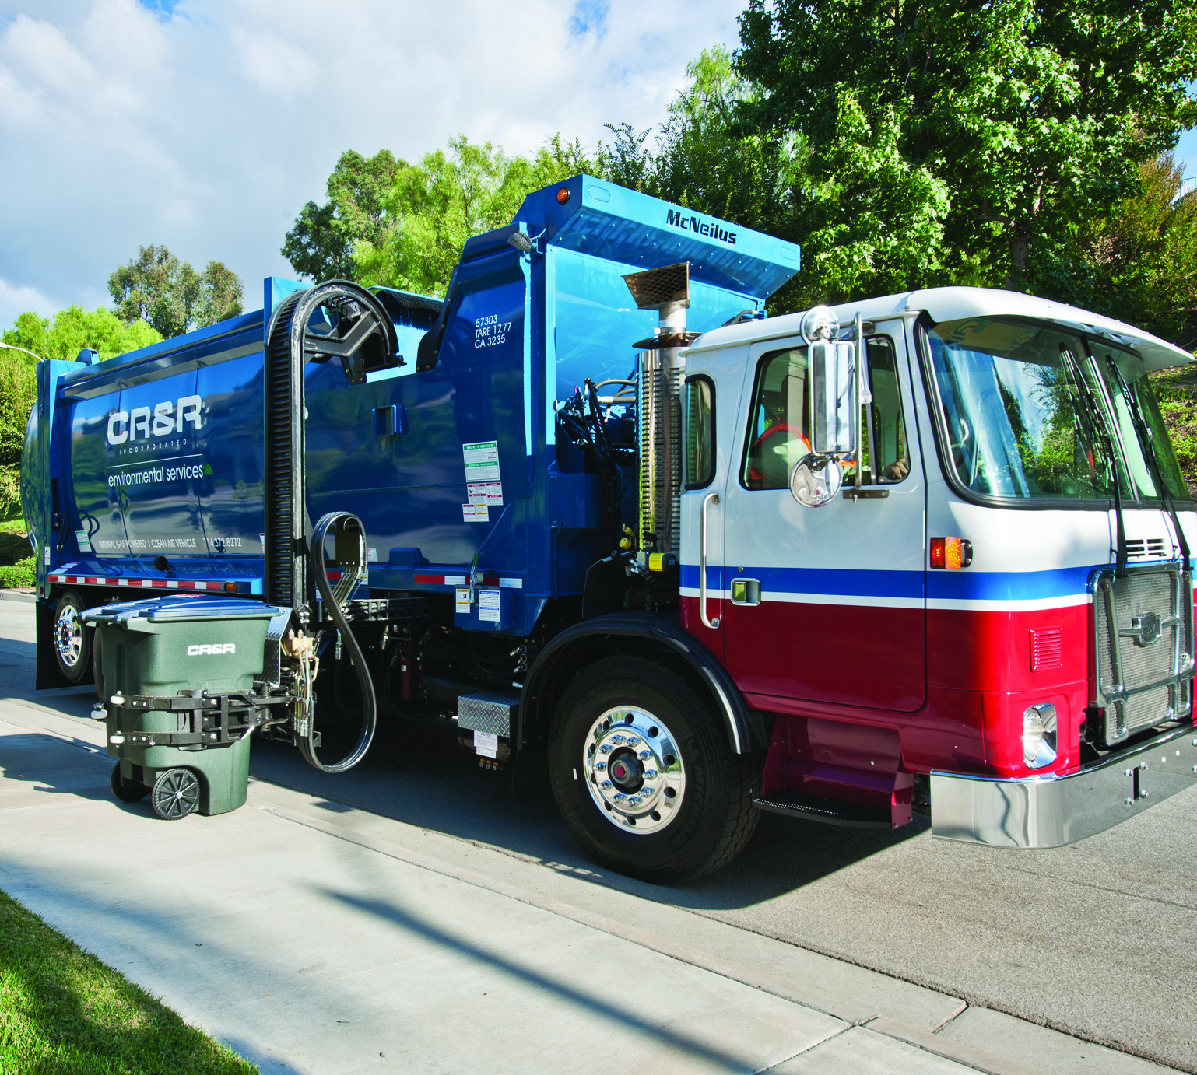

CR&R Environmental Services
SB 1383 – Organic Waste
Notes:
Hello, my name is Goseline Huerta. I was recently hired as a sustainablity specialist here at CR&R this year in early July. I had no previous experience in the waste industry, but I am eager and excited to continue working and learning here. For my presentation, I’ll be focusing more on what I have been exposed to thus far with regards to SB 1383.

Slide 2
Senate Bill 1383 (SB 1383)
Signed into law by Governor Brown in 2016
SB 1383 regulations went into effect January 1, 2022
It requires the State to increase edible food recovery by 20% by 2025
It also requires the State to reduce organic waste disposal by 75% by 2025
And a 75% reduction of organic waste = 20 million tons annually Statewide

Slide 3

Senate Bill 1383 (SB 1383)
When organic waste decomposes, it produces methane
Methane is a greenhouse gas, and is 84 times more potent than carbon dioxide, making it a great contributing factor to climate change
Therefore, to reduce methane emissions, we need to focus on reducing the amount of organic waste that gets tossed into our landfills
Reducing the amount of organic waste in our landfills can also extend our landfill capacities for future generations
Notes:
Why was SB 1383 even signed into law? Well…

Slide 4
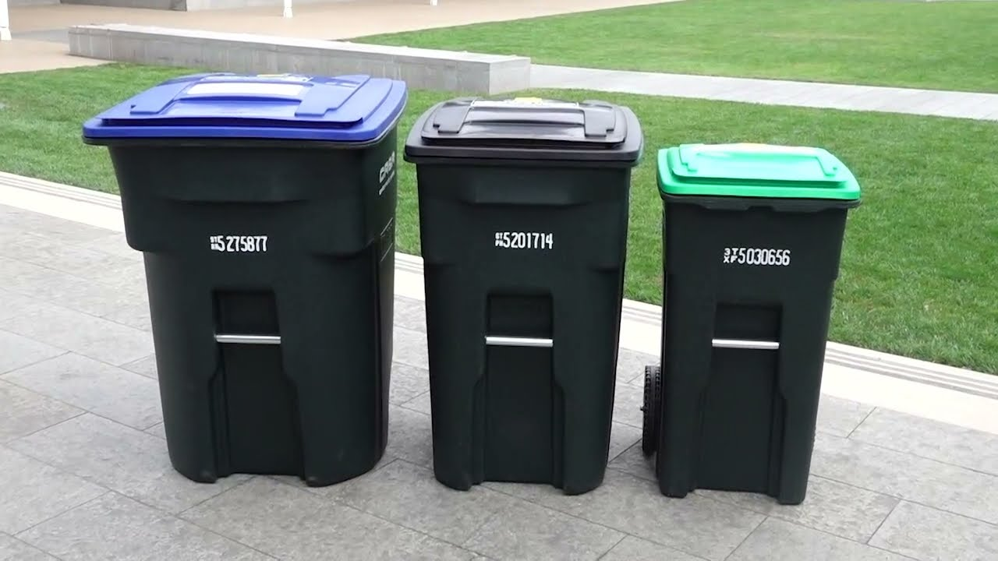



CR&R’s THREE-CART SYSTEM
CR&R first started with the three-crate system in 1986, and then transitioned into the three-cart system in 1991
The color-coding system for CR&R consists of Blue, Black and Green
Recyclables go into the blue cart, trash or material sent to the landfill gets placed into the black cart, and organic waste goes into the green cart

Slide 5

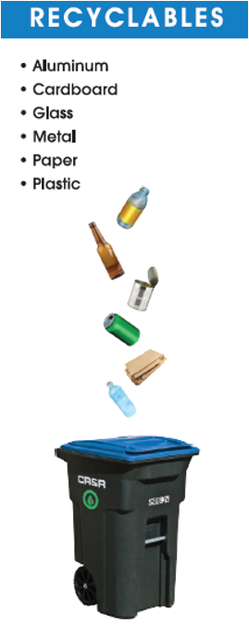
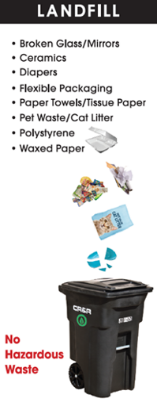
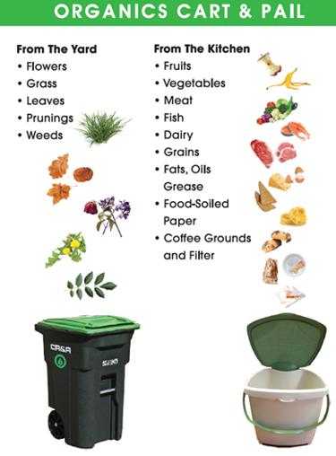
CR&R’s three-cart system
Notes:
As mentioned, recyclables like paper and cardboard get placed into the blue cart. Trash like broken glass, diapers and polystyrene get placed into the black cart. And then yard and food waste get placed into the green cart. We offer our customers this food pail to collect their food scraps. We have already been handing them out. I actually delivered 50 food pails myself last week to the City of Calimesa. And we have actually been getting some positive feedback from our residential customers on these food pails.

Slide 6
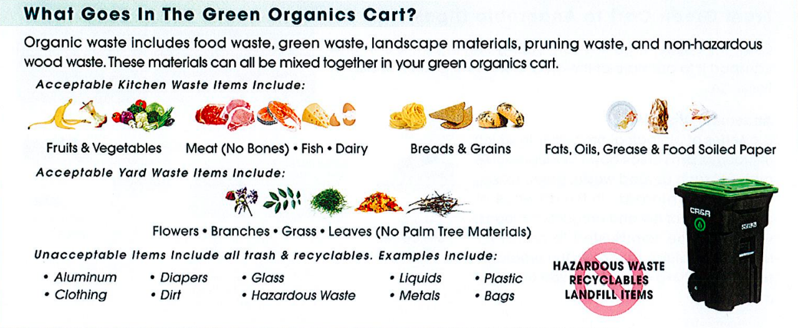
Organics recycling program
Notes:
Here is a better image showing what we accept in the Organic Cart: we have our fruits, meats, breads, fats, and grease. And then the yard waste which consists of flowers, branches, grass and leaves.

Slide 7
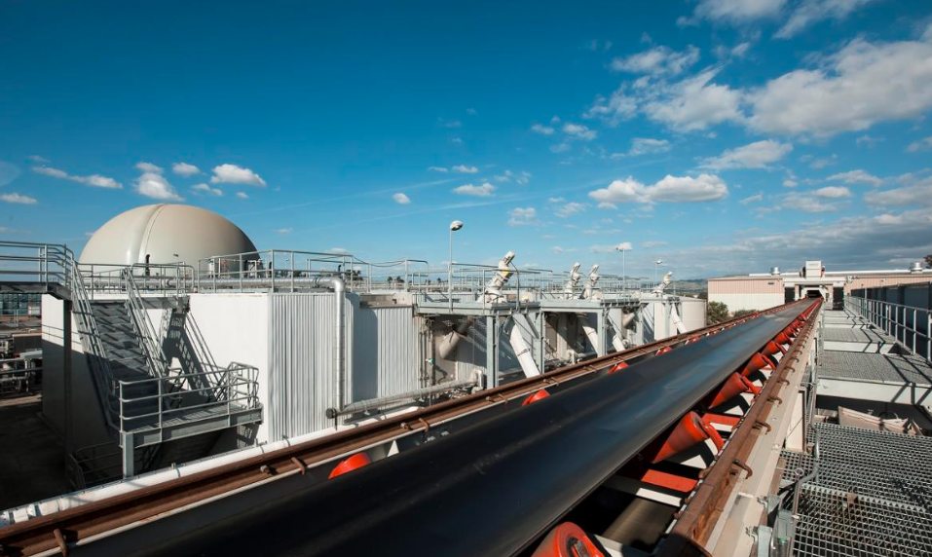
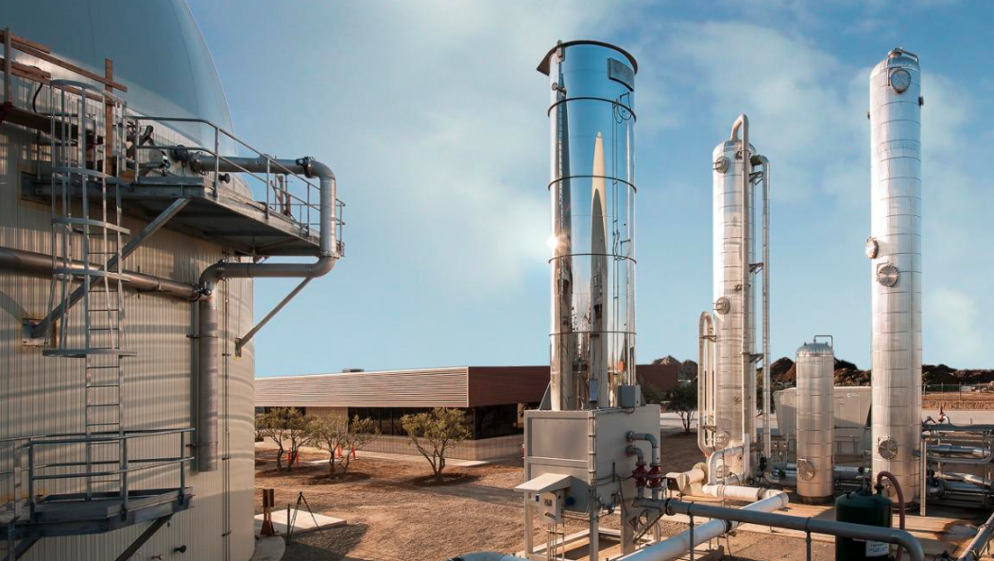
Perris Anaerobic Digester
  After the material in the Organic Carts get collected, it is hauled back to our facility to get sorted out and then transferred into the Anaerobic Digester
  CR&R is one of the only environmental services companies to offer co-collection of residential food waste combined in a single cart with green waste for energy recovery and nutrient production with 100% capture of methane emissions using the AD
  The methane that is captured is used to fuel our trucks and goes into our natural gas pipeline
  We have also already started given our cities the opportunity to procure the compost the AD produces, such as Calimesa, Wildomar and Perris

Slide 8
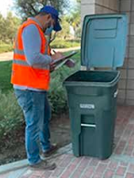
SB 1383 – field audits
Our annual field audits, which are performed at random due to SB 1383 regulations, have already started. Both residential and commercial sites have already been audited.
Auditors are looking for contamination in our customers Trash, Recycling, and Organic carts/bins. Pictures and notes of the contamination are taken and saved using AuditPro. An application we created and patented.
The goal for these field audits are to provide education and information on our recycling program to our customers. Educational tags, which we notate where the contamination occurred, are placed on the carts/bins, and educational flyers are also handed out to our customers (see next slide)

Slide 9
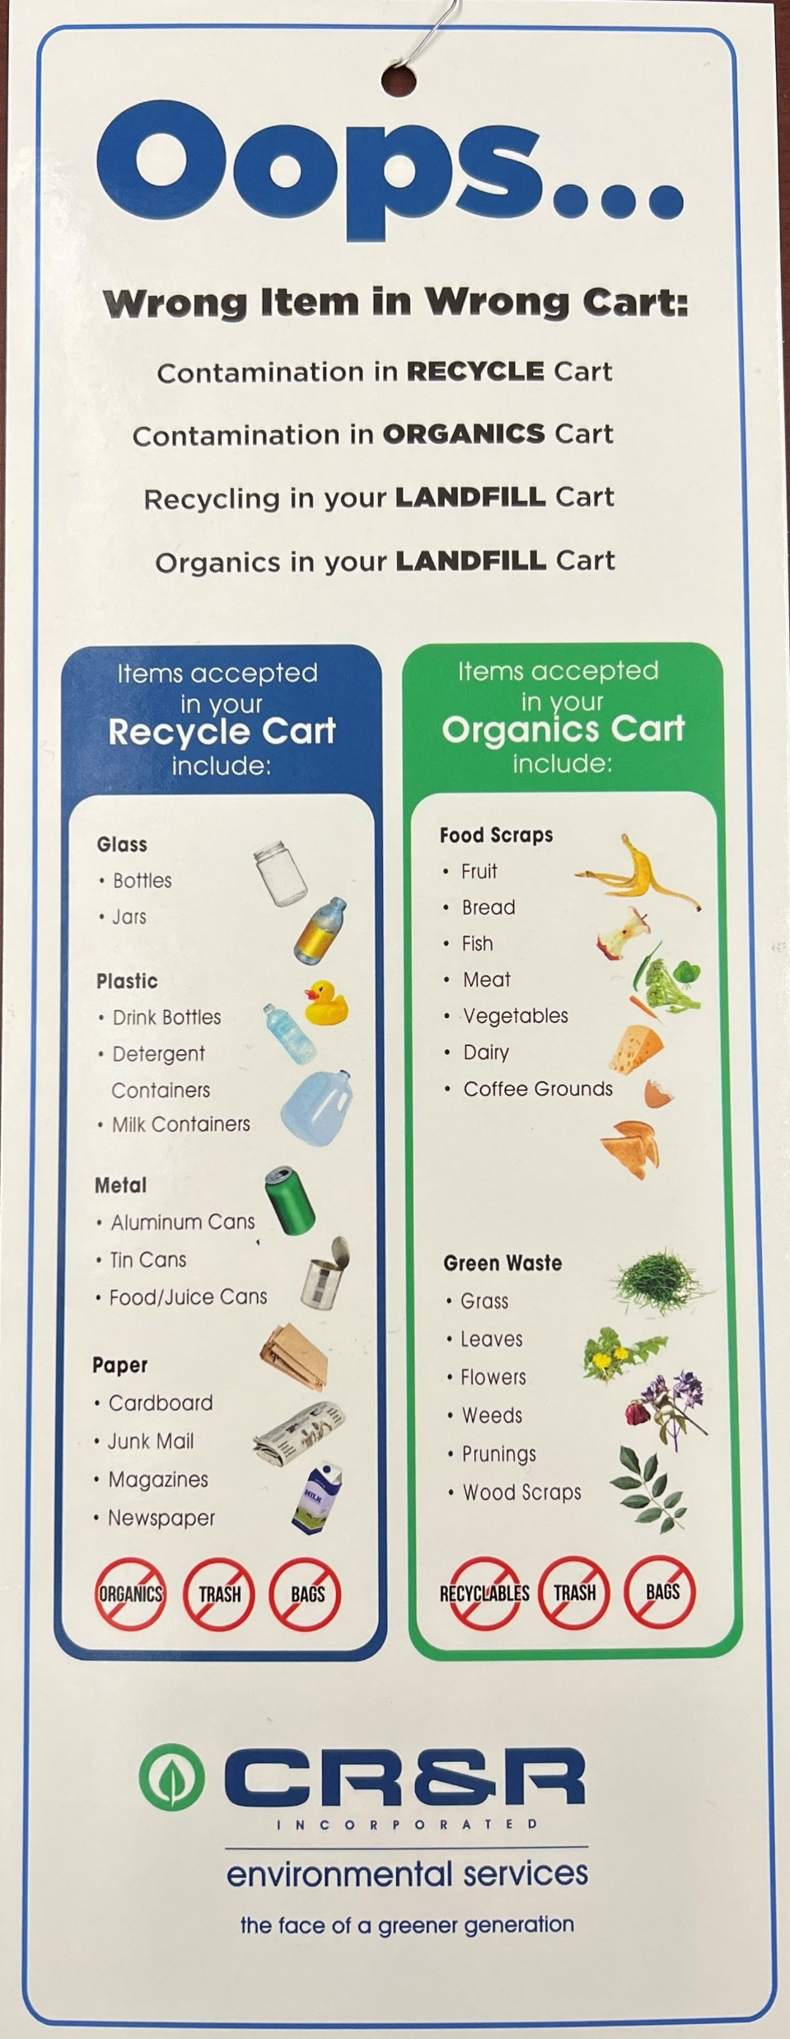
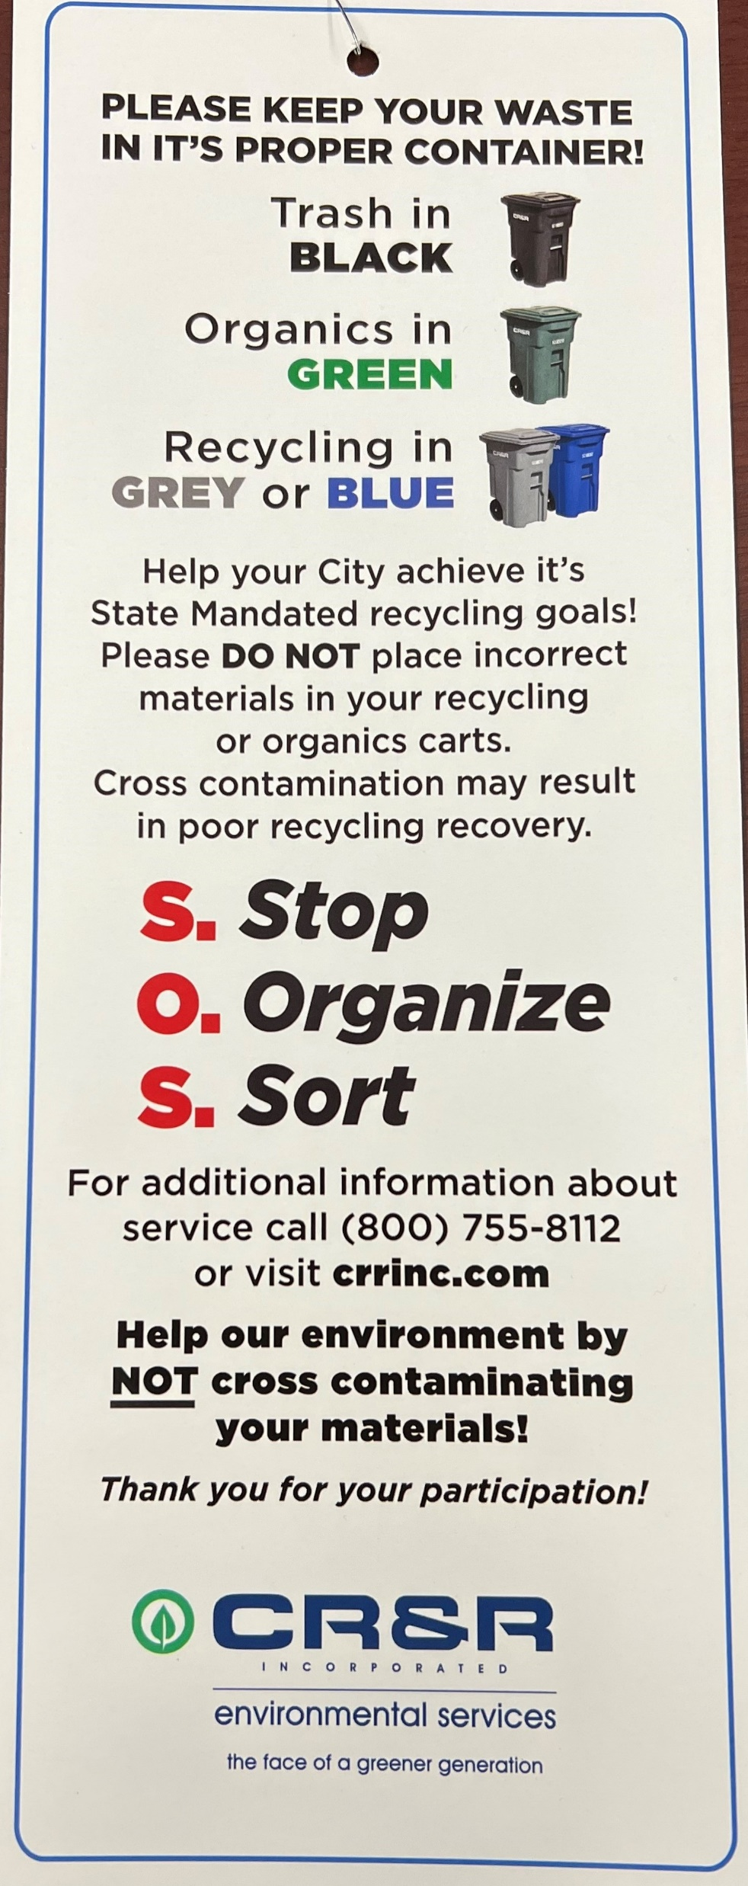
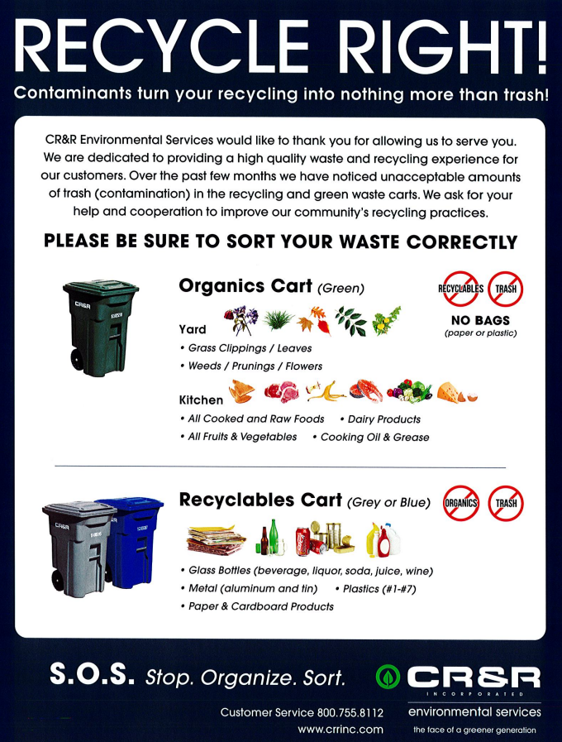
Education!

Slide 10
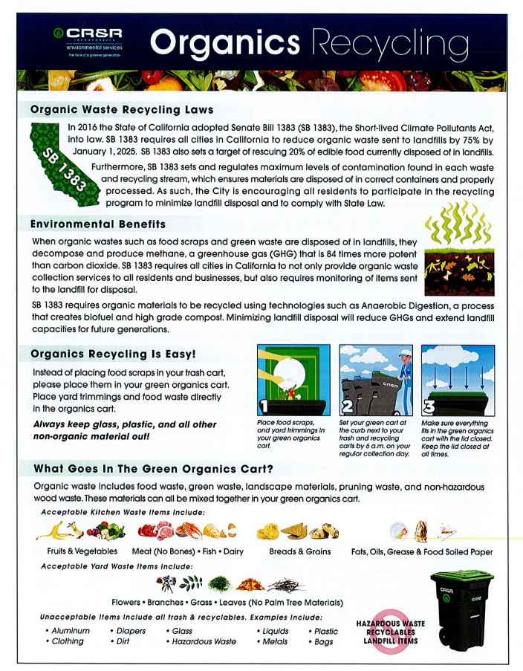
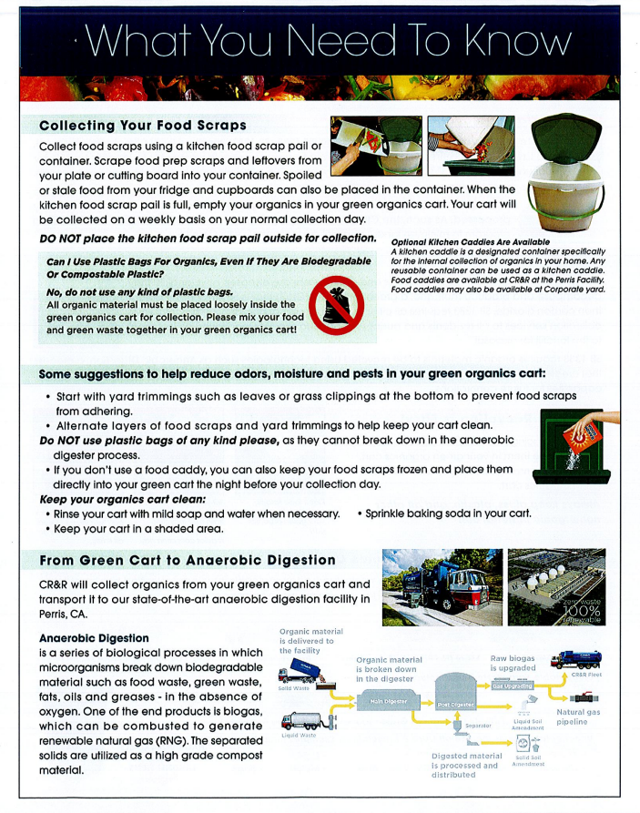
Emphasize education…
Notes:
These are posters we have given to businesses and additional flyers we hand out to the public. We, the sustainablity team, are really trying to focus on educating the cities we services, so we have been constantly getting involved, educating the people on SB 1383, handing out flyers, and just being more easily accessibly for the people. We hand out our cards and tell them that if they any questions to email us. I recently got an email asking if we can place our FOG into the organic cart…

Slide 11

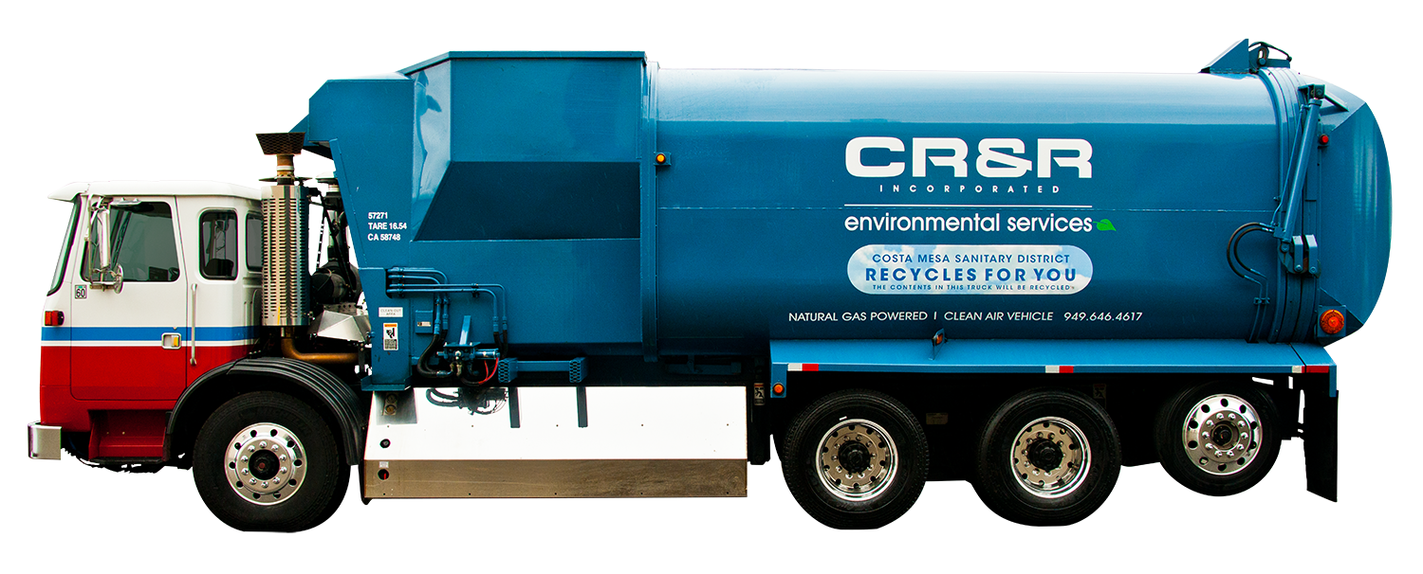
Thank you!
Any questions?
Homepage - CR&R Environmental Services (crrwasteservices.com)

