Slide 1
New Recycling & Organics Recycling Services Rollout
Presented by Riverside County Department of Waste Resources, Riverside County Department of Environmental Health and Franchise Waste Haulers
Notes:
Audience: Business and Multi-family covered by AB1826 and AB341
Speakers/Panel: RCDEH, RCDWR, Haulers

Slide 2
Program coordination CR&R
Ordinance
Contract
Rates
Waivers
Bin/Cart Delivery
Residential Services
Commercial Services
Contamination Inspection
Education
Workshops
Online Media
Monitoring of Compliance
Notes:
Note: This will only be shown in the presentation with the hauler identified in the slide.

Slide 3
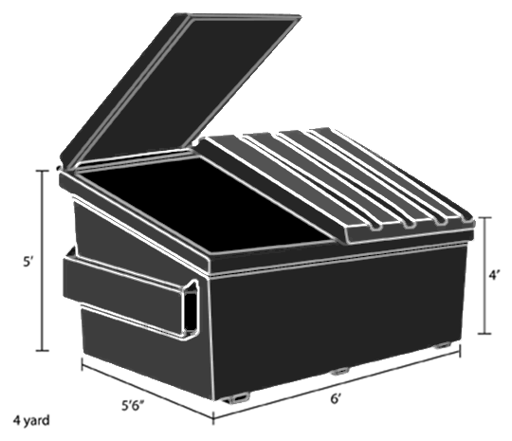
Mandatory Commercial Recycling AB341
Effective July 1, 2012
Who Is required to comply?
Businesses that generate four or more cubic yards of trash per week or
Multi Family Dwellings (MFD) of 5 or more units
A customer can subscribe to a recycling services through their waste hauler, or a business can do their own recycling by donating, self-haul, backhaul, or have a 3rd party take the material to a recycling facility.
Notes:
https://www.calrecycle.ca.gov/recycle/commercial
If you meet these requirements – you must have recycling.

Slide 4
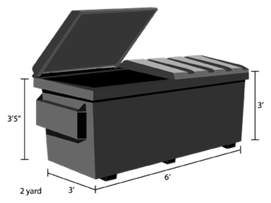
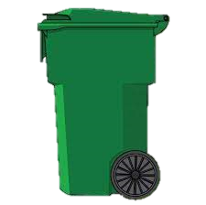
Mandatory Commercial OrgAnicS Recycling AB1826
Effective January 1, 2016
Tiered implementation
Who Is required to comply?
Businesses that generate two or more cubic yards of all waste streams per week or
Multi Family Dwellings (MFD) of 5 or more units
A recycling program is required for organic waste such as turf, landscaping waste, wood waste, food waste and food soiled paper. Note: MFD do not have to recycle food waste or food soiled paper.
Notes:
https://www.calrecycle.ca.gov/recycle/commercial/organics
Tiered approach – this has been phased in over time.
April 2016 – trigger was 8 CY or more of organics
January 2017 – trigger was reduced to 4 CY or more of organics
January 2019 – trigger was 4 CY of all waste streams
December 2020 – trigger is now 2 CY of all waste streams
If you meet these requirements – you must have recycling.

Slide 5
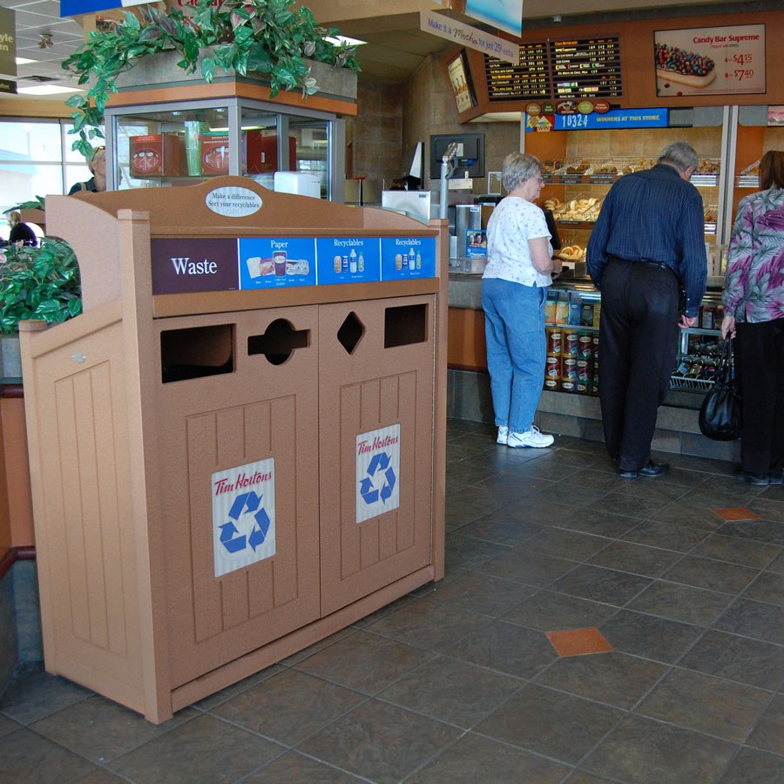
Commercial and Organics Recycling AB827
AB827- MCR and MORe covered businesses must provide organics and recycling containers at front-of-house to collect waste generated from products purchased and consumed on the premises.
These containers must be placed adjacent to trash containers and be visible, easily accessible, and clearly marked.
This law impacts businesses that sell products meant for immediate consumption. Full-service restaurants do not have to provide containers for patrons but must provide containers for employees to separate post-consumer recyclables and organics for customers
Notes:
Legislation language: https://leginfo.legislature.ca.gov/faces/billTextClient.xhtml?bill_id=201920200AB827
Examples/FAQs from CalRecycle. See questions 33, 39, 40, 41, 62-80, https://www.calrecycle.ca.gov/recycle/commercial/organics/faq

Slide 6
Short-Lived Climate Pollutants SB1383
SB1383 is a statewide effort to reduce emissions of short-lived climate pollutants (SLCP).
Reduce organic waste disposal 50% by 2020 and 75% by 2025.
Rescue at least 20% of currently disposed surplus/edible food by 2025 for people to eat.
Notes:
https://www.calrecycle.ca.gov/organics/slcp
Although not in effect currently, it goes in to effect on January 1, 2022

Slide 7
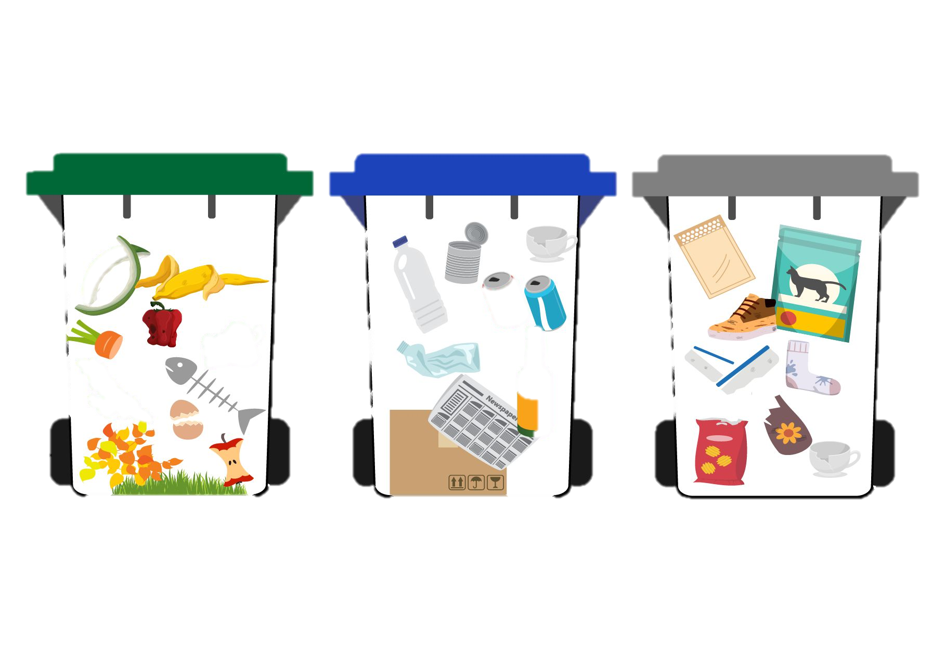
Regulations Riverside County Ordinance 745.4
Compulsory collection and disposal of solid waste and recyclable material within specified unincorporated areas of Riverside County.
Residential & Commercial - Three container system*
Green Container: organic and food waste
Blue Container: source separated recyclable material
Gray Container: all other waste
*(lids colors may adhere to color requirements)
Waivers
Self-haul
Minimal Waste Generation
Notes:
Riverside County Ordinance: https://www.rivcocob.org/wp-content/uploads/2021/04/745.4.pdf
Waivers to be reviewed and approved/denied by DEH

Slide 8
New Services
Adding Recycling and Organics Recycling
Three cart system delivery
Waivers
Self-Haul options
Rate Changes
Service day changes may apply
Notes:
Speaker: DEH

Slide 9
WAIVERS
Waivers and Exemptions are allowed by state regulation and are handled through Ordinance 745
Managed by Riverside County Department of Environmental Health
Possible Waivers
Self Haul
Minimal Waste Generation
Physical Space Limitiations
Customer to apply by date noted in the letter to have them reviewed/approved prior to rollout
Notes:
Speaker: DEH

Slide 10
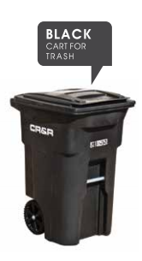
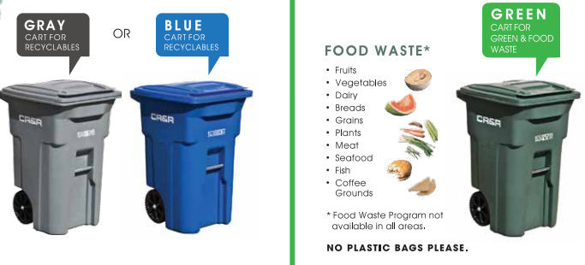
Rates CR&R
Bundled Rates vary by franchise area and include the weekly services below:
96-gallon Recycling cart
65-gallon Organics cart
1.5, 2, 3 or 4 cubic yard Trash bin
Notes:
Note: This will only be shown in the presentation with the hauler identified in the slide.

Slide 11
Timeline of rollout CR&R
June & July 2021 – Commercial workshops, online and recorded
July 1, 2021 - New commercial accounts will receive the bundled service automatically
October 1, 2021 – Cart distribution to existing business and Multi-Family accounts will begin
2022 – Residential cart distribution
Notes:
Note: This will only be shown in the presentation with the hauler identified in the slide.

Slide 12
Future requirements
SB 1383 – Short Lived Climate Pollutants
Areas of concern
Food Waste
Food Rescue
Enforcement
Compliance
Notes:
Although this rollout is not for SB1383, the county needs to educate businesses and multi-family accounts on the upcoming regulations. This will be very brief and there will be future presentations/education materials for SB1383 requirements.

Slide 13
Questions?

Slide 14
Contacts CR&R
Waste audits
Right size your bin
Quotes
Service questions
Oversees franchise haulers
Waivers
1383 program overview for staff
Waste reduction classes
Recycling basics
Waste Wise Champion Program
1706 Goetz Road
Perris, CA 92570
800.755-8112
www.crrwasteservices.com
3880 Lemon Street, Suite 200
Riverside, CA 92501
951.955.8980
www.rivcoeh.org
Lea@rivco.org
14310 Frederick Street
Moreno Valley, CA 92553
951.486.3200
www.rcwaste.org
Notes:
Note: This will only be shown in the presentation with the hauler identified in the slide.

Slide 15
Resources
Regulations
AB341: https://www.calrecycle.ca.gov/recycle/commercial
AB1826, AB827: https://www.calrecycle.ca.gov/recycle/commercial/organics
SB1383: https://www.calrecycle.ca.gov/organics/slcp
Ordinance
https://www.rivcocob.org/wp-content/uploads/2021/04/745.4.pdf
County Resources
http://www.rcwaste.org/business/recycling
https://www.rivcoeh.org/OurServices/Waste/SolidWaste
https://www.rivcoeh.org/OurServices/Foods/FoodDonations
Waivers – contact Riverside County Department of Environmental Health Solid Waste Program at (951) 955-8980 or LEA@rivco.org

